Slide 1
C Review
Fundamentals:
Types, Memory, Scope

Slide 2
Basic types
int
short
long int
long long int
unsigned int (shifts range from -2,147,483648 - +2,147,483,647
to 0 - +4,294,967,295)
float
double
long double
char
_Bool (values are 1 or 0)

Slide 3
Basic types - sizes
int - 32 bits, or 4 bytes, on our system
short - 16 bits
long int - 64 bits
long long int - 64 bits
float - 32 bits
double - 64 bits
long double - 128 bits, or 16 bytes
char - 8 bits
_Bool - 8 bits

Slide 4
Basic types – format specifiers for printf and scanf
int - %d or %i
%o or %#o for octal
%x or %#x for hexadecimal, uses lower case letters
%X or %#X for hexadecimal, uses upper case letters
float - %f
double - %lf (the letter l, not the number 1)
char - %c
_Bool - %d or %i

Slide 5
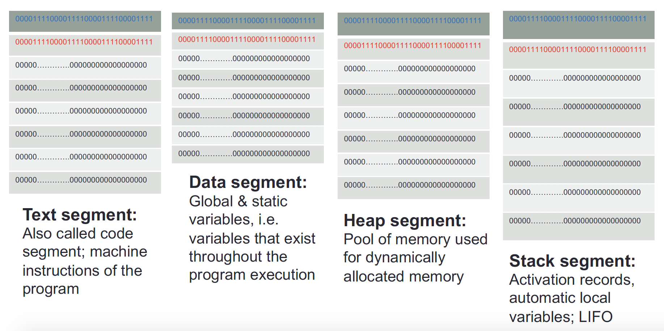
When a program runs, the system loads segments into memory.
Memory

Slide 6
Scope
Region of a program where identifier is visible
Begins (allocated) at definition within block
Ends (deallocated) at end of block
Local variables
Name given to variables defined within block
Can have different local variables with same name declared in different blocks or different functions
Cannot have duplicate local names within a block or function

Slide 7
Scope Rules
Local variables preferred
Maintain individual control over data
Need to know basis (Hidden)
Functions should declare whatever local data are needed to 'do their job'

Slide 8
Global Scope
Variables declared outside of function bodies
Global to all functions in that file
Global variables possible but SELDOM-USED
Lazy – use parameters instead
Dangerous
Global constants could be OK

