Slide 1
Loops, Conditional Statements & Functions

Slide 2
First:
Review of the Basics

Slide 3
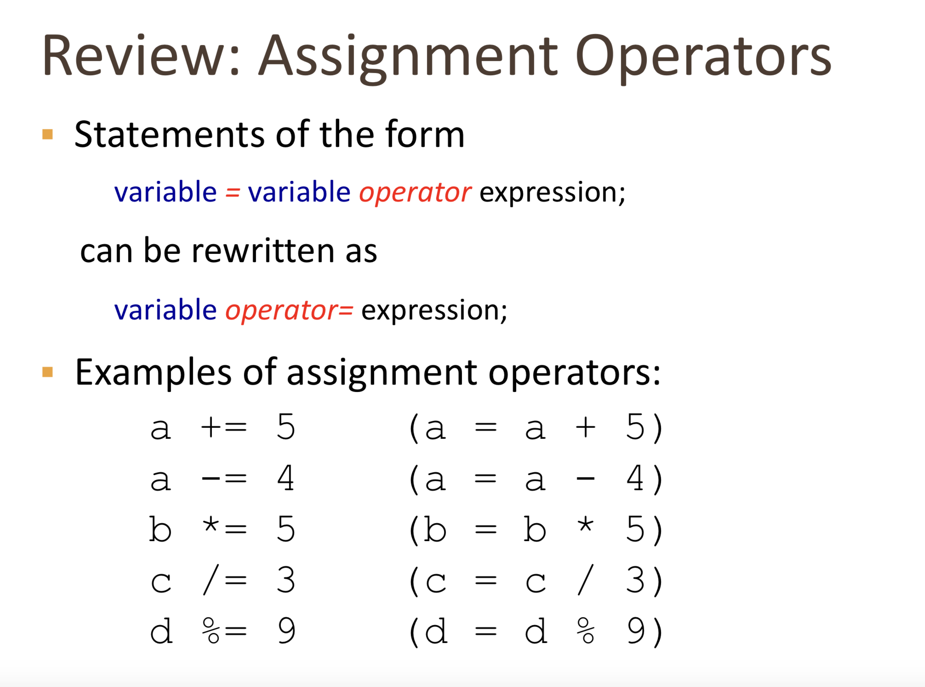

Slide 4
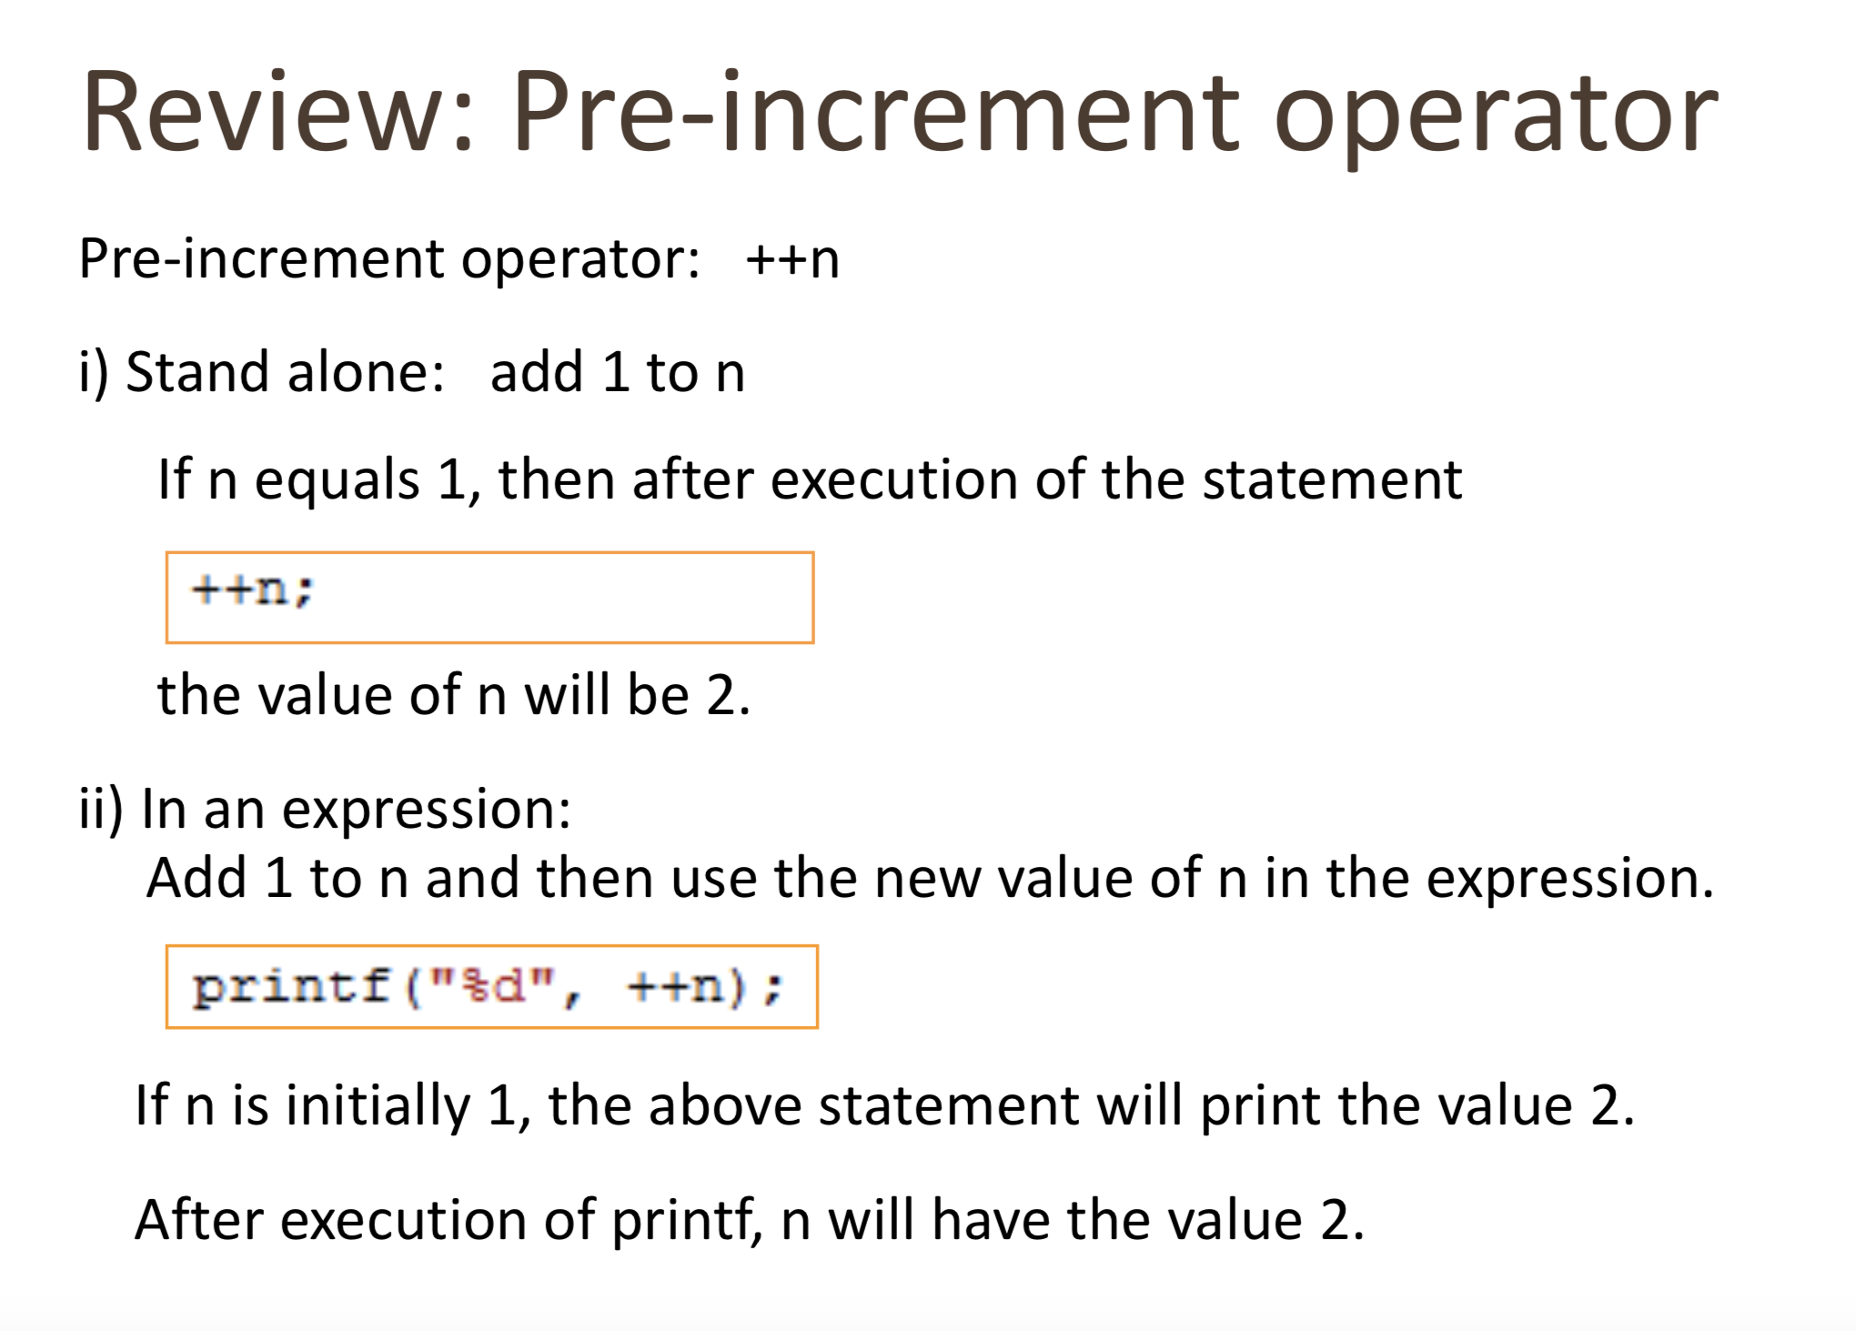

Slide 5
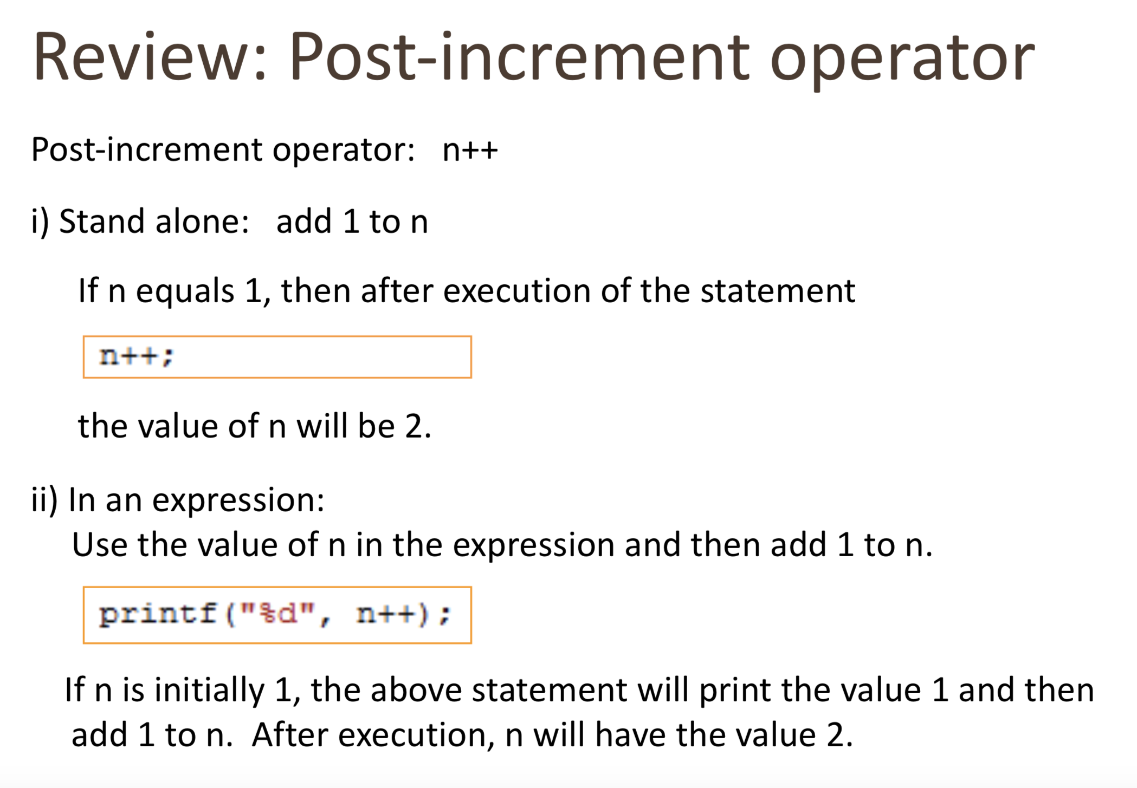

Slide 6
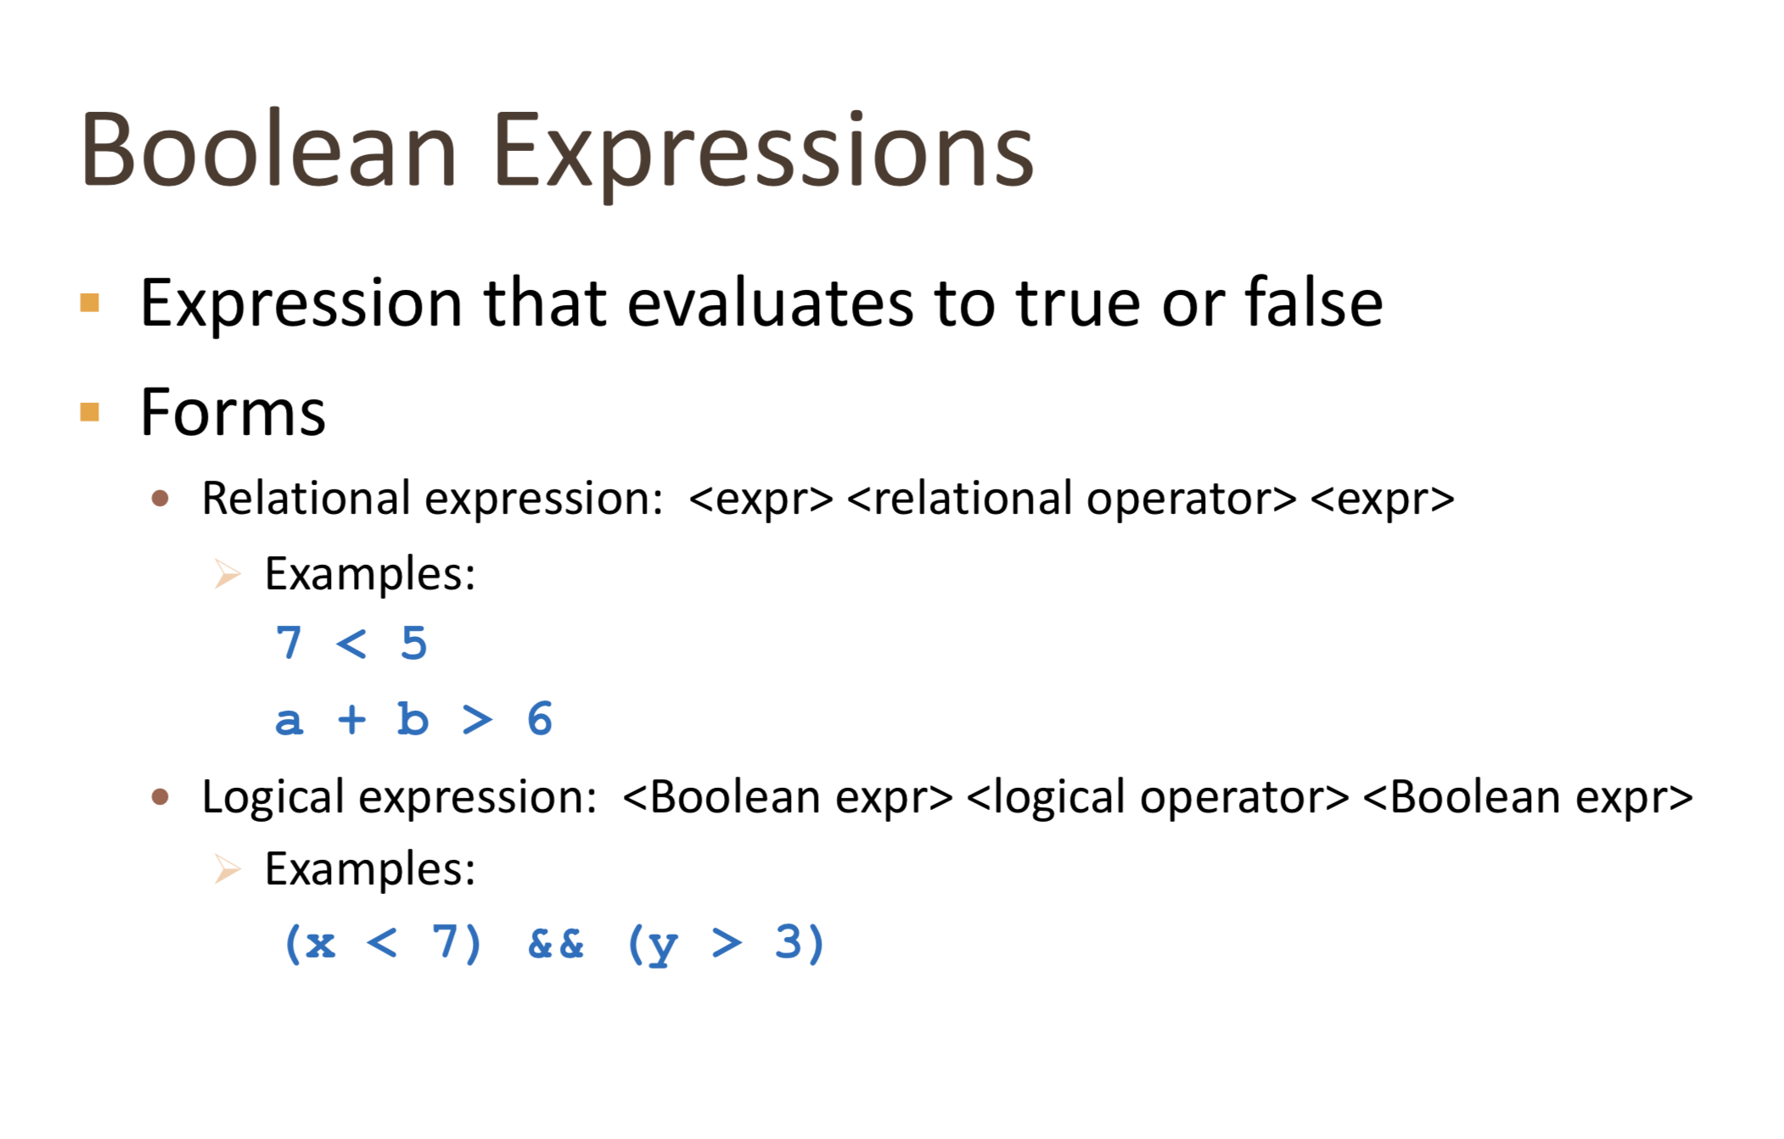

Slide 7
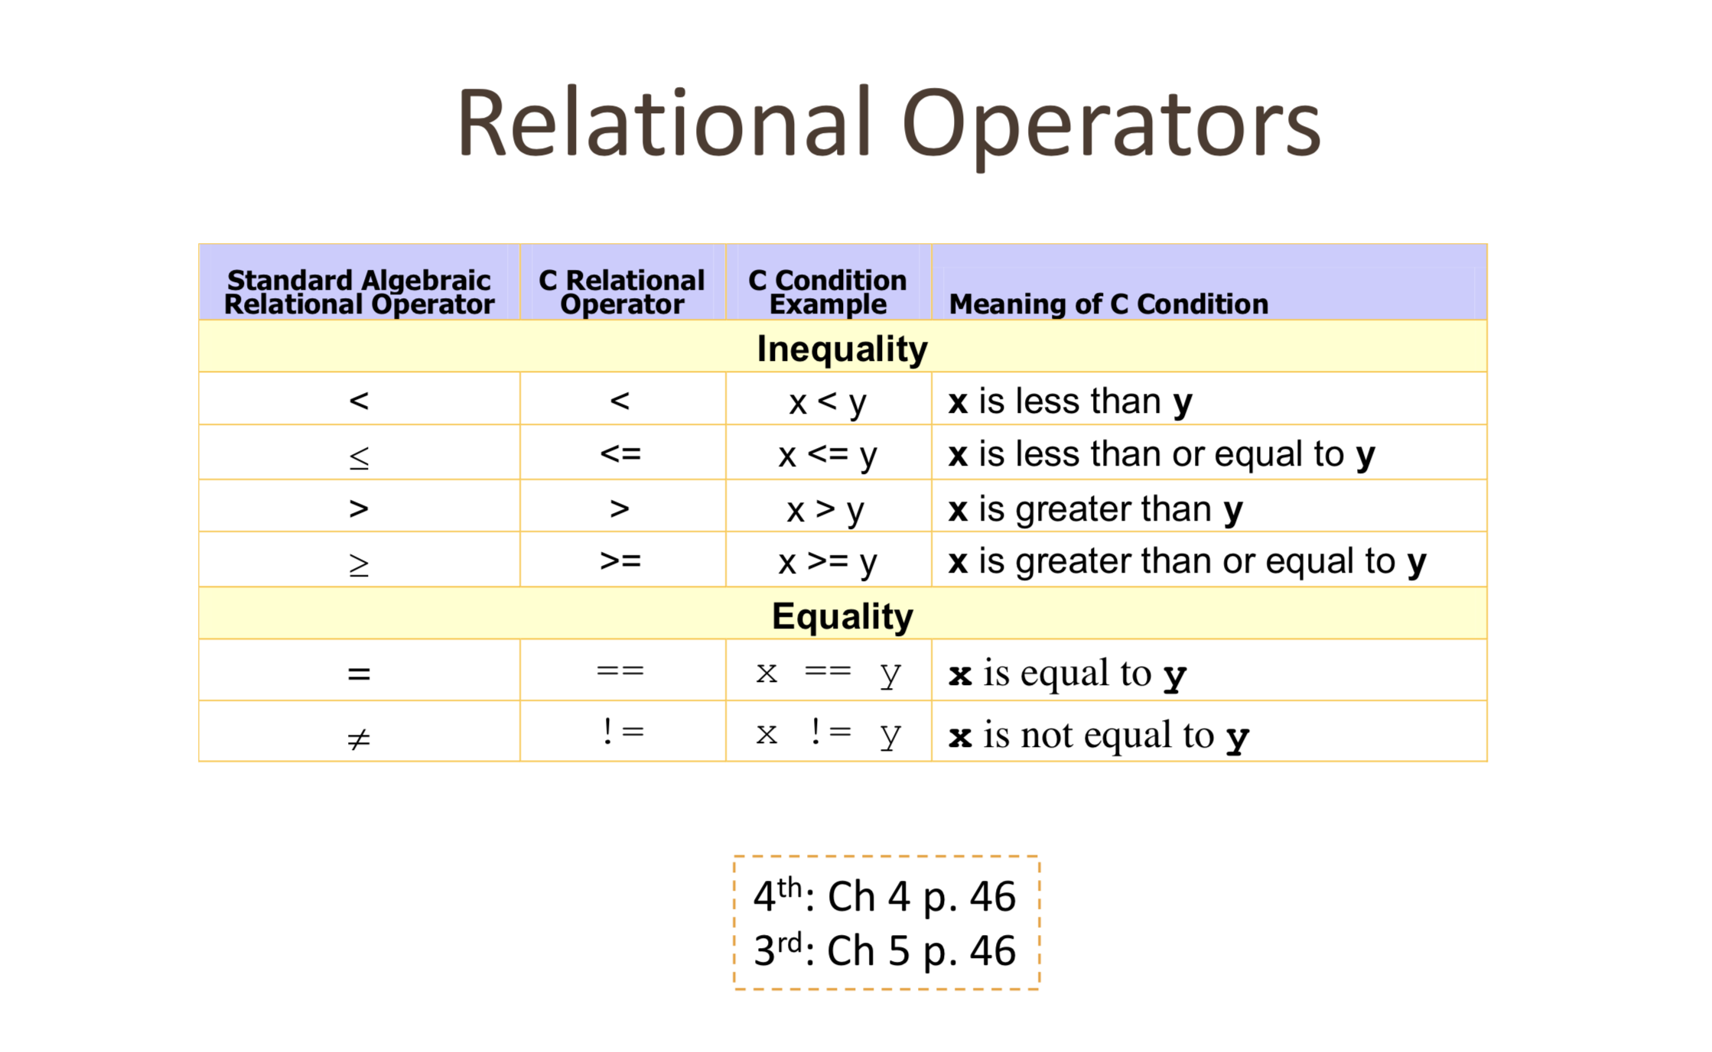

Slide 8
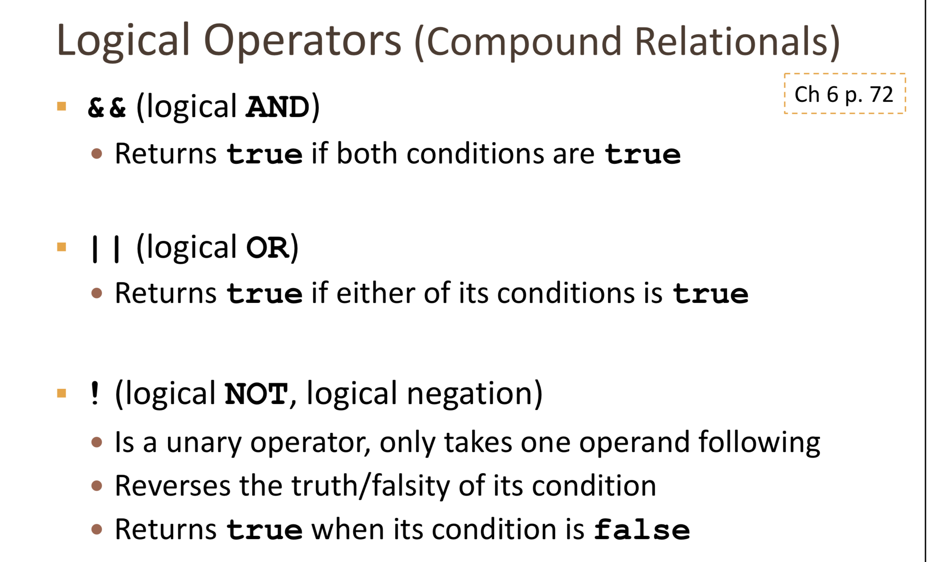

Slide 9
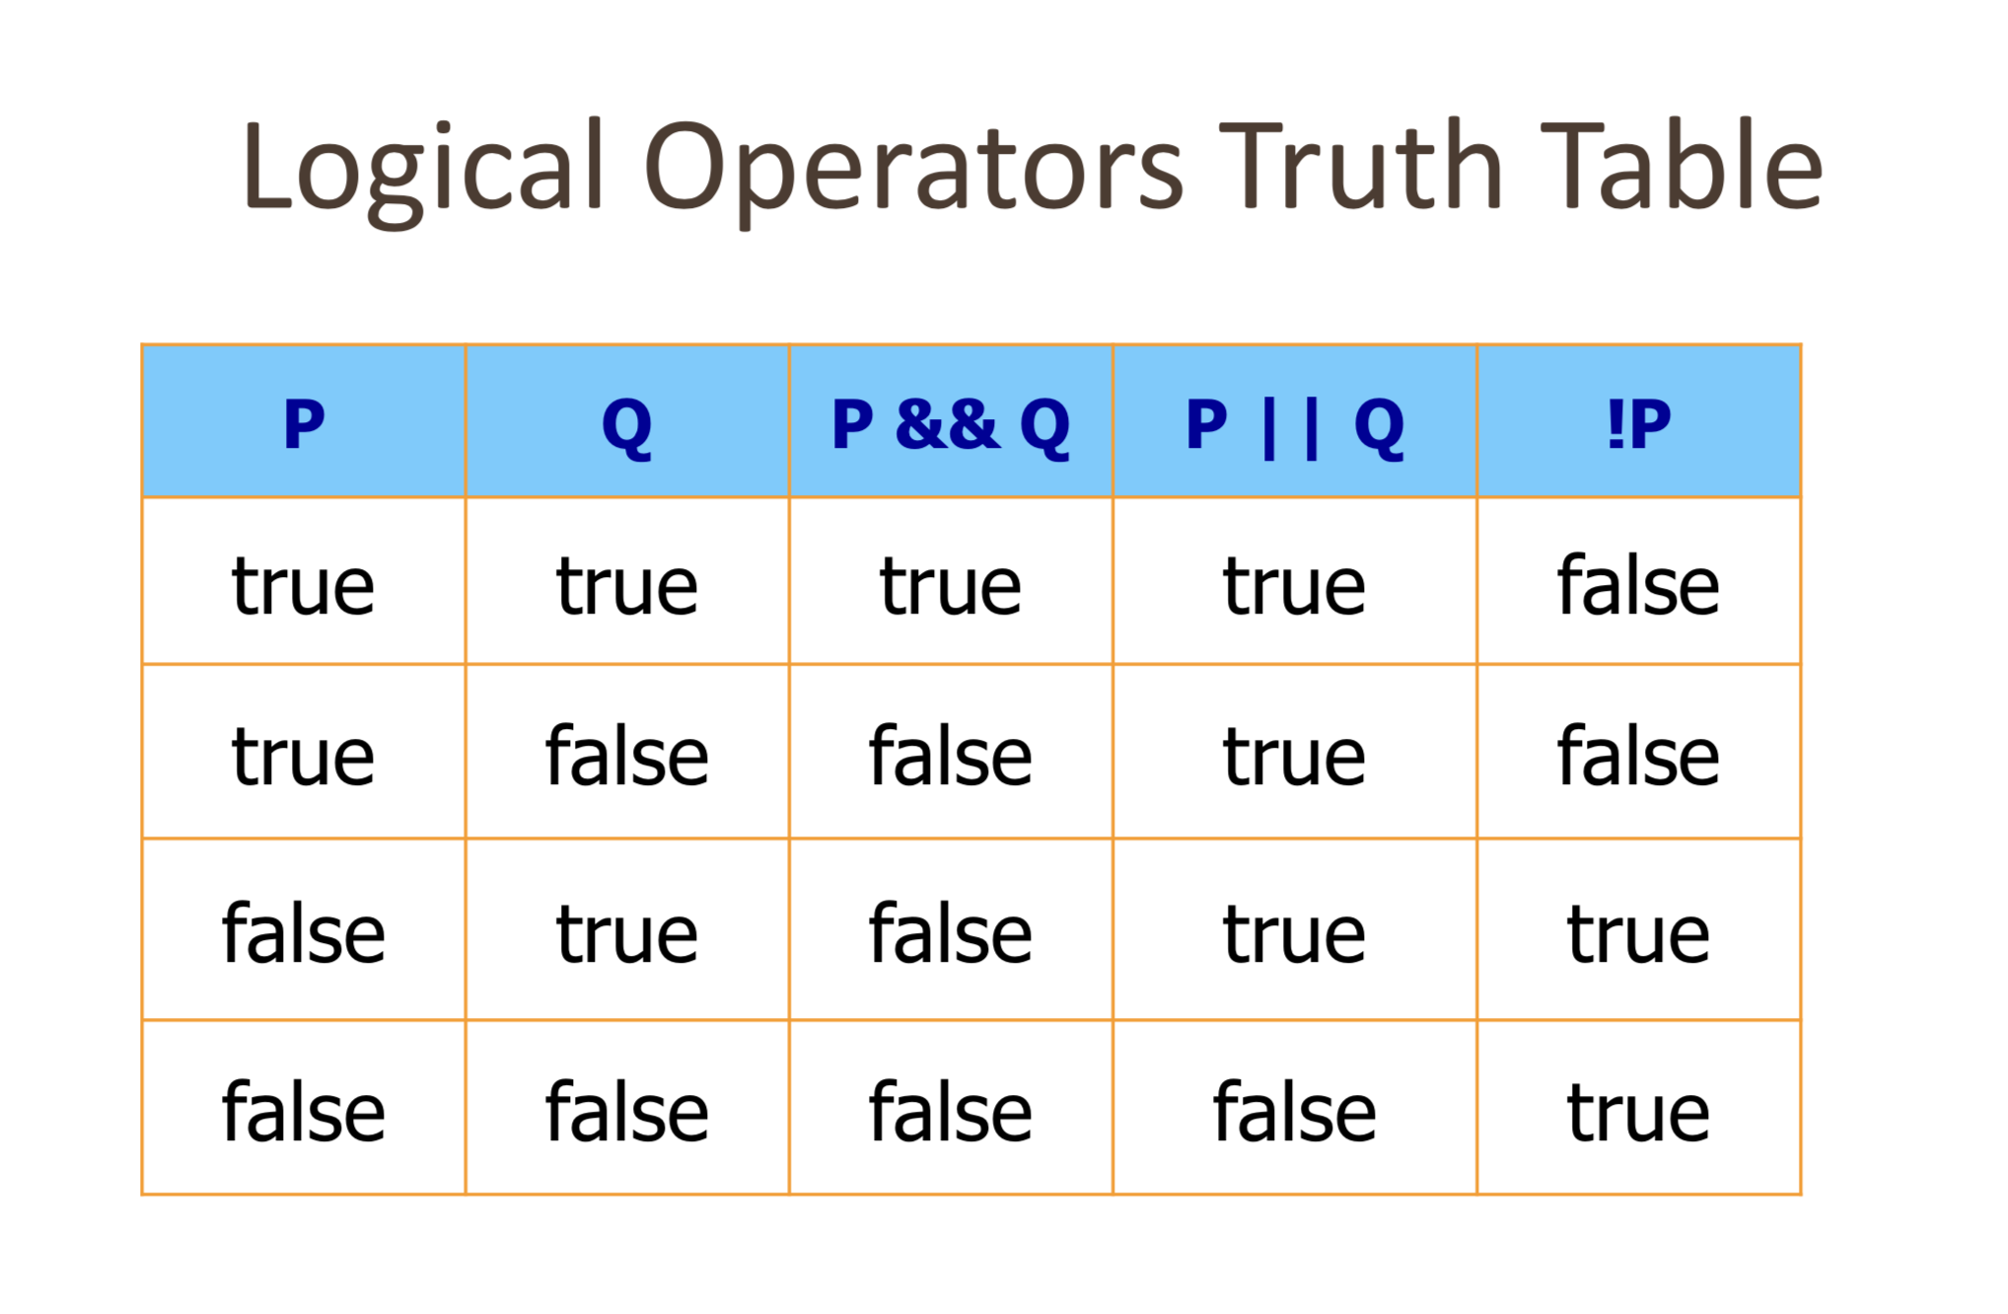

Slide 10
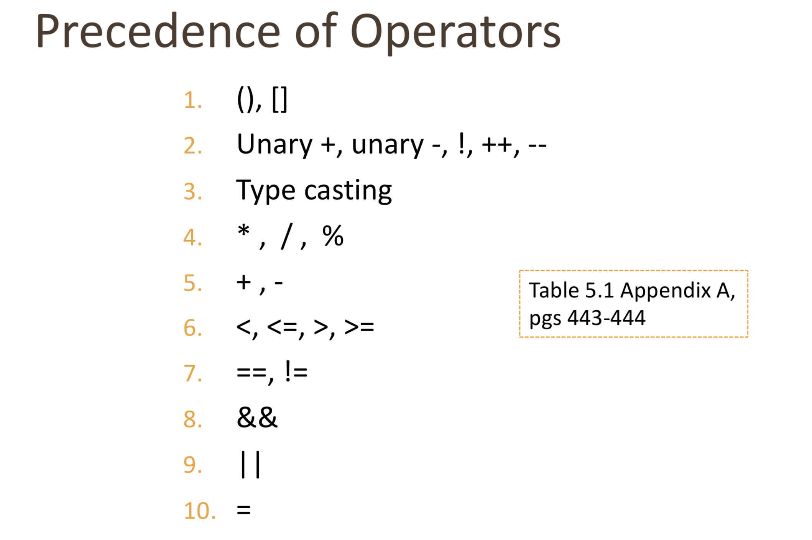

Slide 11
Flow of Control of Execution
Control structures
  combination of individual statements into a logical unit that regulates the flow of execution in a program or function
  Sequential – instructions execution one after the other
  Repetition (Looping) – instructions may be repeated based on a condition, and then back to sequential
  Selection (Making Decisions) – instructions may be executed based on a condition, and then back to sequential
Notes:
In structured programming, there are three structures:
Sequence – one statement after another
Repetition – also called looping
Selection – when you make a decision

Slide 12
Loops

Slide 13

Repetition & Loops
printf("Hello world!\n");
printf("Hello world!\n");
printf("Hello world!\n");
printf("Hello world!\n");
printf("Hello world!\n");
printf("Hello world!\n");
printf("Hello world!\n");
printf("Hello world!\n");
printf("Hello world!\n");
printf("Hello world!\n");
printf("Hello world!\n");
printf("Hello world!\n");
printf("Hello world!\n");
printf("Hello world!\n");
printf("Hello world!\n");
printf("Hello world!\n");
printf("Hello world!\n");
printf("Hello world!\n");
printf("Hello world!\n");
printf("Hello world!\n");
int i;
for (i = 0; i < 20; i++) {
  printf("Hello world!\n");
  }

Slide 14

The for Loop
A natural 'counting' loop
Steps are built into for structure!
  Initialization
  Loop condition test
  Increment or decrement
initialization
false
condition
true
loop body
…
increment
next stmt
Notes:
When we took a look at a while loop with a counter LCV, we were using a counter to control the number of repetitions of the loop body. The for statement allows us to specify the major steps of a counting loop in one structure. A counting loop begins with the initialization of the counter LCV. Before the body of the loop, a condition is tested. If it is true, the loop body is executed including an increment of the counter variable.

Slide 15
For Loop
/* program to calculate the triangular number
of whatever number the user inputs, giving the user 5 tries;
this demonstrates nested for loops
*/
#include <stdio.h>
int main (void) {
int n, number, triangularNumber, counter;
for (counter = 1; counter <= 5; ++counter) {
printf (“What triangular number do you want? “);
scanf (“%i”, &number);
triangularNumber = 0;
for (n = 1; n <= number; ++n)
triangularNumber += n;
printf (“Triangular number %i is %i \n\n”, number, triangularNumber);
}
return 0;
}

Slide 16
Why indent, you ask?
/* program to calculate the triangular number
of whatever number the user inputs, giving the user 5 tries;
this demonstrates nested for loops */
#include <stdio.h>
int main (void) {
int n, number, triangularNumber, counter;
for (counter = 1; counter <= 5; ++counter) {
printf (“What triangular number do you want? “);
scanf (“%i”, &number);
triangularNumber = 0;
for (n = 1; n <= number; ++n)
triangularNumber += n;
printf (“Triangular number %i is %i \n\n”, number, triangularNumber);}
return 0; }

Slide 17
The while Loop
The condition is tested
If the condition is true, the loop body is executed and the condition is retested.
When the condition is false, the loop is exited.
false
condition
true
loop body
next stmt
Notes:
If we look at the flowchart for the while statement, we see that the first thing that is done is that the condition is tested. If the condition is true, the body of the loop is executed and then we go back and retest the condition. If the condition is false, we go to the next statement after the while statement.

Slide 18
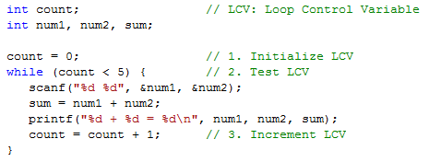
Example 3
Execution Chart
count count<5 repetition
0 true 1
1 true 2
2 true 3
3 true 4
4 true 5
5 false
Notes:
Let’s now modify our program that reads sets and prints sums to handle five sets. We define a LCV called count. Before the loop, it is initialized to zero. The while statement tests the count for less than the final value, five. The body of the loop has our original three statements and it also has a statement that increments count by one.
If we followed the execution of this code, count would have a value of 0, 1, 2, 3, 4, and then 5. At 5, it is no longer less than 5. The body of the loop has been executed 5 times. So, we can start the LCV out at zero, and then our test can be LCV < total-count. We could have also started the LCV out at one and then our test would be LCV <= total-count.

Slide 19
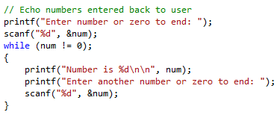

Loop Pitfalls
Enter number or zero to end: 2
What is wrong with my program? It just sits there!
Notes:
Here is a program that should echo back numbers entered by a user but it has a problem. When we run the program, we are prompted for the first number. Upon entering a value of 2, the program stops responding and just sits there – no more program prompts and no Unix command prompt. What is the problem?

Slide 20

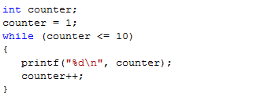
for vs while
Prints the integers from one to ten
Notes:
Here we have a for loop that prints the numbers one through ten. The for statement initializes the counter variable to 1, repeats the loop body as long as the counter is <= 10, and increments the counter by one after each execution of the loop body. This is the same as the while counting loop shown below it. In that code, the initialization, test, and increment are separate statements.

Slide 21
The do-while Loop
The do-while loop is similar to the while loop
  Condition for repetition tested after the body of the loop is executed
loop body
All actions are performed at least once!
true
condition
false
Notes:
Our last C repetition structure is the do-while which is similar to the while structure but the condition is tested after the loop body rather than before. It is a post-test loop rather than a pre-test loop like both the while and the for structures. The major implication of the moving of the condition test is that the body of the loop will be executed at least once.

Slide 22

The do-while Loop
Example
  Prints the integers from 1 to 10
Notes:
Here is a do-while that prints the numbers one through ten. It is equivalent to using a while or a for to do the same thing.

Slide 23

The do-while Loop
Example
  Makes sure that the user enters a valid weight
Notes:
This is an example of how we can use the post-test to our advantage. The user is prompted to enter a positive weight and then the weight is read. This will continue as long as the value entered by the user is not a positive number.

Slide 24

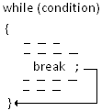

The break Statement
break
  Causes immediate exit from
  a while, for, do/while or switch structure
  We will use the break statement
  only to exit the switch structure!
Notes:
It is possible to use the same break statement that we saw in the switch statement in one of our C repetition structure loop bodies. It will cause execution to break out of the loop and go to the next statement after the loop. This is considered bad programming practice because it is harder to determine how you arrived at that next statement. For that reason, we will only be using the break statement in the switch structure.

Slide 25
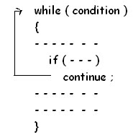

The continue Statement
continue
  Control passes to the next iteration
  We will not use the continue statement!
Notes:
There is also a continue statement that causes execution to go to the next iteration of the loop. This is also considered a bad programming practice so we will not use the continue statement.

Slide 26
Conditional Statements: Making Decisions

Slide 27
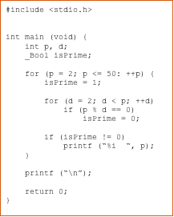
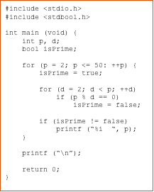
Boolean Types
C type _Bool bool if #include <stdbool.h>
Notes:
Example on left uses C _Bool type, which has a value of either 1 or 0.
Example on right uses the stdbool.h library, which allows you to use bool type, which then has values of true or false.

Slide 28


The if Selection Structure
Branching
  used when we want the computer to choose between two alternative courses of action
Notes:
The first C statement to implement a selection or decision structure is the if statement. It allows us to choose between two sets of actions.

Slide 29
The if Selection Structure
if Statement
Boolean
Expression
true
false
true block
Notes:
Here we see a graphical representation of the flow of logic, called a flowchart, for the if statement. As we come into the statement, a Boolean expression or condition is evaluated. If the expression is true then a block of code will be executed. If not, no statements are executed. The true path and the false path meet and continue to the next statement.

Slide 30
Another if Statement Example
int age;
scanf(“%d”, &age);
if ((age >= 13) && (age <= 19)) {
printf("You are a teenager\n");
}
Notes:
This one uses the logical and operator && which will evaluate to true ONLY if both expressions are true.

Slide 31
The if-else Selection Structure
if
  Only performs an action if the condition is true
if-else
  A different action is performed when condition is true and when condition is false
Notes:
With the if statement, we could only perform a block of code if the expression is true. With an if-else we can perform different sets of statements depending on the value of the Boolean expression.

Slide 32
if-else Selection Structure
if-else statement
false
true
Boolean
Expression
false block
true block
Notes:
If we look at a flowchart for an if-else, we see that a Boolean expression is evaluated and if the result is true, a block of code, the true block, is executed. With the if-else, if the result is false, we can execute a different block of code, the false block. Again, the true path and the false path join at the end of the statement to proceed to the next statement.

Slide 33
Another if-else Example
int age;
scanf(“%d”, &age);
if ((age >= 13) && (age <= 19)) {
printf("You are a teenager\n");
}
else {
printf("You are not a teenager\n");
}
Notes:
This one uses the logical and operator && which will evaluate to true ONLY if both expressions are true.

Slide 34

The if-else Selection Structure
Nested if-else structures
  Test for multiple cases by placing if-else selection structures inside if-else selection structures.
Notes:
One or more of the statements inside of the true block or the false block can be another if-else or if. This is called nested ifs.

Slide 35
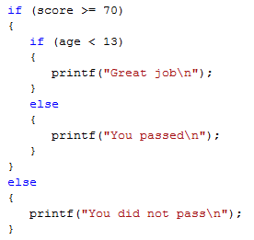
Nested if-else Structures
Notes:
In this example: If score is >= 70, print one of two messages depending whether age is less than 13, otherwise print the “did not pass” message. The test for age is nested within the test for score’s true block.
Note: Since the blocks of code only consist of one printf statement, they did not need to be enclosed in braces.

Slide 36

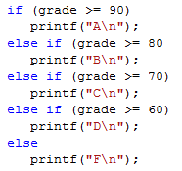
The if-else-if Construct
The standard way to indent the previous code is
Notes:
There is a better and shorter way to construct this code which is called the if-else-if. With this construct, the next if is placed on the same line and following the else. This results in less indention of the statements to the right.

Slide 37


The if-else Selection Structure
Compound statement:
  Set of statements within a pair of braces
  Example:
Notes:
If you want to execute multiple statements when a condition is true, you MUST enclose them in braces.
Based on the indention in this example with no braces, it looks like the programmer meant for both statements to be executed if the grade is greater than or equal to 90.

Slide 38

The if-else Selection Structure
Without the braces, only one statement is executed. e.g. given the following code:
  The statement,
  will be executed independent of the value of grade.
  The statement,
  will execute only if grade is
  greater than or equal to 90.
Notes:
However, the second printf will always be executed. Only the first printf is dependent on the value of grade. So, braces are required in this case.

Slide 39


The dangling else
  Note: the compiler matches an else with the closest unmatched if
  The above will be treated as
Notes:
Remember that C is free form and doesn’t care about the indentation. It is only for the programmer.
In the first set of code, it appears that the else goes with the first if. However, the else will go with the closest prior unmatched unenclosed if.
How can we fix this so that it will compile like the top example looks?

Slide 40
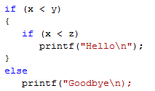

The dangling else
  If the else is to match the outer if, use braces.
Notes:
If the else is to match the first if, the second if must be enclosed in braces.

Slide 41
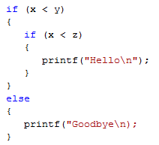
if-else Construct
To avoid confusion, and possible errors, it is best to use braces even for single statements.
  However, code will be longer
{ }
Notes:
To avoid confusion and errors, you can always use braces. However, this is up to you. The resulting program may take up more lines of code.

Slide 42
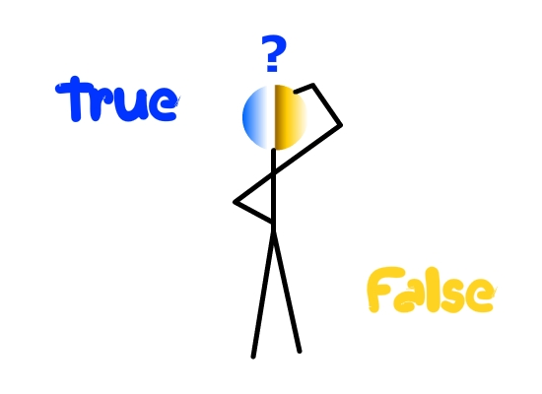
Conditional Expressions
C uses an integer to represent Boolean values
  Zero is interpreted as false
  Any other integer value is interpreted as true
not zero
zero
Notes:
C doesn’t truly have a Boolean type. It uses an integer instead. A value of zero is interpreted as false. Any other value will be interpreted as true.

Slide 43
Conditional Expressions
is not a syntax error in C.
  The expression, n = 0, assigns zero to n and the value of the expression is 0. Zero is interpreted as false, and the false branch of the if statement will be taken.
is not a syntax error in C.
  The expression assigns 5 to n. 5 is interpreted as true, and the true branch of the if statement will be taken.
Notes:
Using the assignment operator in the condition of an if is not a syntax error. The value of an assignment operation is the value that is placed in the destination.
With gcc, you will get a warning if you have an assignment as the conditional expression unless the assignment expression is enclosed in parentheses. The program will still run if you do not correct the warning. In the first example, n is assigned a zero and the conditional expression will have a value of zero. Zero is interpreted as false. In the second example, the conditional expression will have a value of 5. Five will be interpreted as true.

Slide 44
Conditional Expressions
==
Remember to use the == operator to test for equality.
To help catch the error when the equality check involves a constant, put the constant on the left hand side of the ==.
  For example, use
    instead of
  Since is not a valid assignment in C, the compiler will detect this error when == is intended.
Notes:
Remember to use == for relational tests. You can place a constant on the left when checking an expression for a constant value and then if you use = instead of ==, you will get a syntax error.

Slide 45
The switch Multiple-Selection Structure
switch
  Useful when variable or expression is tested for multiple values
  Consists of a series of case labels and an optional default case
Notes:
If we are testing an expression for multiple values, an alternative to multiple ifs is the switch statement. If consists of the switch statement followed by a series of case labels and optionally a default case.

Slide 46
The switch Multiple-Selection Structure
With Breaks
case a
case a action(s)
break
case b
case b action(s)
break
case z
case z action(s)
break
default action(s)
Notes:
This is a flow chart for a switch structure with break statements. Different cases are checked. If a match is found, a corresponding block is executed with a set of actions ending in a break statement. The break statement causes execution to go to the completion of the switch statement. You can have a default block of statements with actions to be done if none of the cases are matched.

Slide 47
The switch Multiple-Selection Structure
Without Breaks
case a
case a action(s)
case b
case b action(s)
case z
case z action(s)
default action(s)
Notes:
If break statements are not there, execution will fall into the block for the next case without checking to see if that case is true and will continue until either a break statement or the end of the switch statement. We can actually use this to our advantage if we want to check for multiple values for a case.

Slide 48

switch Statement Syntax
switch (switch_expression) {
case constant1:
statementSequence1
break;
case constant2:
statementSequence2
break;
…
case constantN:
statementSequenceN
break;
default:
defaultStmtSequence
}
Notes:
The switch statement begins with the keyword switch, is followed by a switch expression enclosed in parentheses, and then last comes the body of the statement enclosed in braces. In the body are case statements which contain the keyword case, a constant to be compared to the switch expression value, and then a colon.
Following each case statement are statements to be executed when the constant is equal to the value of the switch expression value. There can also be a default statement which specifies a default case to be performed if none of the cases match the switch expression.
The optional but generally used break statement causes execution to flow to the next statement following the switch statement.

Slide 49

switch Statement
The switch_expression is compared against the values constant1, constant2, …, constantN
  constant1, constant2, …, constantN must be simple constants or constant expressions.
    Can be a char or an int
    Best to use the same type constant as the switch expression
      If not, a type conversion will be done.
Notes:
The constants in the case statements that are compared to the switch expression must be simple constants or constant expressions yielding a data type of char or int. If your switch expression is char, your constant should be a char constant. If your switch expression is an int, your constant should be an integer. If not, the constant will be converted to the type of the switch expression before the comparison is made.

Slide 50

switch Statement Reminder
The switch statement ends with
  break statement
  end of the switch statement
When executing the statements after a case label, it continues to execute until it reaches a break statement or the end of the switch.
If you omit the break statements, then after executing the code for one case, the computer will continue to execute the code for the next case.
Notes:
Remember: The switch statement will end when either execution gets to a break statement or it gets to the end of the switch statement. Once it starts executing statements, it continues until a break statement or the end ignoring case statements along the way. So if you leave out a break statement at the end of a case, execution will continue right into the next case’s statements.

Slide 51
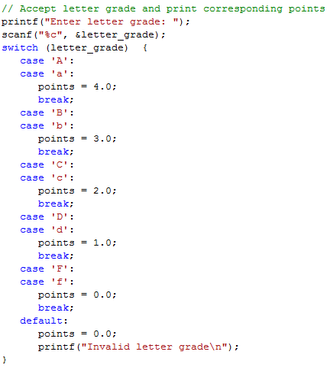
Example of switch
Notes:
In this example, we input a letter grade which can be in upper or lower case. We wish to print grade points based on a letter grade that we get from the user.
The first case is an upper-case A. If that matches letter_grade, execution will begin. There is no break statement in this case and in fact there are no statements. Execution continues into the next case’s statements so points are set to 4 and then the break is executed which ends the switch statement.
If a lower-case c was entered, letter_grade would be compared to A, a, B, b, C, and then c before a match is found. The variable points would then be set to 2 and the break statement would end the switch.
If the user entered an invalid letter grade, one not matching any of the case constants, the statements in the default case would be executed. Points would be set to zero and an error message would be printed.

Slide 52
Example of switch
printf(“Enter month number: “);
scanf(“%d”, &month);
switch(month) {
case 1:
case 3:
case 5:
case 7:
case 8:
case 10:
case 12:
printf(“The number of days is 31\n”);
case 4:
case 6:
case 9:
case 11:
printf(“The number of days is 30\n”);
default:
printf(“The number of days is 28 or 29\n”);
}
Notes:
What happens when user enters a 2? 6? 3?
2: The number of days is 28 or 29
6: The number of days is 30
The number of days is 28 or 29
3: The number of days is 31
The number of days is 30
The number of days is 28 or 29

Slide 53
Conditional Operators
condition ? expression1 : expression2
The condition is an expression, usually a relational expression, and is evaluated first. If it evaluates to TRUE, then expression1 takes place. If the condition evaluates to FALSE, then expression2 takes place.
printf(“Enter an integer: “);
scanf(“%d”, &x);
s = (x < 0) ? -1 : x * x;
printf(“%d\n”, s);
Notes:
If user enters a -3 for x, s is -1 and printf statement prints -1
If user enters a 4 for x, s is 16 and printf statement prints 16

Slide 54
Functions

Slide 55
Program Function Definition Structure
main first (preferred)
  Top down design
  Some prototypes required
  Complete prototyping allows function definition in any order
main is last – lowest level functions first
  Bottom up design
  Prototypes not required
main in the middle
  Confusing: Do not do!
main
Level 2
Level 2
Level 2
Level 3
Level 3
main
Level 2
Level 2
Level 2
Level 3
Level 3
Notes:
The preferred method for structuring a C program is to have main be the first function. With main as the first function, it is easy to find where the program starts. When main is the first function, prototypes are required for at least the functions that are called in main. By specifying prototypes for all functions, the functions can be defined in any order.
Another method that is used is to place main last and to define the functions starting at the lowest level. It is a little bit harder to find the start of the program but prototypes may not be required.
A confusing method is to place main in the middle and have some mixture of prototypes first or definitions first. With this method you have to search to find the beginning of the program so we will not be using this structure.

Slide 56

Components of Function Use
Three steps for user-defined functions
  Function declaration/prototype
  Function implementation (body)
  Function call
Notes:
There are three steps to implementing your own functions. The first is to declare the function. This is generally called a prototype. It is required if the function definition is not done before the function is used. The second is the function definition which contains the actual instructions for the function. Lastly comes the use of the function, the function call. Since all names in C have to be defined before they can be used, either the function prototype or the function definition must precede the function call.
The prototype and or definition can either go in the same file as the main function or they can be placed in a separate header file so that multiple programs can include the file. An example of a separate header file would be stdio.h.

Slide 57
1. Function Declaration/Prototype
An ‘informational’ declaration for compiler placed at the top of the file above main() or in a header file
Tells compiler how to interpret calls to that particular function
Syntax:
    <return_type> FnName(<formal-parameter-list>);
The <formal-parameter-list> contains, at the very least, the type of each parameter. It may also include the formal parameter name.
Examples:
  double total_cost(int, double);
  double total_cost(int quantity, double unit_cost);
Notes:
The first step to creating user-defined functions is the declaration or prototype which is required if the function is not defined before use. It’s purpose is to give information to the compiler about what the call to the function should look like. It begins with the return type and the function name. The function name is followed by the formal parameter list enclosed in parentheses. If there are no parameters, the parentheses are still required. The statement ends with a semi-colon.
Each item in the formal parameter list consists of a data type and an optional parameter name.
The example shows:
A prototype for a function called total_cost which returns a double. It shows only the types of the two parameters.
A prototype for the same function but including the parameter names this time.

Slide 58
void Functions
Functions that do not return anything have the word void as the return type.
There is no return statement needed for a function that does not return anything.
Example prototype of a void function:
  void sortArray(int array[], int size);

Slide 59
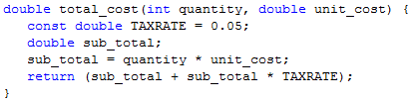
2. Function Implementation
Actual implementation/code for what function does
  Just like implementing function main()
  General format – header & basic block:
    <return_type> FnName (<formal-parameter-list>) {
    // code for body of function
    }
Example of a value-returning function:
header
Notes:
The second step in using functions is the function implementation. It is here that we actually implement the function with C statements. As we have seen with main, a function consists of a header followed by a basic block. The header looks like a prototype except that the parameter names are required and there is no semi-colon.
Here we see the implementation of our total_cost function. It starts with the header and is followed by the basic block with the statements to implement what the function does. The parameter names are identifiers that we use in the block for referring to values that are sent to the function.

Slide 60
2. Function Definition - continued
Example of a void function:
void sortArray(int array[], int size) {
int i, j, temp;
for (i = 0; i < size – 1; i++) {
for (j = 0; j < size - 1 – i; j++) {
if (a[j] > a[j + 1] {
temp = a[j + 1];
a[j + 1] = a[j];
a[j] = temp;
}
}
}
}
Notes:
Here we see the implementation of the sortArray function. It is a void function, doesn’t return anything, thus no return statement.

Slide 61

3. Function Call
Using function name transfers control to function
  Values are passed through parameters
  Statements within function are executed
  Control continues after the call
For value-returning functions, either
  Store the value for later use
  Use the value returned without storing
  Throw away return value
Notes:
The third part of using a function is to call the function. When a function is called, the parameters in the call are evaluated, the values are stored in a temporary location, and the temporary values are passed through the parameters in the function definition. The statements within the function’s block are executed. Upon a return statement, control passes back to the caller and continues after the function call which might be the next statement or part of an expression evaluation.
Functions can modify the values of the parameters. If they do, the function only modifies the temporary value not the variables that might be used in the call. The calling function will not see the modified values.
The value returned by a function can be stored for later use in the calling function by an assignment statement or could be used directly in an expression in the current statement. If the call does not appear in an assignment statement or expression, the return value will be discarded and you will not be warned.

Slide 62
3. Function Call - continued
For void functions
  Just call the function
sortArray(arr1, numItems);

Slide 63
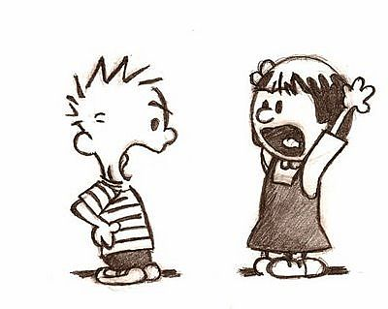
Parameter vs. Argument
Names used interchangeably
Technically, parameter is 'formal' piece
while argument is 'actual' piece
Parameter!
Argument!
Notes:
Even though they are called parameters in C, the terms parameter and argument are often used interchangeably. Some people use parameter for the formal parameter in the function header and argument for the actual parameter in the call.

Slide 64

Function documentation
Used to aid in program maintenance
Comments at non-main definition header
  Purpose of function
  Parameters
  Return
  Example:
// sorts the array sent in ascending order
// parameters: the array to be sorted
the size of the array
// return: nothing
void sortArray(int array[], int size) {
int i, j, temp;
// ... rest of function
}
Notes:
Programs are generally documented in comments at the beginning of the program. Individual functions need to be documented as well to help in program maintenance. The comments should be placed at non-main function definition headers (immediately preceding the function implementation) and should include the purpose of the function and any additional comments necessary to understand the working of the function. The comments should also include preconditions which are the functions parameters and the postcondition for the function, which is the return value; in this case, it is a void function

