Slide 1
Makefiles

Slide 2
What is a makefile?
A file that contains a list of files and their dependencies along with commands that you would otherwise type at the command prompt.
Type make at the command prompt and the system searches for a file called makefile or Makefile, and if found, the command for the first target in that file will be run.
A makefile can have more than one target. If you wanted to execute other targets, you would have specify which one when you type make: make <target>
Notes:
Your “Programming in C” book explains makefiles on pages 341-342.
Real world programs usually consist of many files that are all compiled and linked together to form one executable. If a programmer makes a change or fixes a bug in just one of those files, by typing make (or make compile if the target is named compile) at the command prompt, only that file that was modified will be recompiled rather than recompiling every single file. The make utility can tell which source files need to be compiled based on the modification times of the files. If make finds that your source (.c) file is newer than the corresponding executable file (e.g., lab6) or object (.o) file (we’ll learn about these later), it automatically recompiles the source file to create a new executable or object file.

Slide 3
Example 1
main: main.c
gcc –Wall -o main main.c
The above shows a very simple makefile for lab. If these two lines were put into a file called makefile (or Makefile), then whenever you would need to compile main.c, you would simply just type: make

Slide 4
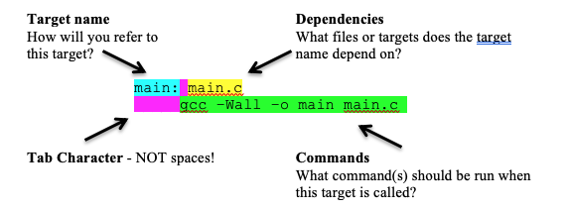
Example 1

Slide 5
Example 2
main: main.o
gcc –Wall -o main main.c
clean:
rm –f *.o
rm –f main

Slide 6
Example 3
CC = gcc
CFLAGS = -g -Wall
main: main.o
$(CC) $(CFLAGS) -o main main.c
clean:
rm –f *.o
rm –f main

Slide 7
Example 4
CC = gcc
CFLAGS = -g -Wall
main: main.o
$(CC) $(CFLAGS) -o $@ main.c
clean:
rm –f *.o
rm –f main

Slide 8
Example 5
CC = gcc
CFLAGS = -g -Wall
.c.o:
$(CC) $(INCLUDE) $(CFLAGS) –c $<
main: main.o
$(CC) -o $@ $^ -L. –L/usr/lib –lc -lm
clean:
rm –f *.o
rm –f main

Slide 9
Example 6
CC = gcc
CFLAGS = -g –Wall
LDFLAGS = -L. –L/usr/lib
LDLIBS = -lc -lm
.c.o:
$(CC) $(INCLUDE) $(CFLAGS) –c $<
main: main.o
$(CC) -o $@ $^ $(LDFLAGS $(LDLIBS)
clean:
rm –f *.o
rm –f main

