Slide 1
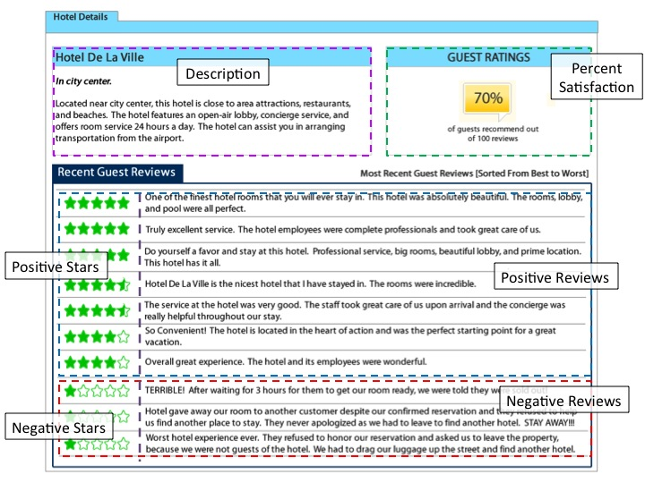

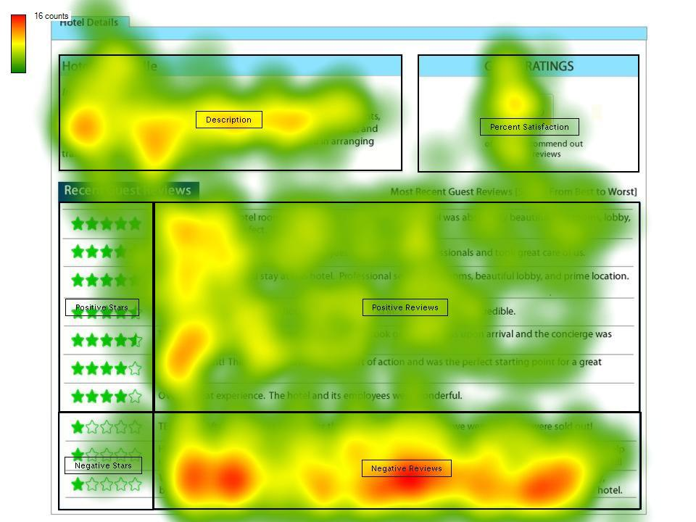
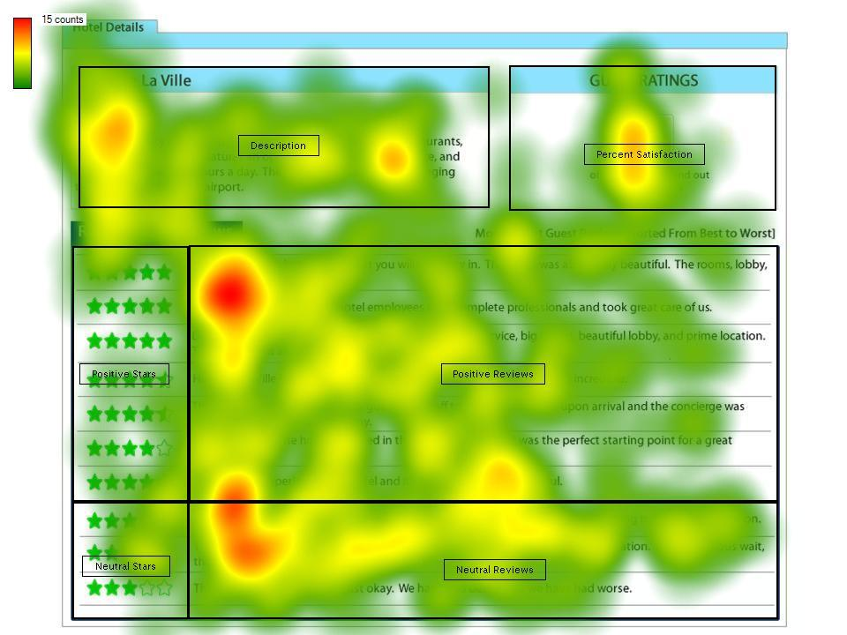
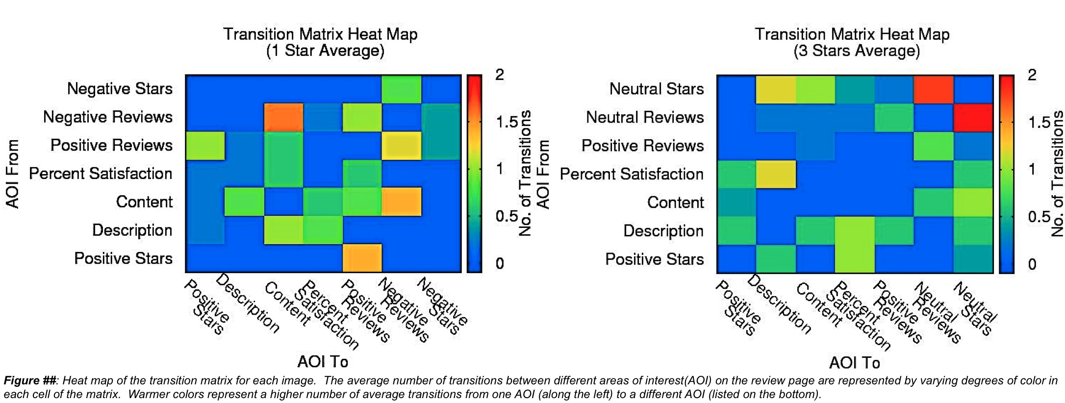



Understanding Consumers’ Processing of Online Review Information via Eye Tracking
Zachary C. Joyce
COMPUTER SCIENCE
XAVIER UNIVERSITY
joycez@xavier.edu
Thomas L. Baker
MARKETING
CLEMSON UNIVERSITY
tbaker2@clemson.edu
Andrew T. Duchowski
SCHOOL OF COMPUTING
CLEMSON UNIVERSITY
duchowski@acm.org
William A. Hill
COMPUTER SCIENCE
YOUNGSTOWN STATE UNIVERSITY
wahill@student.ysu.edu
Abstract
Methodology
Discussion
This study is an extension of a broader marketing research study examining how consumers utilize online reviews in making purchase decisions. Using eye movement data, we illustrate how consumers process review information in the presence of various review types and what areas of the review page they focus on most. The results indicate that with the presence of more negative review types, consumers look at reviews longer, and spend more time looking at the negative section(s). The presence of negativity appears to shift consumer attention to the negative areas while more moderate review pages do not lead consumers to focus on any particular section.
10 university students were given a scenario requiring them to search for a hotel room with intent to purchase, and shown an accompanying mock hotel web review page.
Half of the participants viewed reviews with moderate scores (three out of five stars being the lowest) and half of the participants viewed more negative reviews (one out of five stars) (Figure 1).
Participants were instructed to view the online review page as if they were intending to purchase a room at the given hotel.
Eye movement data was captured using a 17” Tobii ET-1750 eye tracking monitor (Figure 2).
Participants then filled out a questionnaire determining their likelihood to stay at the hotel and their perception of hotel experience from the review.
When presented with negative reviews (one star) people tended to spend more time viewing the image, indicating increased awareness brought on by risk aversion in the presence of the negative reviews. Tendencies toward risk aversion can also be seen by the significant difference in time spent on the variable review section. When participants were presented with negative reviews (in place of neutral reviews), they tended to spend more time on that area of the review page (Figure 5). The increased negativity of the review page directed attention to the negative review area and an increased viewing time shows that more consideration was taken.
Also, the lack of significance in terms of time spent and fixation count between the neutral review section and total percent satisfaction AOI indicates that social proof was in effect as the participants spent equal time and concentration on the two areas. However, when negative reviews were introduced to the review page, there was a significant effect between aggregate score and negative reviews, indicating that participants switched from social proof thinking to risk aversion.
Results
Figure 5: Screenshots of heatmaps highlighting the most viewed areas on the review page featuring 1 star (left) or 3 star (right) ratings as the lowest score.
Figure 1: Layout of the mock hotel web review page.
Figure 2: Tobii ET-1750 Eye Tracking Monitor (left) and setup of test environment.
Introduction & Background
The internet has provided the basis for competitive online marketing and integrated online shopping as a key component of daily consumer behavior (Lin et al. 2011). In need of a trusted information source, consumers have turned to online word of mouth to review products and services available to purchase online. In a recent survey, over 60% of consumers had used online customer feedback before making a purchase decision, and over 80% of them were influenced in some way by the reviews (O’Connor 2010). Trustworthy information is needed even more for high risk purchases, such as leisure travel (Lin et al. 2011). This is especially so for hotel room purchases because the buyer must rely on the experiences of others to make pre-purchase decisions. For this reason, user-generated content has been cited as the most reliable information source when dealing with hotels.
When looking at a review page, consumers tend to exhibit either social proof or risk aversion when processing the information presented to them. Social proof suggests the likelihood of following the majority (Cialdini 1999). Risk aversion, however, is more personal and says that consumers will weigh negative feedback more heavily to avoid possible negative outcomes associated with the purchase (Kahneman and Tversky 1979). The purpose of this study was to present potential consumers with review pages of varying degrees of content negativity to see if their response focused on the negativity (risk aversion) or on aggregate scores (social proof).
Figure 3: Graphs showing the mean time each subject spent per AOI (left) and average fixation count per AOI for each subject (middle) and mean time spent per image as a whole (right).
The results were analyzed across seven metrics between subjects. The metrics include time spent and fixation count per image, time spent and fixation count per area of interest (AOI), time spent and fixation count per AOI per image, and transitions between AOIs for each image.
A between subjects ANOVA showed a significant difference (p < 0.01) in time spent per AOI within each image, as well as between the images. Also a marginally significant difference (p <0.05) was shown between time spent per image (Figure 3).
Pairwise t-tests revealed a significant difference (p < 0.01) between time spent on neutral reviews versus negative reviews (Figure 3).
Pairwise t-tests showed significant difference between the review AOIs and percent satisfaction (aggregate score) in time spent (p < 0.01) and fixation count (p < 0.01).
Pairwise t-tests also showed, however, no significance in time spent (p > 0.80) or fixation count (p > 0.38) between neutral reviews and percent satisfaction (Figure 3).
There was no significance found to suggest that any one transition stood out from the others, although some variation did take place (Figure 4).
Conclusion
The study showed that when negativity is present in the review, more attention will be placed on the negative areas due to risk aversion.
The results of this study would be of interest in future research, to help understand how consumers utilize peer review information in the formation of purchase decisions, as well as what type of information consumers look for while reading online reviews.
A replication of this study with more participants may produce greater significance by reducing the variance and sampling a larger demographic. It would also help to examine the transition matrix in more detail with the larger data set.
A replication of this study with varying degrees of negative reviews, as well as different areas of negativity (overall score, review section, individual star rating) would help confirm the results and give insight to the sensitivity of consumers to online reviews.
References
CIALDINI, R., et al. 1999. Culture and Compliance. Personality and Social Psychology Bulletin 125, 1242–1253.
KAHNEMAN, D. AND TVERSKY, A. 1979. Prospect Theory: An Analysis of Decision under Risk. Ecoonometrica 47, 263–292.
LIN, C.-L., LEE, S.-H., AND HORNG, D.-J. 2011. The effects of online reviews on purchasing intention: the moderating role of need for cognition. Social Behavior Personality: An International Journal 31, 71–82.
O’CONNOR, P. 2010. Managing a Hotel’s Image on TripAdvisor. Journal of Hospitality Marketing and Management 19, 754–772.
*This research was supported, in part, by NSF Research Experience for Undergraduates (REU) Site Grant CNS-0850695.
Figure 4: Heat map of the transition matrix for each image. The average number of transitions between different areas of interest (AOI) on the review page are represented by varying degrees of color in each cell of the matrix. Warmer colors represent higher number of average transitions between the AOIs.
Notes:
11

