Slide 1

Shelf Real Estate: Package Spacing in a Retail Environment
Dan Hutcherson + Rachel Randall
Dr. Duchowski
Fall 2011

Slide 2
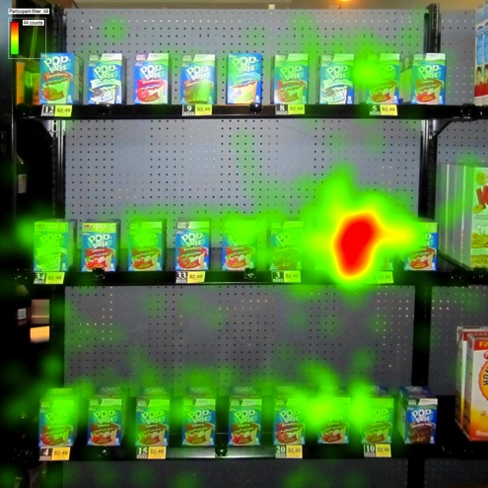
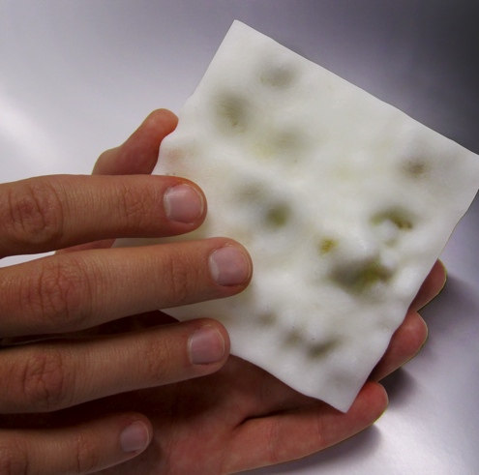
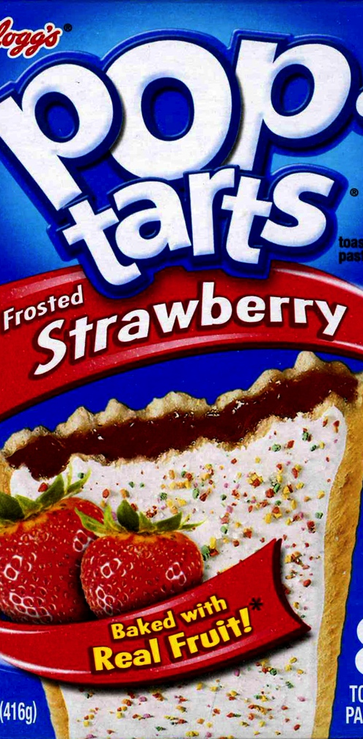
BACKGROUND
HYPOTHESIS
METHOD
RESULTS
CONCLUSIONS

Slide 3
BACKGROUND

Slide 4

TERMINOLOGY
PACKAGE SPACING- measurement of the distance recorded between on package and the next (usually 0 to .25-1.0 inches)
SHELF REAL ESTATE: value and attention paid towards in the retail environment. These factors are:
Size of package
Quantity of packages
Shelf- life of products
Store calendar
Product demand
Promotional strategies
Stocking challenges

Slide 5
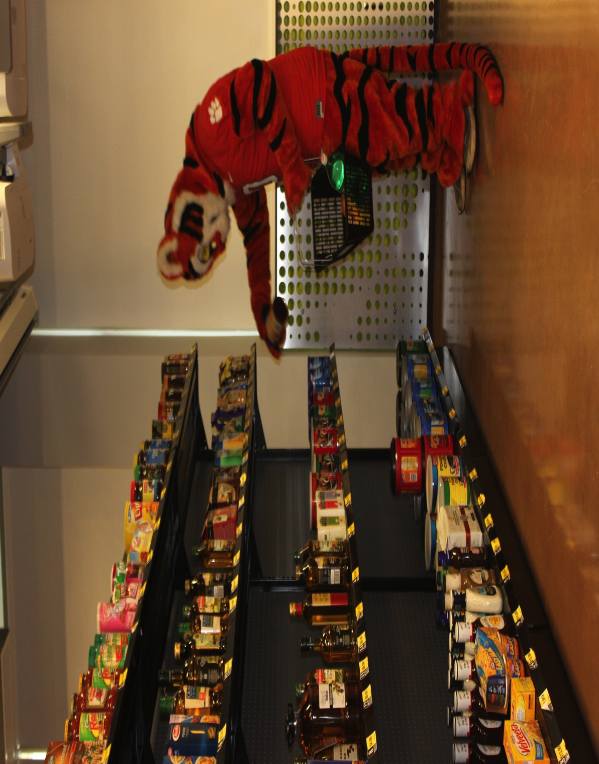
TERMINOLOGY
FULL SCALE TEST MARKET- “most ideal method of confirming the effectiveness of a new package design program
CUSHOP: a realistic shopping environment on Clemson’s campus. This setting was shipped to Las Vegas, NV for PackEXPO 2011. This space is considered a “full scale test market”

Slide 6
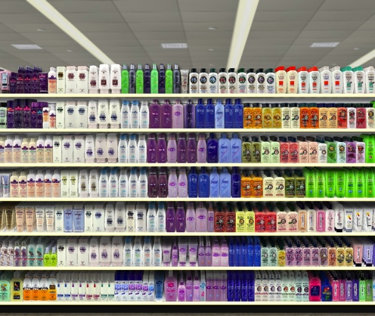
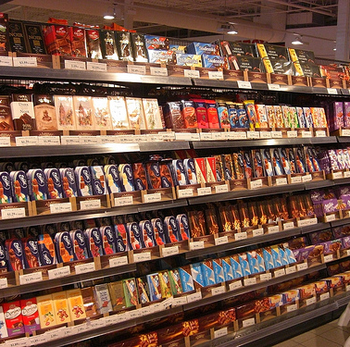
WHY?
To better understand reaction times in relation to spacing
Spacing is a key factor recognized by other fields (architecture, real estate, art) Each of these involve engaging a human response.
Groceries stores also seek a human response, but it is mostly driven by marketing techniques
The size of the product is typically the only driver in shelf spacing and layout

Slide 7
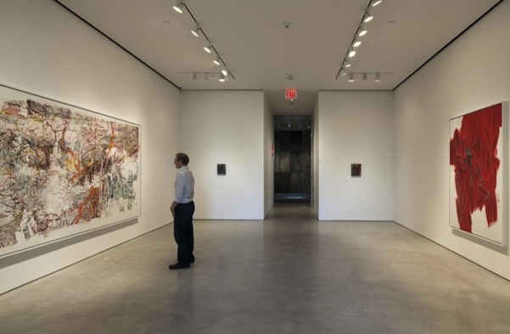

art galleries
Using voided space in galleries can be a large scale comparison to packages on grocery shelves
Some paintings would look impossibly busy even if a frame were added. Empty space in reference to art is extremely valuable

Slide 8
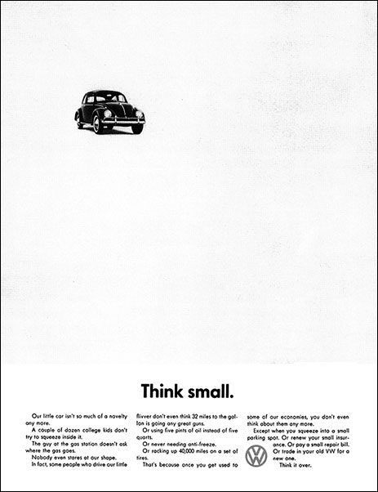

graphic design
Elam describes “white space” as unoccupied space . Using this space in graphic design can create organization and hierarchy
We can compare this “white space” to distance between products on shelves

Slide 9
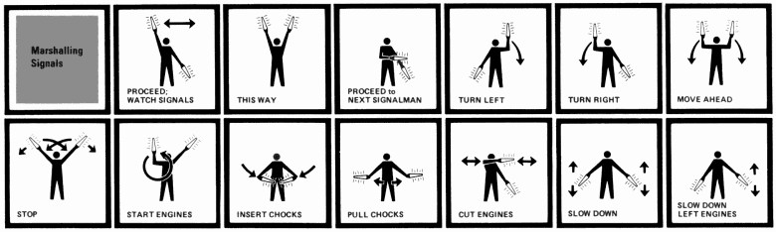
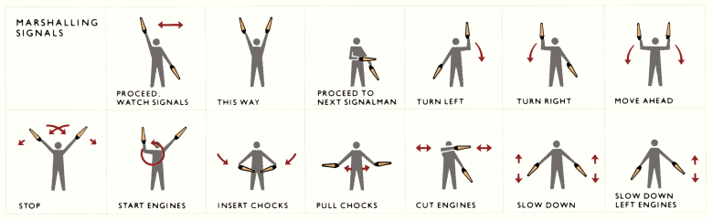
graphic design
The two images above show the same information with the below image more successful with Tufte’s layering and separation techniques
Edward Tufte’s theory of layering + separation where minimal white space can lead to confusion and clutter (design failures)
Retailers can promote easy shopping and stocking options with optimized shelf design

Slide 10
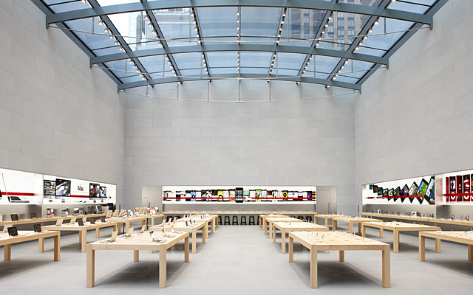
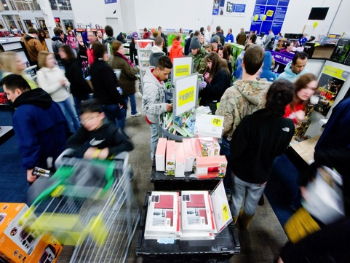
Best Buy vs. Apple
Retailers express white space in other environments. Both Best Buy and Apple stores sell Apple computers at competitive prices, yet people flock to Apple stores
This can be attributed to the de-cluttered environment.

Slide 11
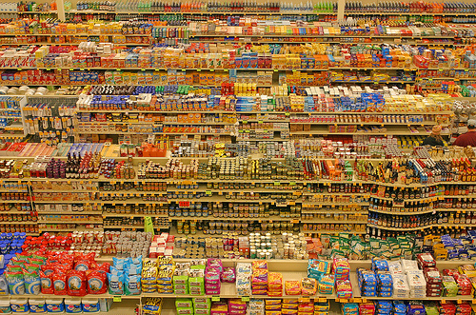
relevant studies
Chang and Wilcox – Marsh Supermarkets spacing analysis
Curhan- profit may be maximized by increase display size

Slide 12
HYPOTHESES

Slide 13
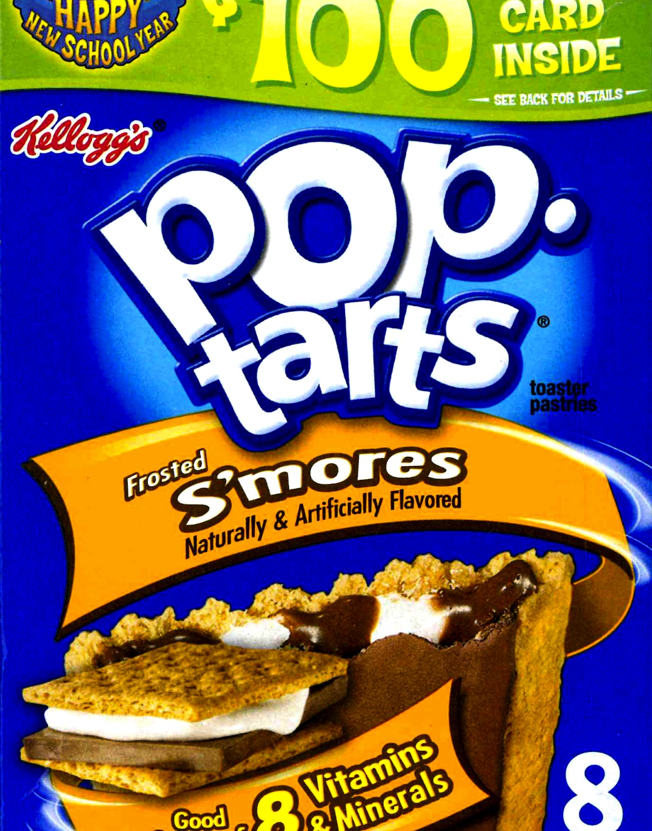
shelf spacing
Minimum- spacing is regarded as nothing, 0 inches
Moderate- a third of the of the package’s width (1/3 Pop Tarts= 1.17 inches)
Maximum- the width of the package (whole Pop Tarts box= 3.5 inches)

Slide 14
HYPOTHESES
H1:
shoppers will find their desired package quicker when there is maximum spacing between each package
H2:
shoppers will give up when looking for packages at minimum spacing

Slide 15
METHOD

Slide 16
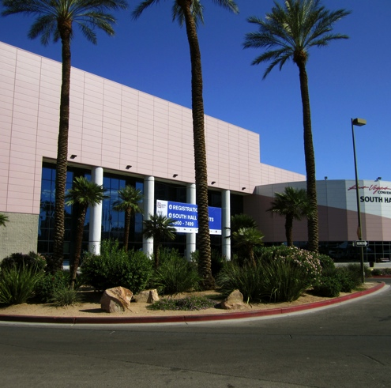
CONTEXT:
Las Vegas Convention Center- PackEXPO 2011

Slide 18
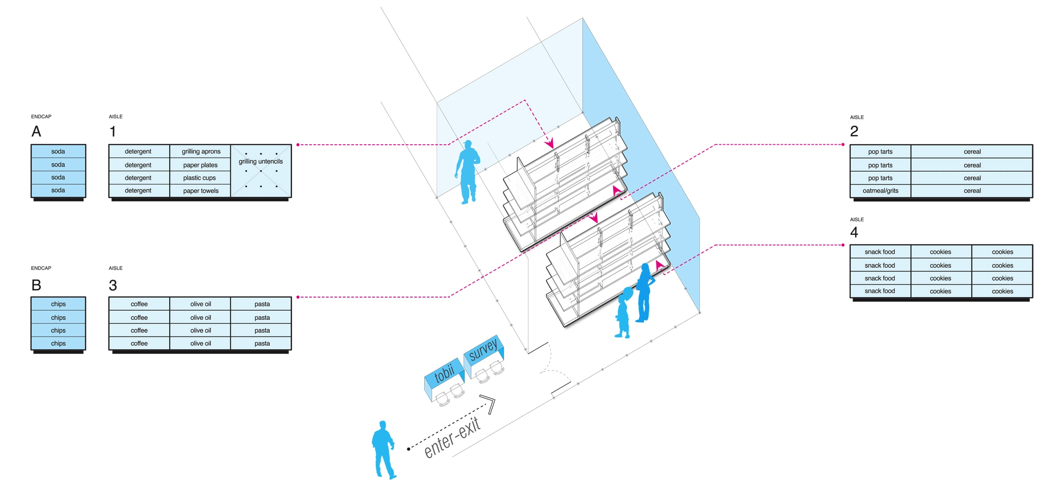
CUshop environment

Slide 19
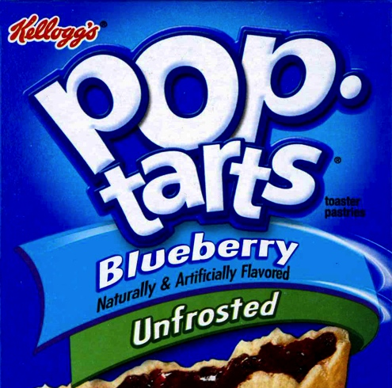

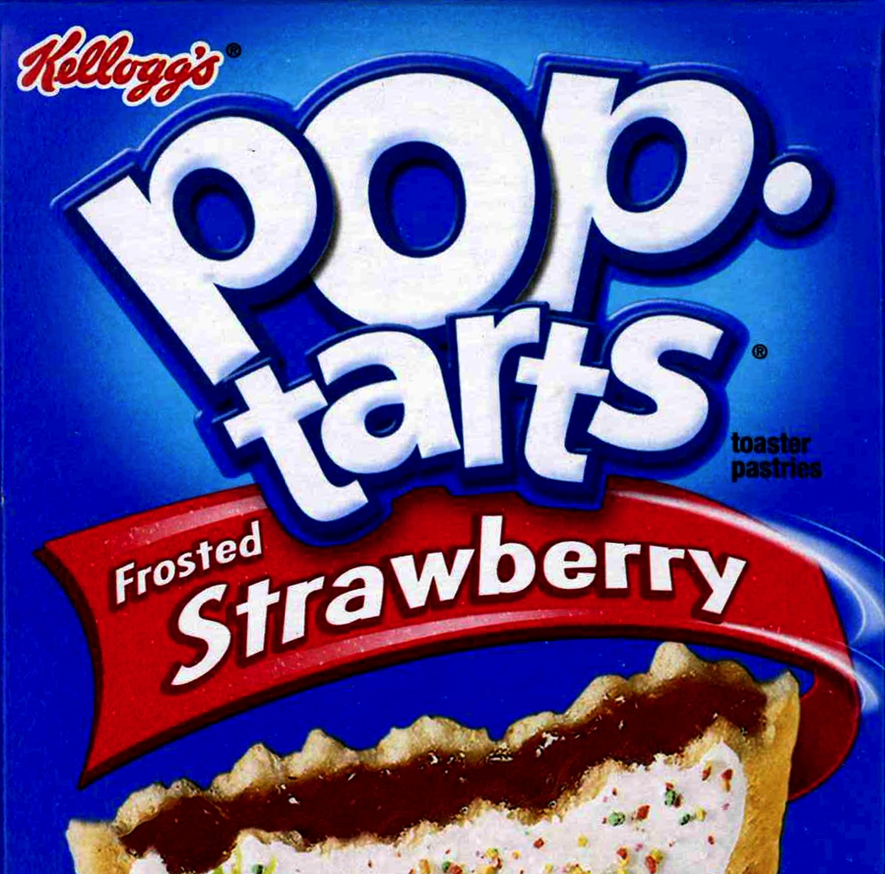
stimuli

Slide 20
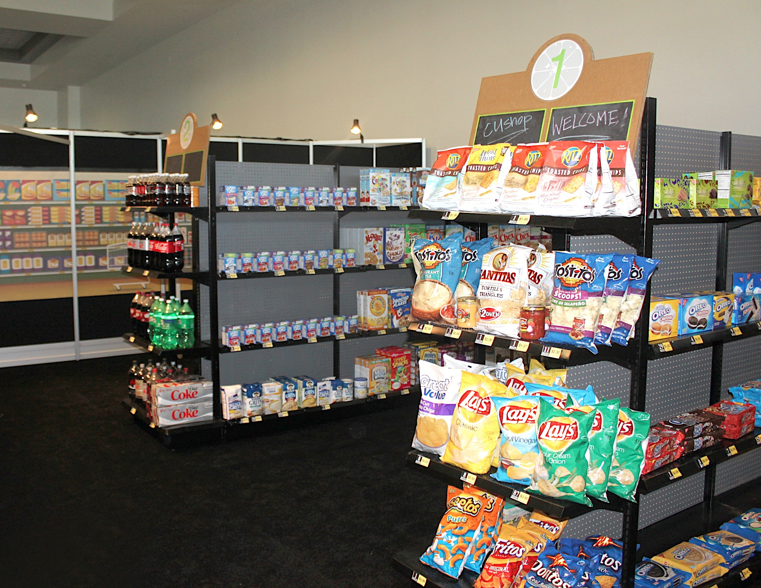
stimuli on shelves

Slide 21
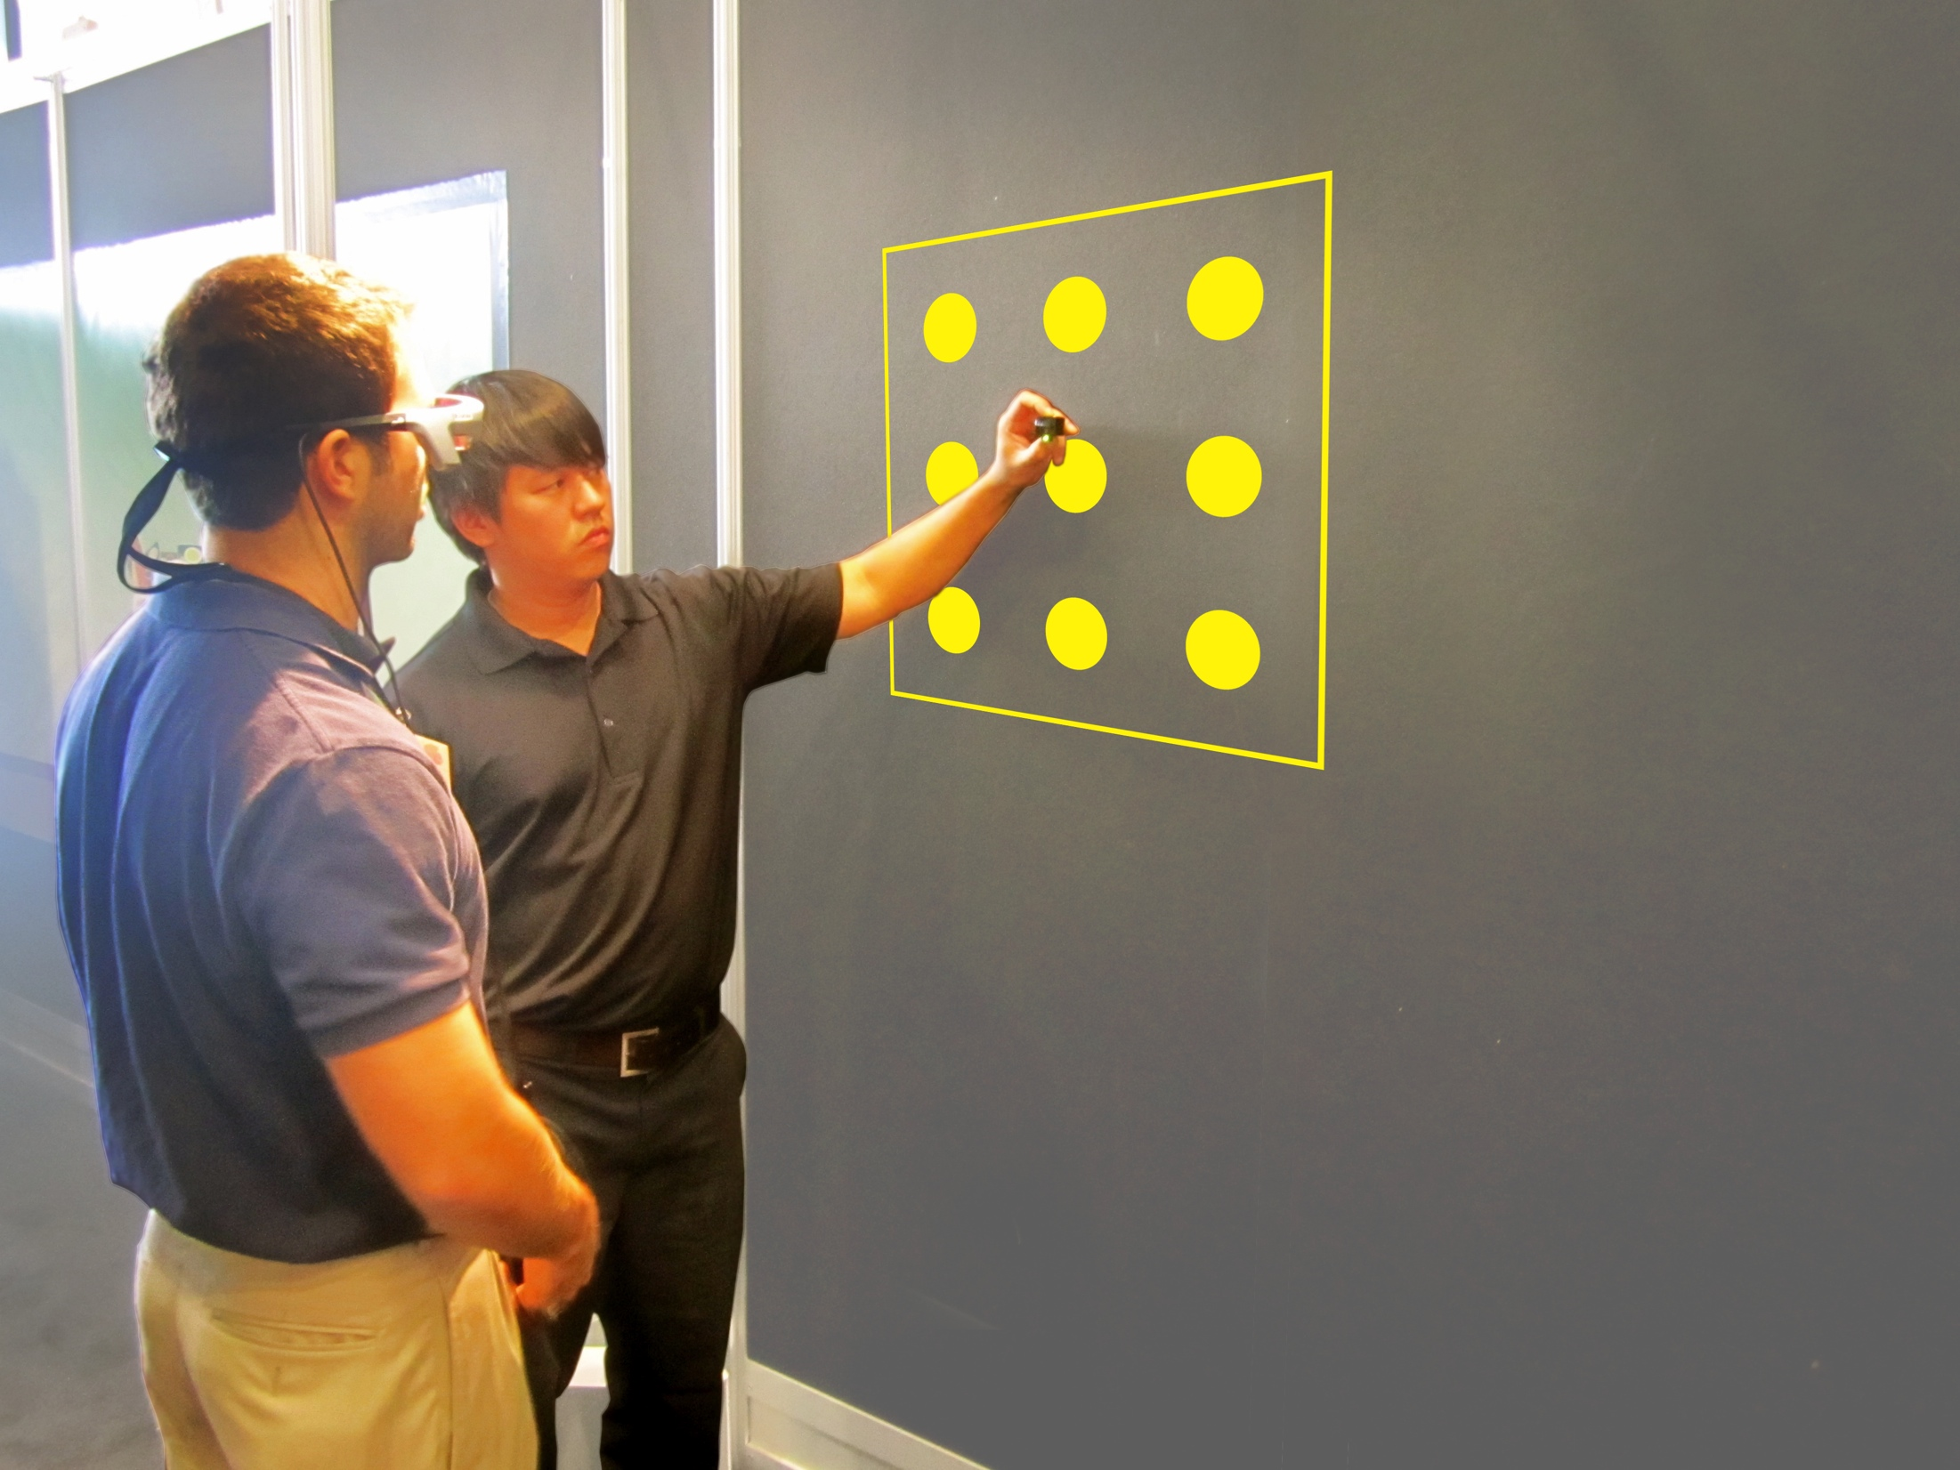
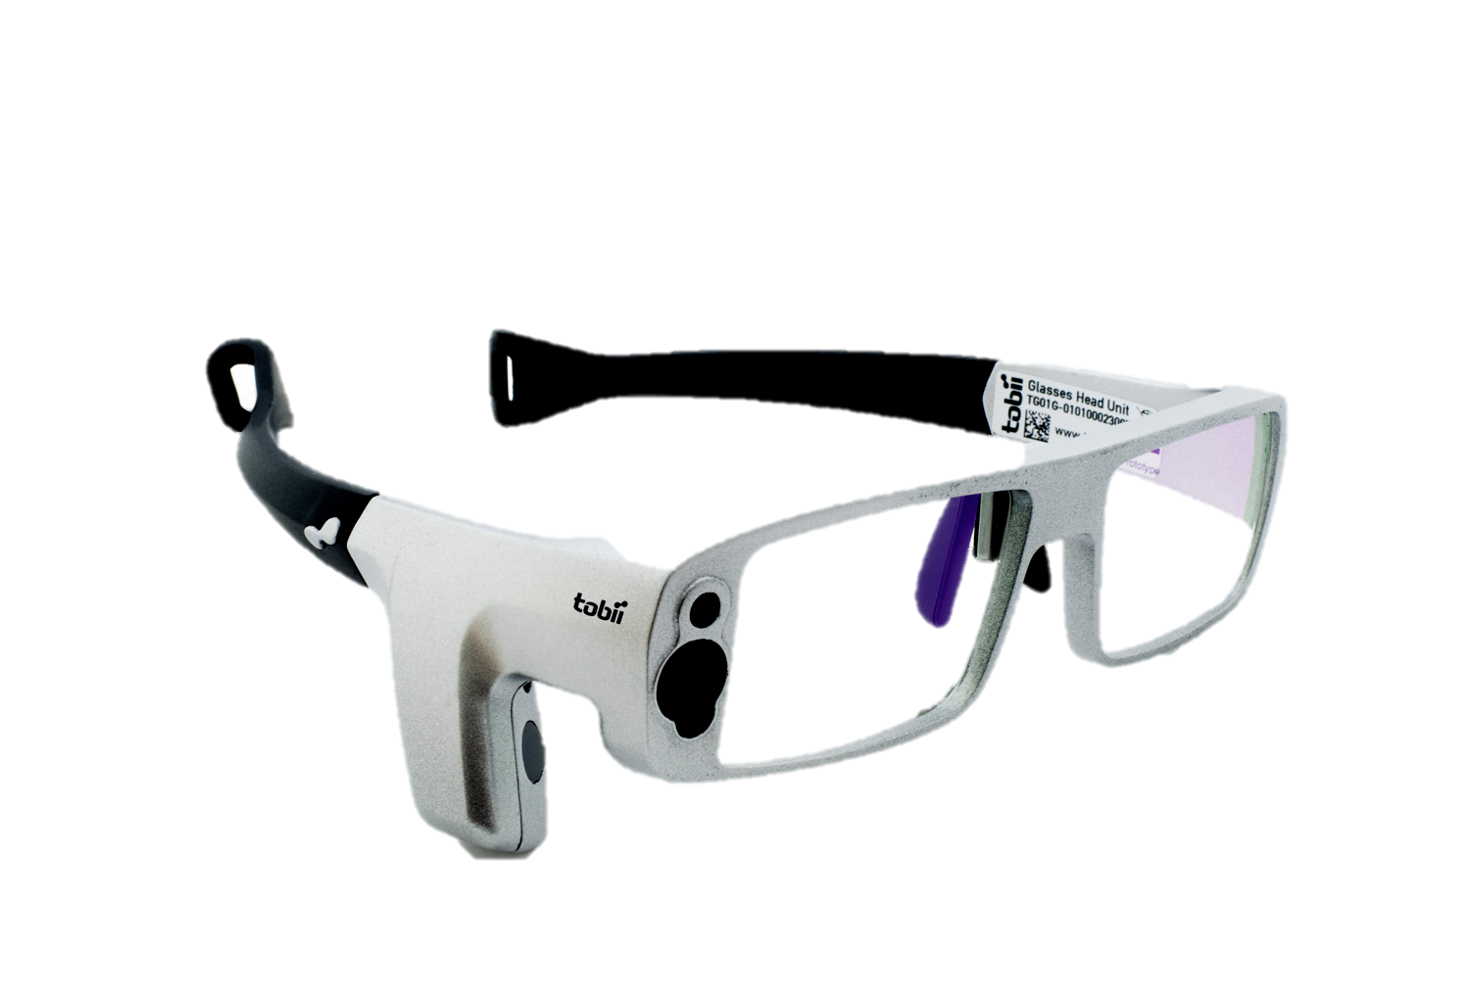
Tobii Eye Tracking glasses +calibration

Slide 22
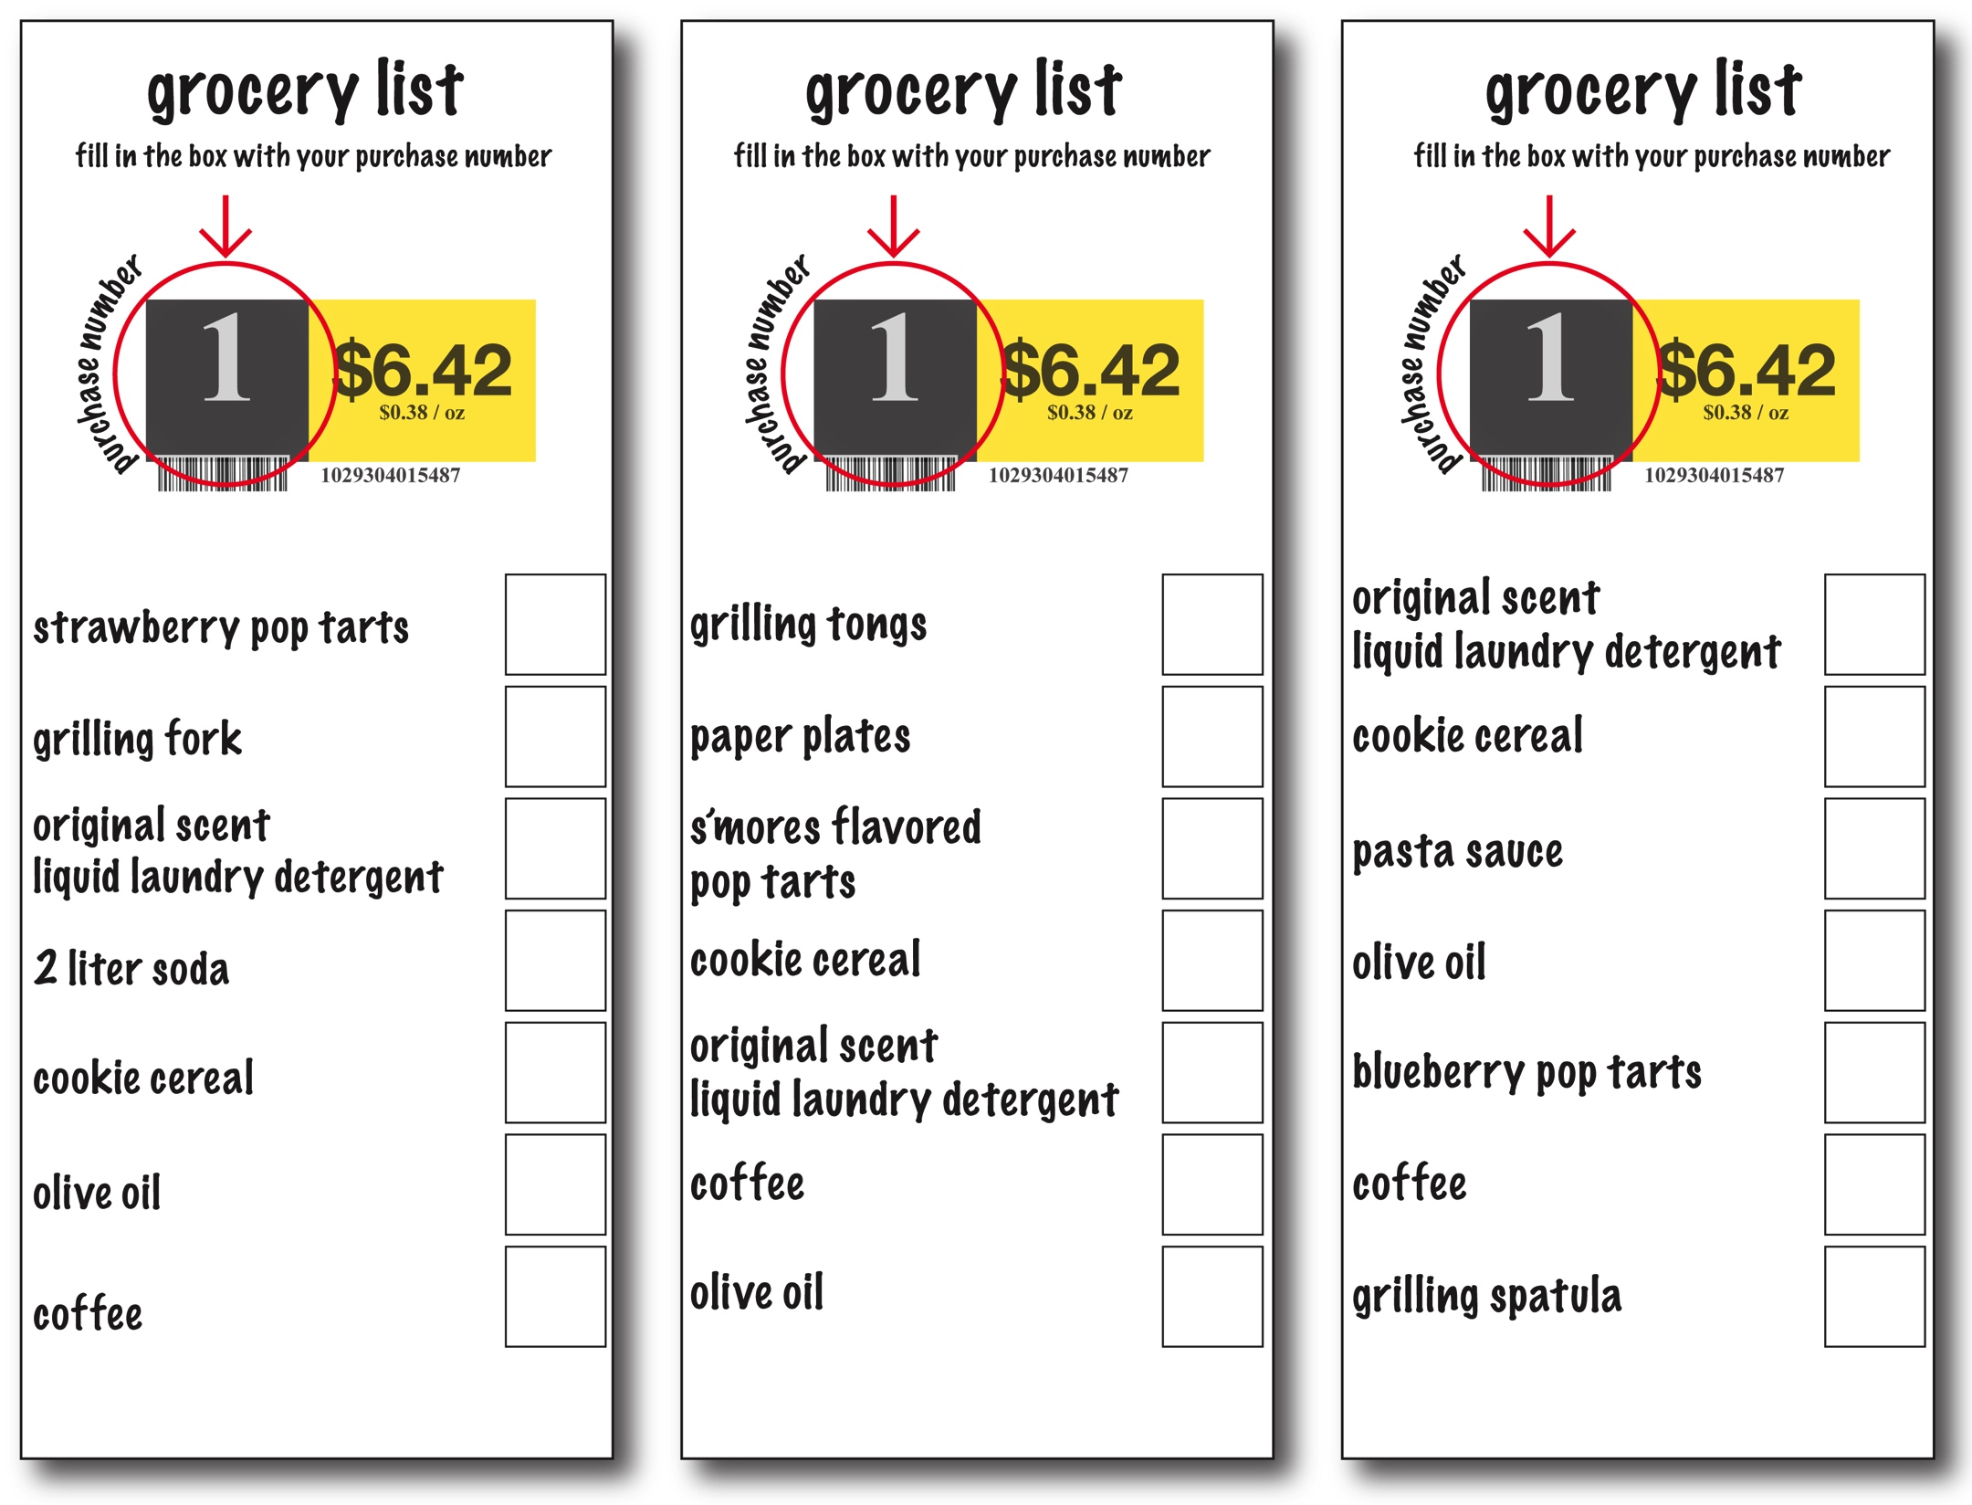
participant shopping list

Slide 23
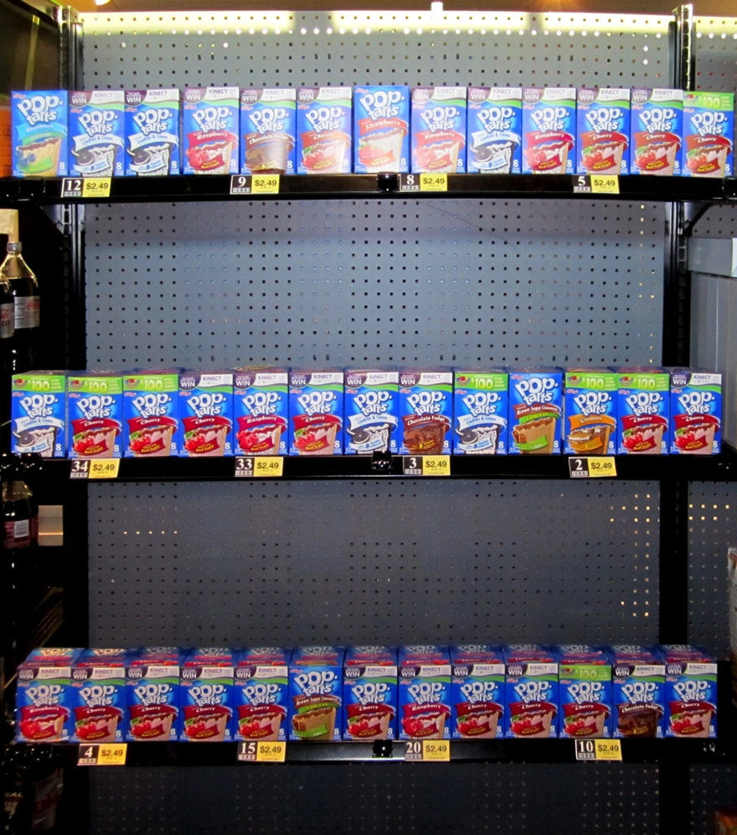
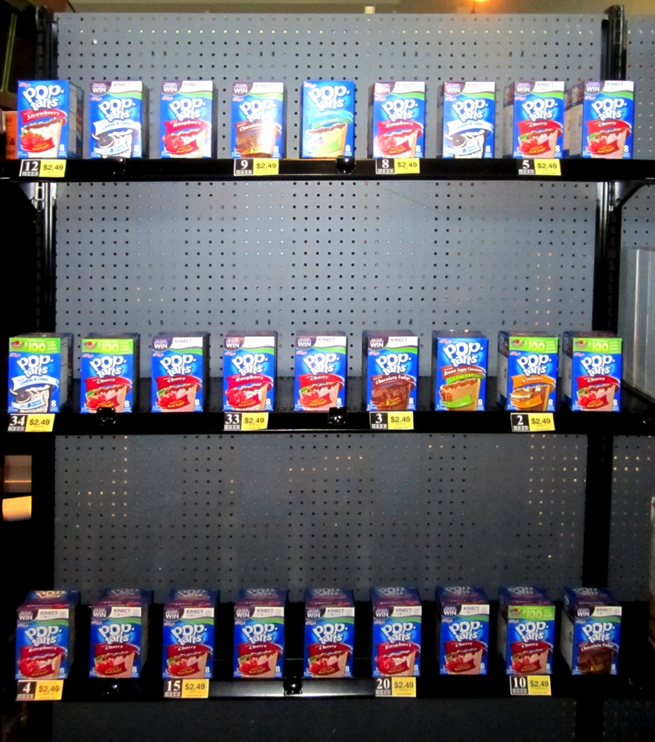
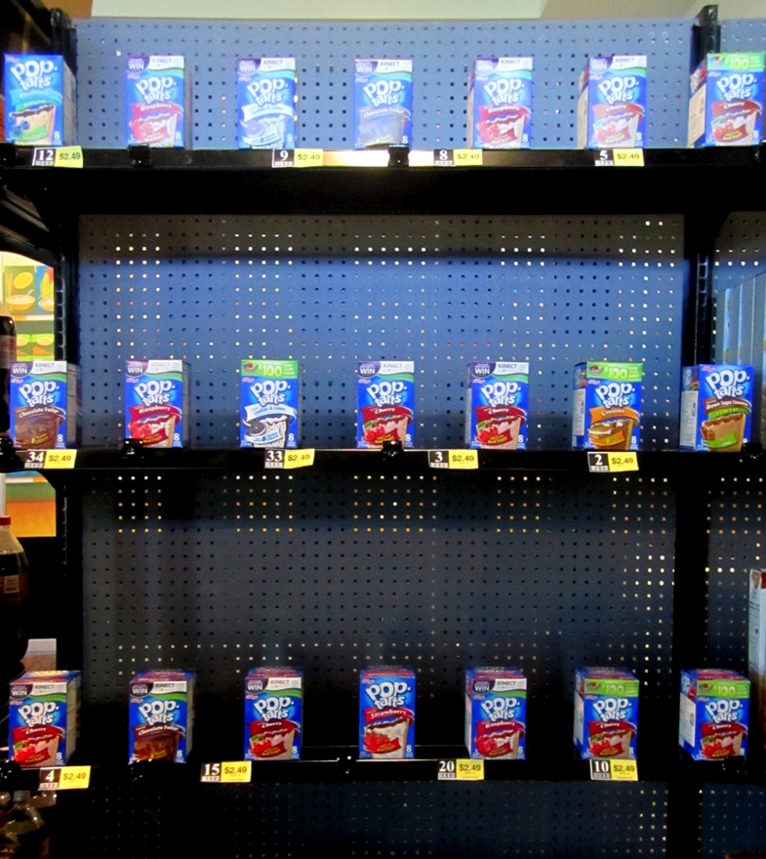
spacing
day 001: minimum
day 002: moderate
day 003: maximum

Slide 24
RESULTS

Slide 25
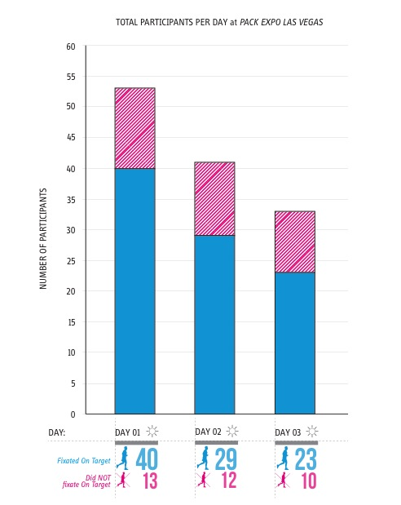
participant totals
[127 over 3 days]
[27.56% never fixated on target data]

Slide 26
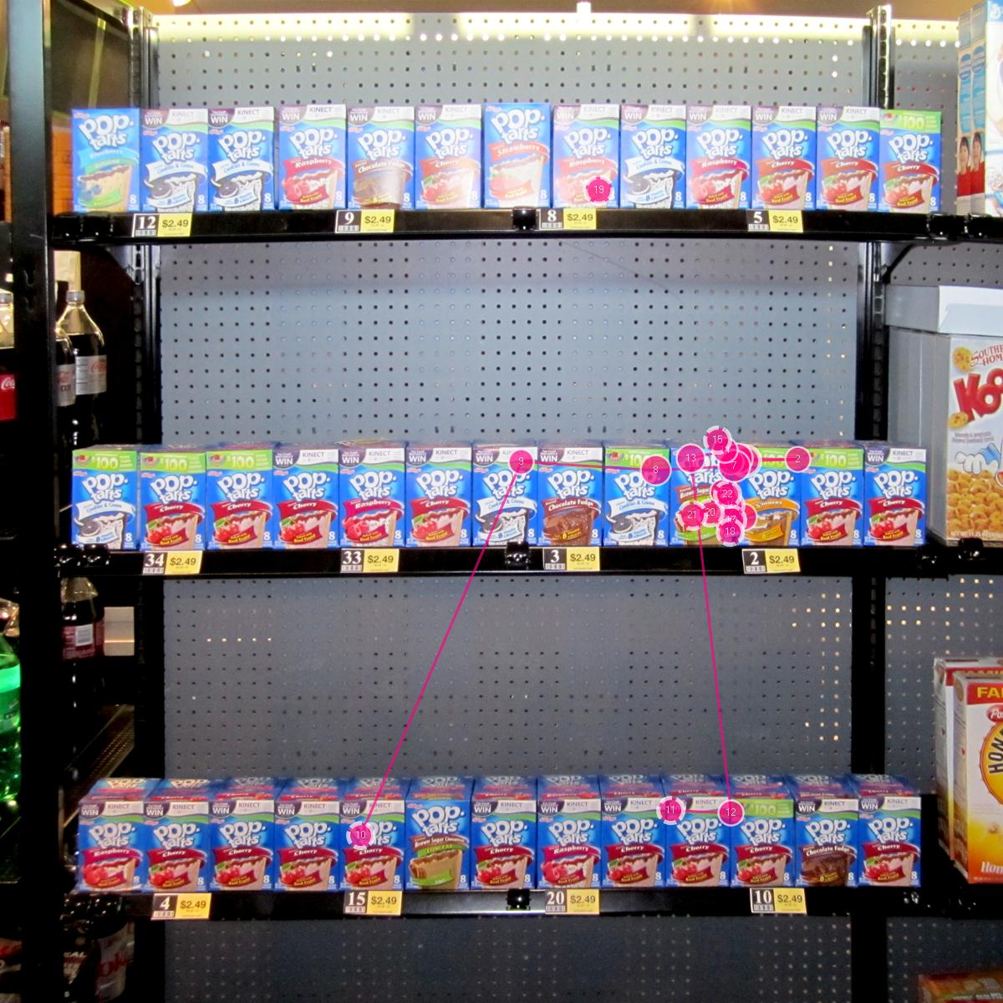
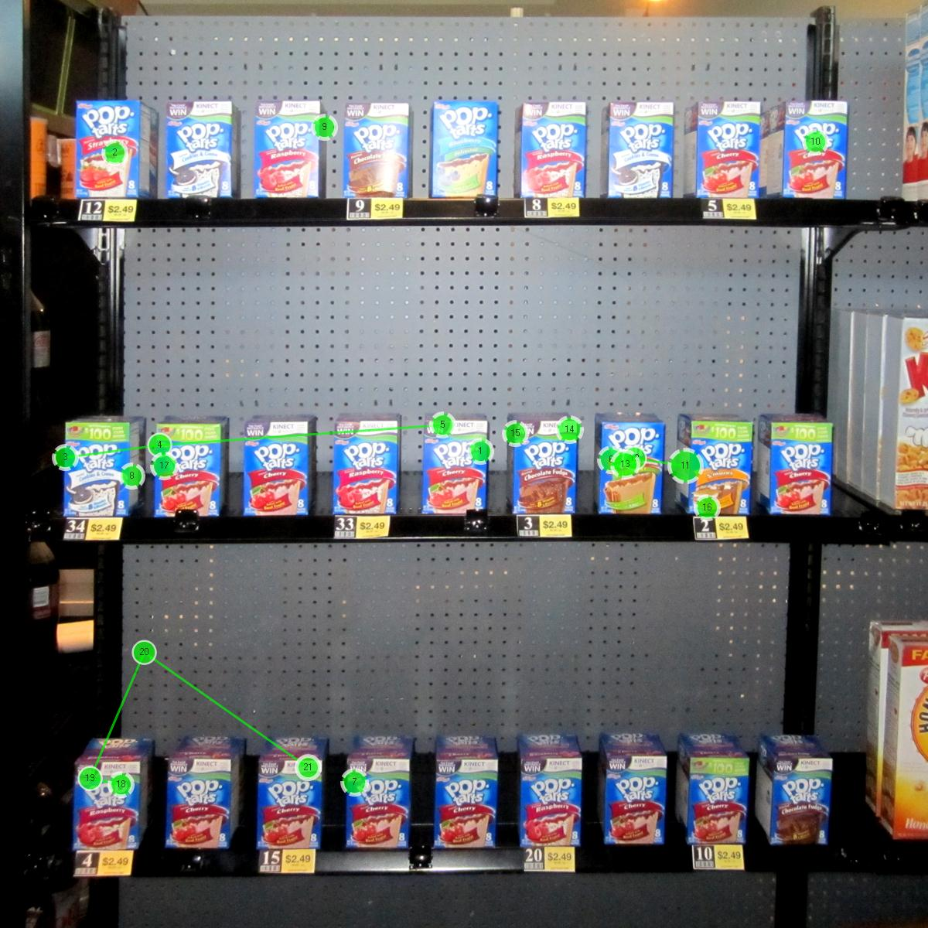
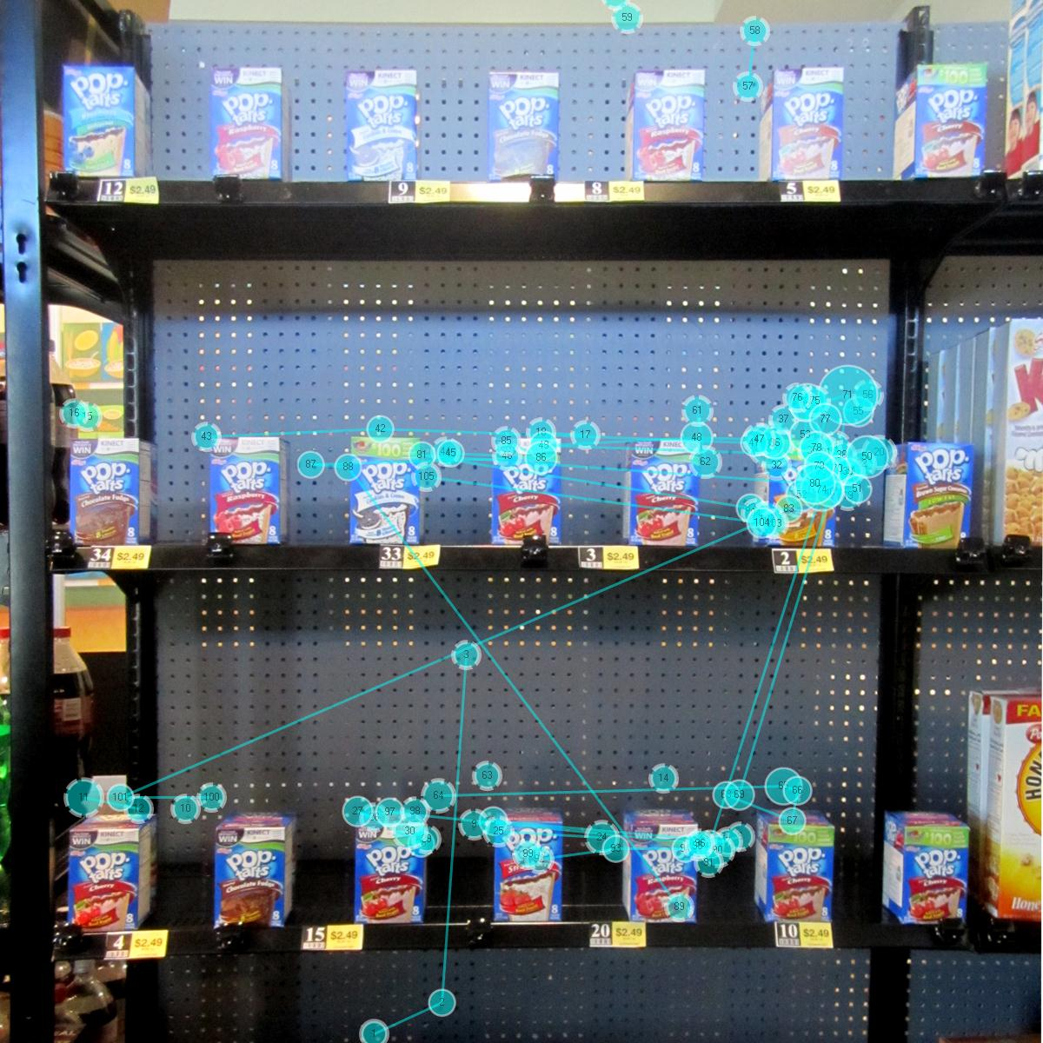
scan paths
day 001: minimum
day 002: moderate
day 003: maximum

Slide 27
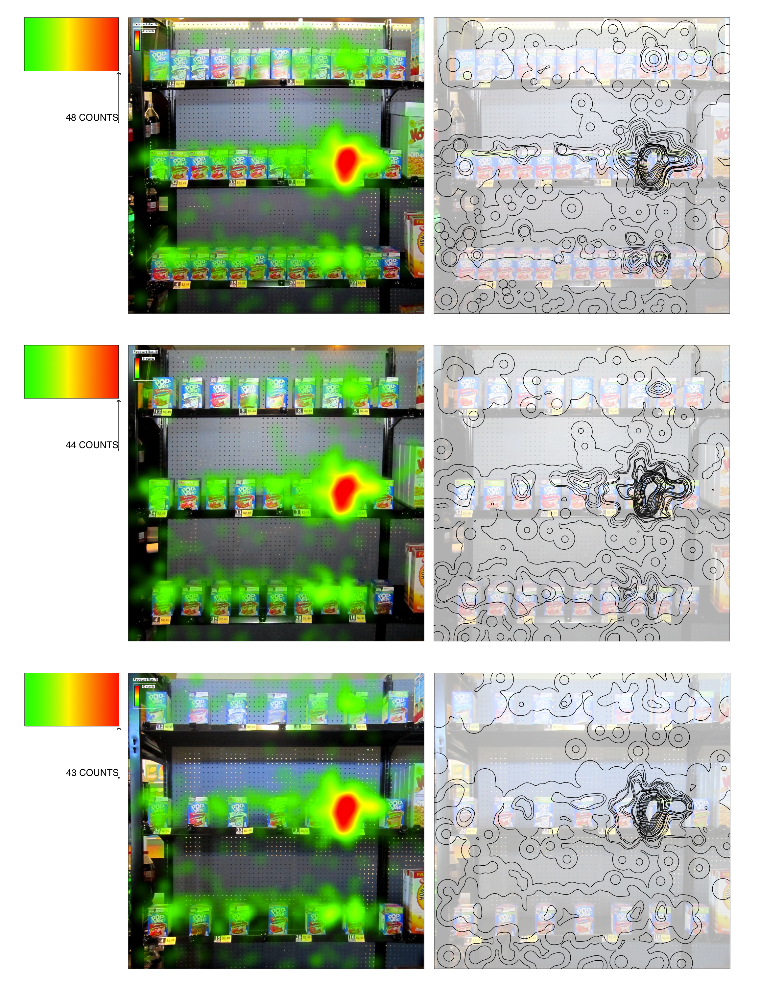
heat maps

Slide 28
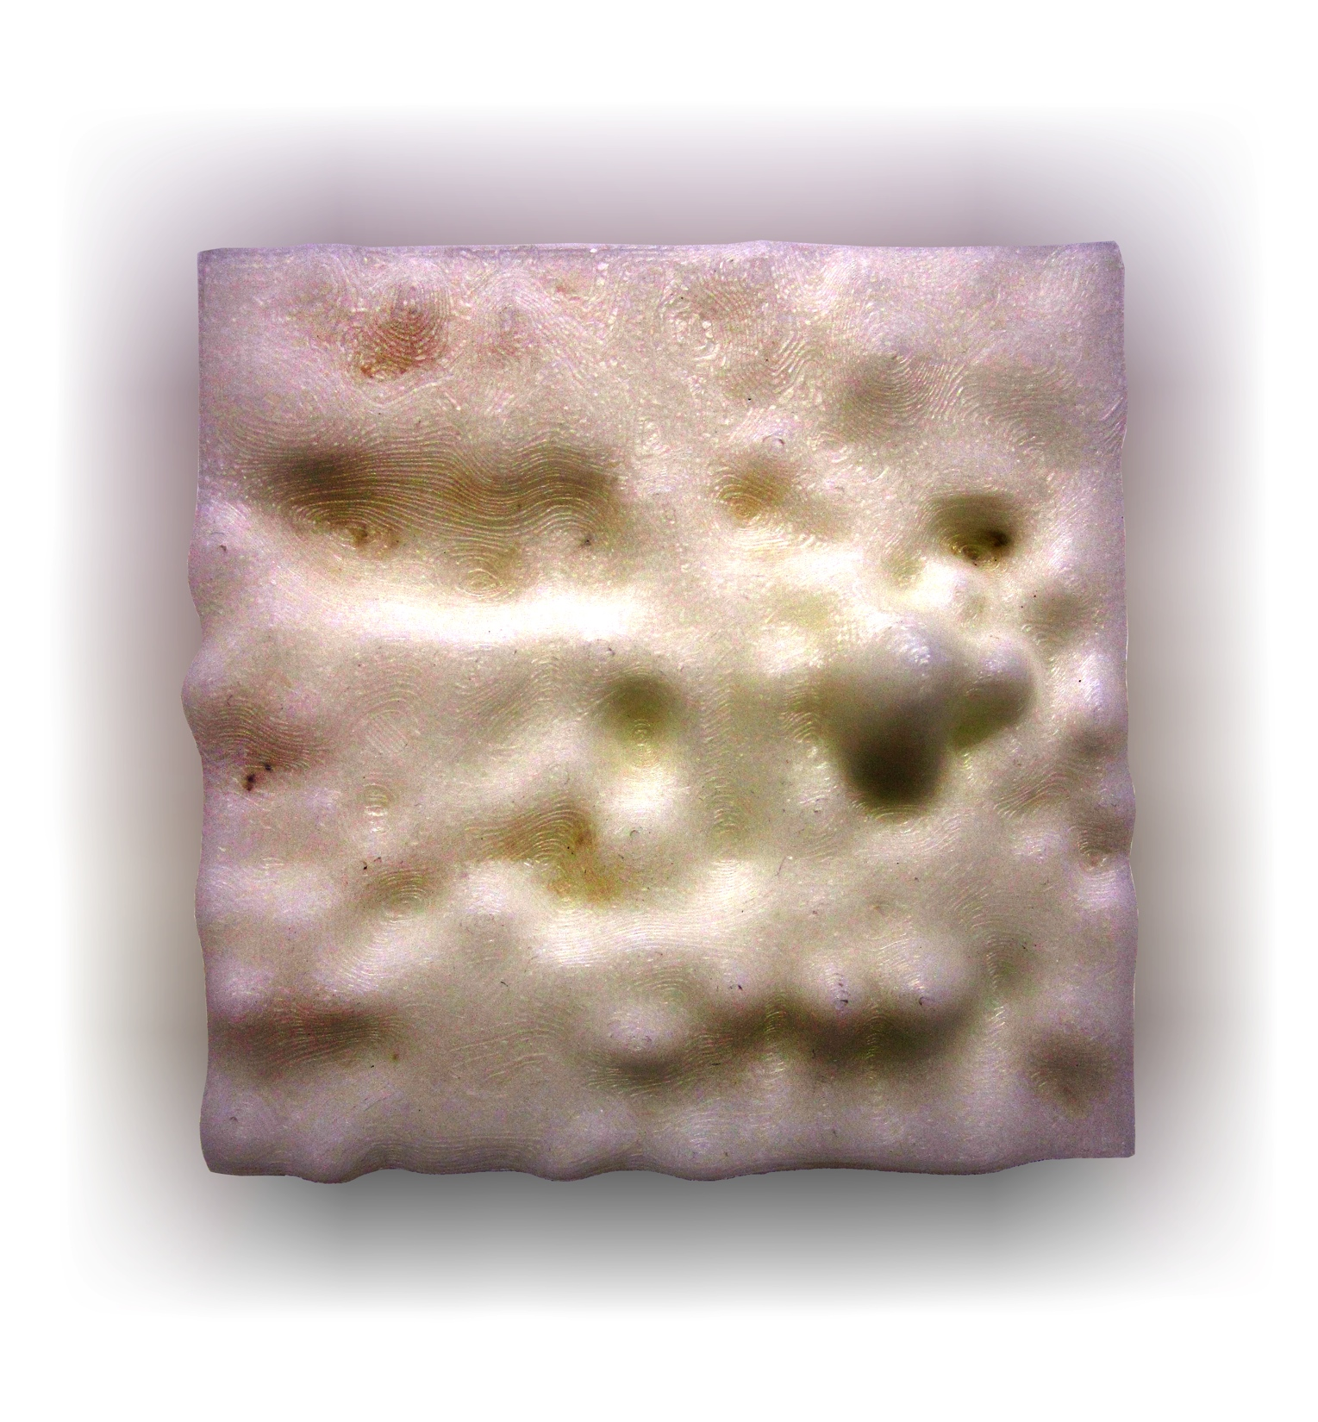

3D prototypes
single hue, 3D tangible prototypes

Slide 29
time to first fixation
[days 1-3]

Slide 30
time to first fixation
[packages 1-3]

Slide 31
results
Statistical difference measured between the two groups and no statistical difference was found
A two factor [box type, spacing] ANOVA of time to first fixation was used to measure significance
No significance [f[2,90]= 0.32, p=0.73] ns was found for the spacing factor
No significance [f[2,90]= 0.20, p=0.82 ns] was found for the type of the box
Graphs of means with standard error on 2 previous slides

Slide 32
DISCUSSION

Slide 33

discussion
What do these conclusions tell retailers about how to stock their shelves?
Who do these results favor?
Do these results apply to other retail environments?

Slide 34
CONCLUSION

Slide 35
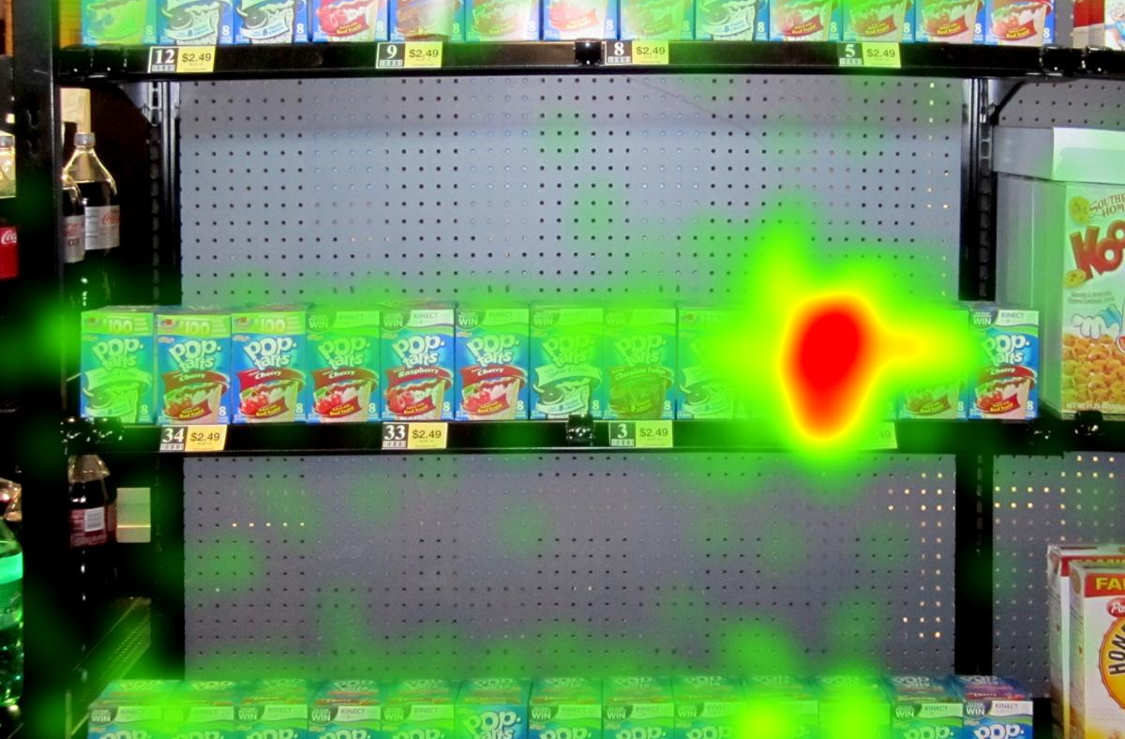
conclusions
No significant difference was found between package spacing and package type.
Stores can valuable conclude that packing as many products as possible onto their shelves will not negatively effect the shoppers atmosphere + search time.

Slide 36
special thanks to…
PMMI at PackEXPO 2011 Las Vegas show, the Sonoco Institute of Packaging Design and Graphics, Kodak, Harris A. Smith, and the graduate research team at the Sonoco Institute

Slide 37
references
1. Barnes, C., Southee, C., & Henson, B. (2003). The impact of affective design of product packaging upon consumer purchase decisions. Paper presented at the Proceedings of the 2003 International Conference on Designing Pleasurable Products and Interfaces, Pittsburgh, PA, USA. 134-135. doi:http://doi.acm.org/10.1145/782896.782930
2. Bultez, A., & Naert, P. (1988). SH.A.R.P.: Shelf allocation for retailers’ profit. Marketing Science, 7(3), pp. 211-231. Retrieved from http://www.jstor.org/stable/183714
3. Bushman, B. J. (1993). What’s in a name? the moderating role of public self-consciousness on the relation between brand label and brand preference. Journal of Applied Psychology, 78(5), 857-861. doi:10.1037/0021-9010.78.5.857
4. Buzzell, R. D., Salmon, W. J., Vancil, R. F., & Harvard University. Graduate School of Business Administration. (1965). Product profitability measurement and merchandising decisions : A pilot study in retail food stores. Boston: Division of Research, Graduate School of Business Administration, Harvard University.
5. Carrier, D. (2011). The art museum today. Curator: The Museum Journal, 54(2), 181-189. doi:10.1111/j.2151-6952.2011.00080.x
6. Chiang, J., & Wilcox, R. T. (1997). A cross-category analysis of shelf-space allocation, product variety, and retail margins. Marketing Letters, 8(2), pp. 183-191. Retrieved from http://www.jstor.org/stable/40216443
7. Curhan, R. C. (1972). The relationship between shelf space and unit sales in supermarkets. Journal of Marketing Research, 9(4), pp. 406-412. Retrieved from http://www.jstor.org/stable/3149304
8. Duchowski, A. (2007). Eye tracking methodology : Theory and practice: Theory and practice. DE: Springer. doi:10.1007/978-1-84628-609-4
9. Duchowski, A., Meyer, M., Orero, P. and Price, M. “Aggregate Gaze Visualization with Real-time Heatmaps,” to appear at CHI 2012, Austin, Texas, May 2012.
10. Elam, K. (2004). Grid systems: Principles of organizing type. New York: Princeton Architectural Press.

Slide 38
references, cont.
10. Elam, K. (2004). Grid systems: Principles of organizing type. New York: Princeton Architectural Press.
11. Hansen, J. M., Raut, S., & Swami, S. (2010). Retail shelf allocation: A comparative analysis of heuristic and meta-heuristic approaches. Journal of Retailing, 86(1), 94-105. doi:10.1016/j.jretai.2010.01.004
12. Hoch, S. J. (1993). When Do Private Labels Succeed? Sloan Management Review, 34(4), 57.
13. Jacoby, J., & Olson, J. C. (1985). Perceived quality: How consumers view stores and merchandise. Lexington, Mass: LexingtonBooks.
14. Kingshuk, Das. “7 Steps For Creating Disruptive New Retail Experiences | Co. Design.”Fastcodesign.com. Fast Company, 07 Nov. 2011. Web. 07 Dec. 2011.
15. Lucas, A. (1996). Shelf wars. Sales and Marketing Management, 148(3), 121.
16. Meyers, H. M., Lubliner, M. J., & American Marketing Association. (1998). The marketer’s guide to successful package design. Lincolnwood (Chicago), Ill: NTC Business Books.
17. Tufte, E. R. (1990). Envisioning information. Cheshire, Conn. (P.O. Box 430, Cheshire 06410): Graphics Press.
18. Van Nierop, E., Fok, D., & Franses, P. H. (2008). Interaction between shelf layout and marketing effectiveness and its impact on optimizing shelf arrangements. Marketing Science, 27(6), 1065-1082. doi:10.1287/mksc.1080.0365
19. Wooding, D., Fixation Maps: Quantifying Eye-Movement Traces, in Proceedings of the Eye Tracking Research & Applications Symposium (ETRA), New Orleans, LA, 2002, ACM.

