Slide 1
Does Fixation Reflect Fascination?
Eye Movements for Images of Different Levels of Restorativeness
Shuai Yuan & Xuewei Chen 12/07/2021
Team 3

Slide 2
Fascination: Bottom-up attention that requires no effort and be resistant to fatigue
Attention restoration theory
(Kaplan, 1995)

Slide 3
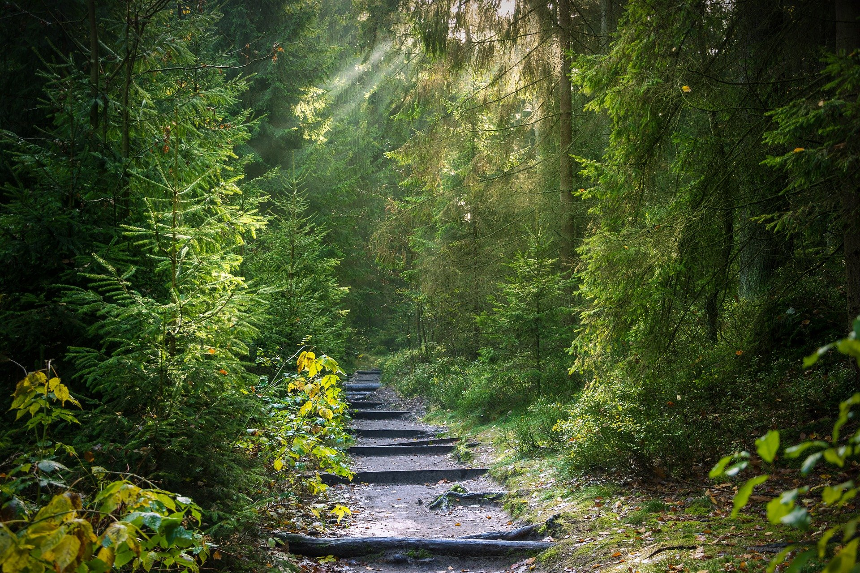
Fascination & Restorative benefits of nature
Restorative benefits of being in nature
Improve positive mood, reduce nagetive mood
Improve cognitive functions
Recover from stress
Fascination: critical for restorative effects of nature
Voluntary attention get fatigue by attention-demanding tasks and distractions
Nature providing soft fascination which are gentle, positive, and allow reflection.
E.g., clouds, snow patterns, the motion of leaves inthe wind
Help the recovery of Voluntary attention/cognitive resources from fatigue

Slide 4
Fascination and Eye-tracking
Article | Stimuli | Eye Mov. Measures | Stimuli type | Results (fixation-related)
Berto et al. (2008). | Nature vs. Urban | Fixation#, Travel distance, mean saccades# | Desktop | Mean fixation numbers: Urban > nature Mean fixation durations: Urban < nature
Franěk et al. (2018). | Nature vs. Modern city vs. Historic city | Fixations#, Duration, Travel Distance
Franěk et al. (2019). | Nature vs. Nature without foliage (reduced fractal level) vs. Urban | Fixations#, Duration
Martínez-Soto et al. (2019). | Nature vs. Urban | Fixations#, Duration, Pupil Size | HMD
Ren (2019). | Rural landscape: Roads vs. Houses vs. Waterscapes vs. Farmland | Fixations#, Duration, attention area | Desktop | Durations: waterscapes < roads < farmland < houses (competing)
High fascination environments →
Longer fixation durations
Smaller number of fixations
Attention is “held/captured” by nature?

Slide 5
Fascination and Eye-tracking
“View an image with composure. Do not try to remember its content or its details” (Franěk et al., 2018).
“you should look freely at the photographs, don’t try to memorize any detail because this is not a memory task and no task related to the photograph contents will occur at the end of the eye movements recording” (Berto et al., 2008).
Issue: no specific task
Participants may create their own internal tasks
Undermined the validity of the results.

Slide 6
Research goal and hypothesis
Goal
To test the relationship between fixation and fascination while giving task that is compatible to fascination.
Hypothsis
Longer mean fixation duration for high fascination scenes
Smaller mean fixations number for high fascination scenes

Slide 7
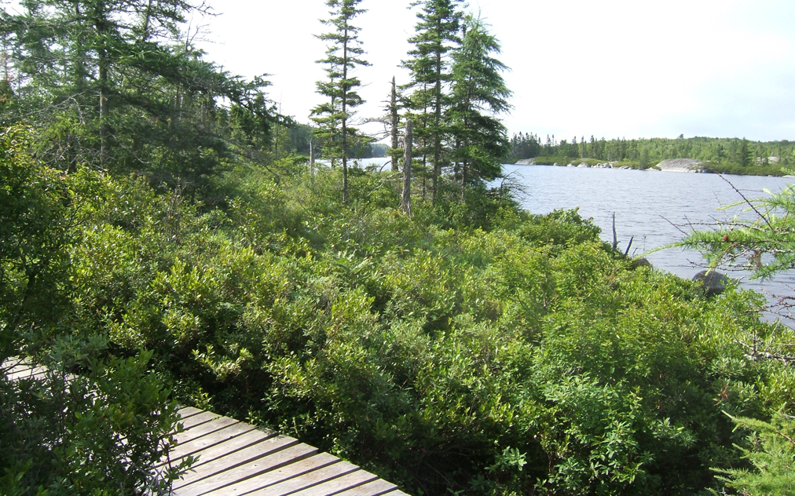
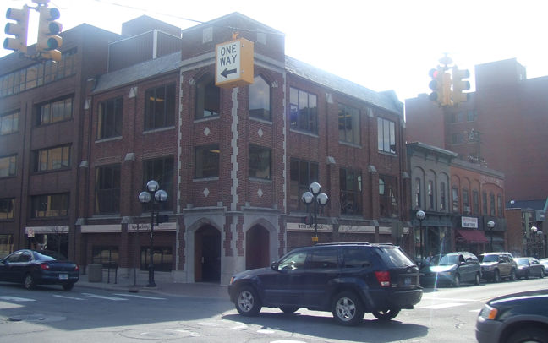
Methods
Single-factor within-subject design
DV: mean fixation duration, mean fixation count
IV: Fascination level
Stimuli
12 high fascinaiton (nature) scenes
12 low fascination (urban) scenes
Task: “feel how your attention is captured by interesting things in the pictures.”
Adapted from PRS-11 (Pasini et al., 2014), a self-reported scale including fascination
Analysis
Remove outliers, outside [m+3*sd, M-3*sd]
Fixation measures were averaged across scenes
Independent sample t test (N=24 scenes)

Slide 8
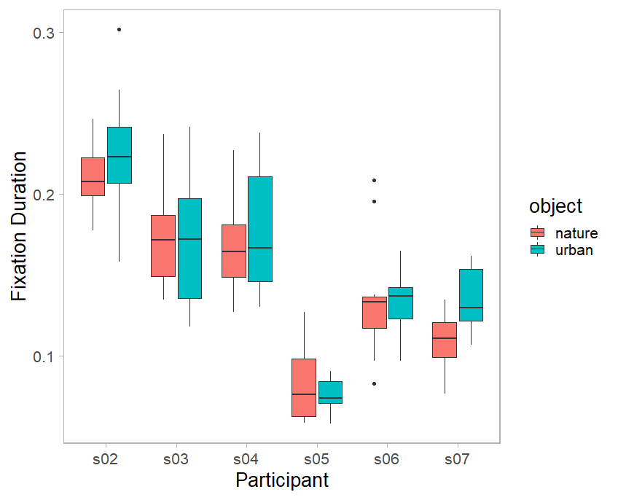
Fixation and fascination
Data exploration
Large variation between individual participants
Subtle difference between fascination level
No significant difference
in the mean fixation duration, t(22) = -0.43, p = 0.67
Or in the mean fixation count, t(22) = 0.27, p = 0.79.

Slide 9
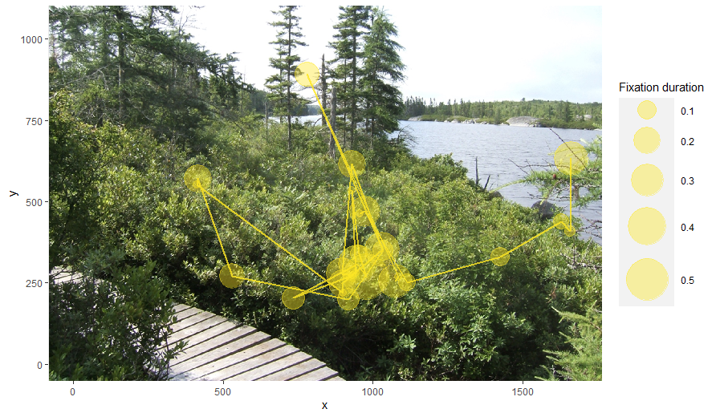
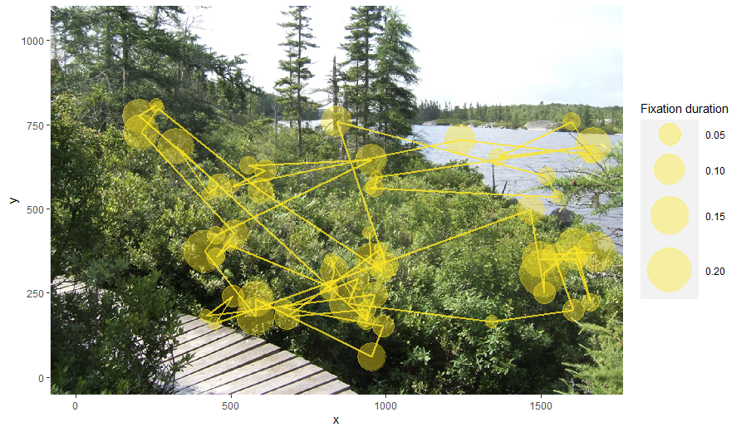
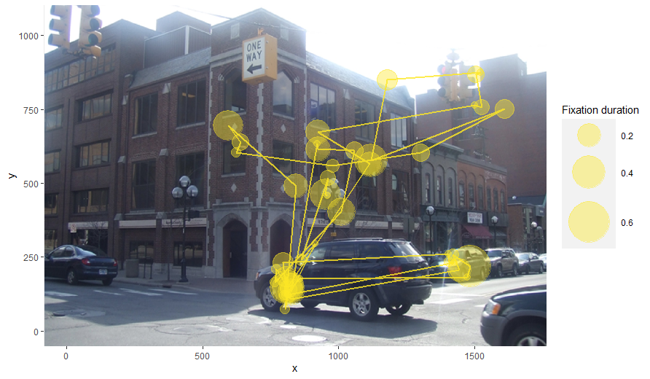
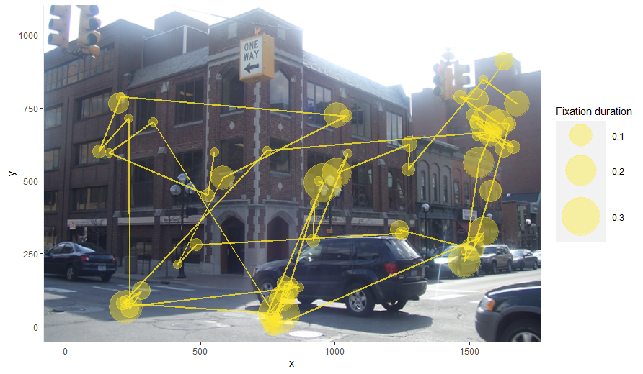
Scan path plots
s04
s05

Slide 10
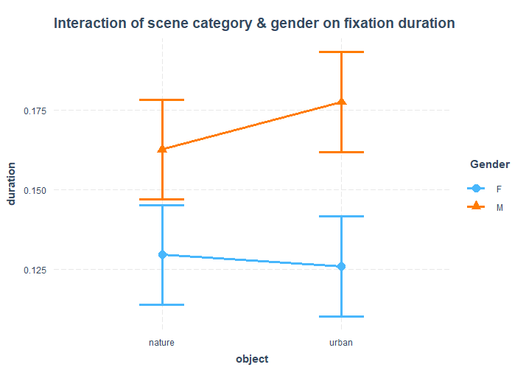
The effects of gender
Two-way ANOVA: gender and fascination
Gender difference was found
No interaction between gender and fascination level.

Slide 11
Discussion
Explanations:
The sample size was too small to represent the university student population
Factors related to personal interests to nature
Perceived safety (related to gender, (Jiang et al., 2017; Berg & Heijne, 2005 )
Nature hobbies, childhood nature experiences (Korpela et al., 2008)
The revised instruction
Implications:
Explore appropriate instructions for restorative environment research
Address potential moderators and mediators
Acquire the meaning/contexts of fixations (by requiring verbal description) (Holsanova, 2006, 2008)

Slide 12
References
Berg, A. E. van den, & Heijne, M. ter. (2005). Fear versus fascination: An exploration of emotional responses to natural threats. Journal of Environmental Psychology, 25(3), 261–272. https://doi.org/10.1016/j.jenvp.2005.08.004
Berto, R., Massaccesi, S., & Pasini, M. (2008). Do eye movements measured across high and low fascination photographs differ? Addressing Kaplan’s fascination hypothesis. Journal of Environmental Psychology, 28(2), 185–191. https://doi.org/10.1016/j.jenvp.2007.11.004
Franěk, M., Petružálek, J., & Šefara, D. (2019). Eye movements in viewing urban images and natural images in diverse vegetation periods. Urban Forestry & Urban Greening, 46, 126477. https://doi.org/10.1016/j.ufug.2019.126477
Franěk, M., Šefara, D., Petružálek, J., Cabal, J., & Myška, K. (2018). Differences in eye movements while viewing images with various levels of restorativeness. Journal of Environmental Psychology, 57, 10–16. https://doi.org/10.1016/j.jenvp.2018.05.001
Holsanova, J. (2006). Dynamics of picture viewing and picture description. In A. Liliana (Ed.), Visual Thought: The Depictive Space of Perception (Vol. 67, p. 235). John Benjamins.
Holsanova, J. (2008). Discourse, Vision, and Cognition. John Benjamins Publishing. https://doi.org/10.1075/hcp.23
Jiang, B., Mak, C. N. S., Larsen, L., & Zhong, H. (2017). Minimizing the gender difference in perceived safety: Comparing the effects of urban back alley interventions. Journal of Environmental Psychology, 51, 117–131. https://doi.org/10.1016/j.jenvp.2017.03.012
Kaplan, S. (1995). The restorative benefits of nature: Toward an integrative framework. Journal of Environmental Psychology, 15(3), 169–182. https://doi.org/10.1016/0272-4944(95)90001-2
Korpela, K. M., Ylén, M., Tyrväinen, L., & Silvennoinen, H. (2008). Determinants of restorative experiences in everyday favorite places. Health & Place, 14(4), 636–652. https://doi.org/10.1016/j.healthplace.2007.10.008
Ren, X. (2019). Consensus in factors affecting landscape preference: A case study based on a cross-cultural comparison. Journal of Environmental Management, 252, 109622. https://doi.org/10.1016/j.jenvman.2019.109622
Valtchanov, D., & Ellard, C. G. (2015). Cognitive and affective responses to natural scenes: Effects of low level visual properties on preference, cognitive load and eye-movements. Journal of Environmental Psychology, 43, 184–195. https://doi.org/10.1016/j.jenvp.2015.07.001

Slide 13
Thank you
Shuai Yuan syuan2@clemson.edu
Xuewei Chen xueweic@clemson.com

