Slide 1
Effectiveness of Store Shelf Item Placement
Chris Thomas

Slide 2
Related Work
There have been studies in the past to gain insight on customers emotional experience and behavior intention during online shopping using eye tracking technology
In online shopping it was found that the chosen product, in browsing vs searching, received more eye fixations than non chosen products in both displays
There have also been studies showing outside influence having minimal impact on shopping behavior
Participants focused on spectacle design more than any other factors, such as brand, price and promotion banner.

Slide 3
Goal
I hypothesize that, items in the center of the shelf will receive the most attention from users
Use time taken to determine if this trend is true

Slide 4
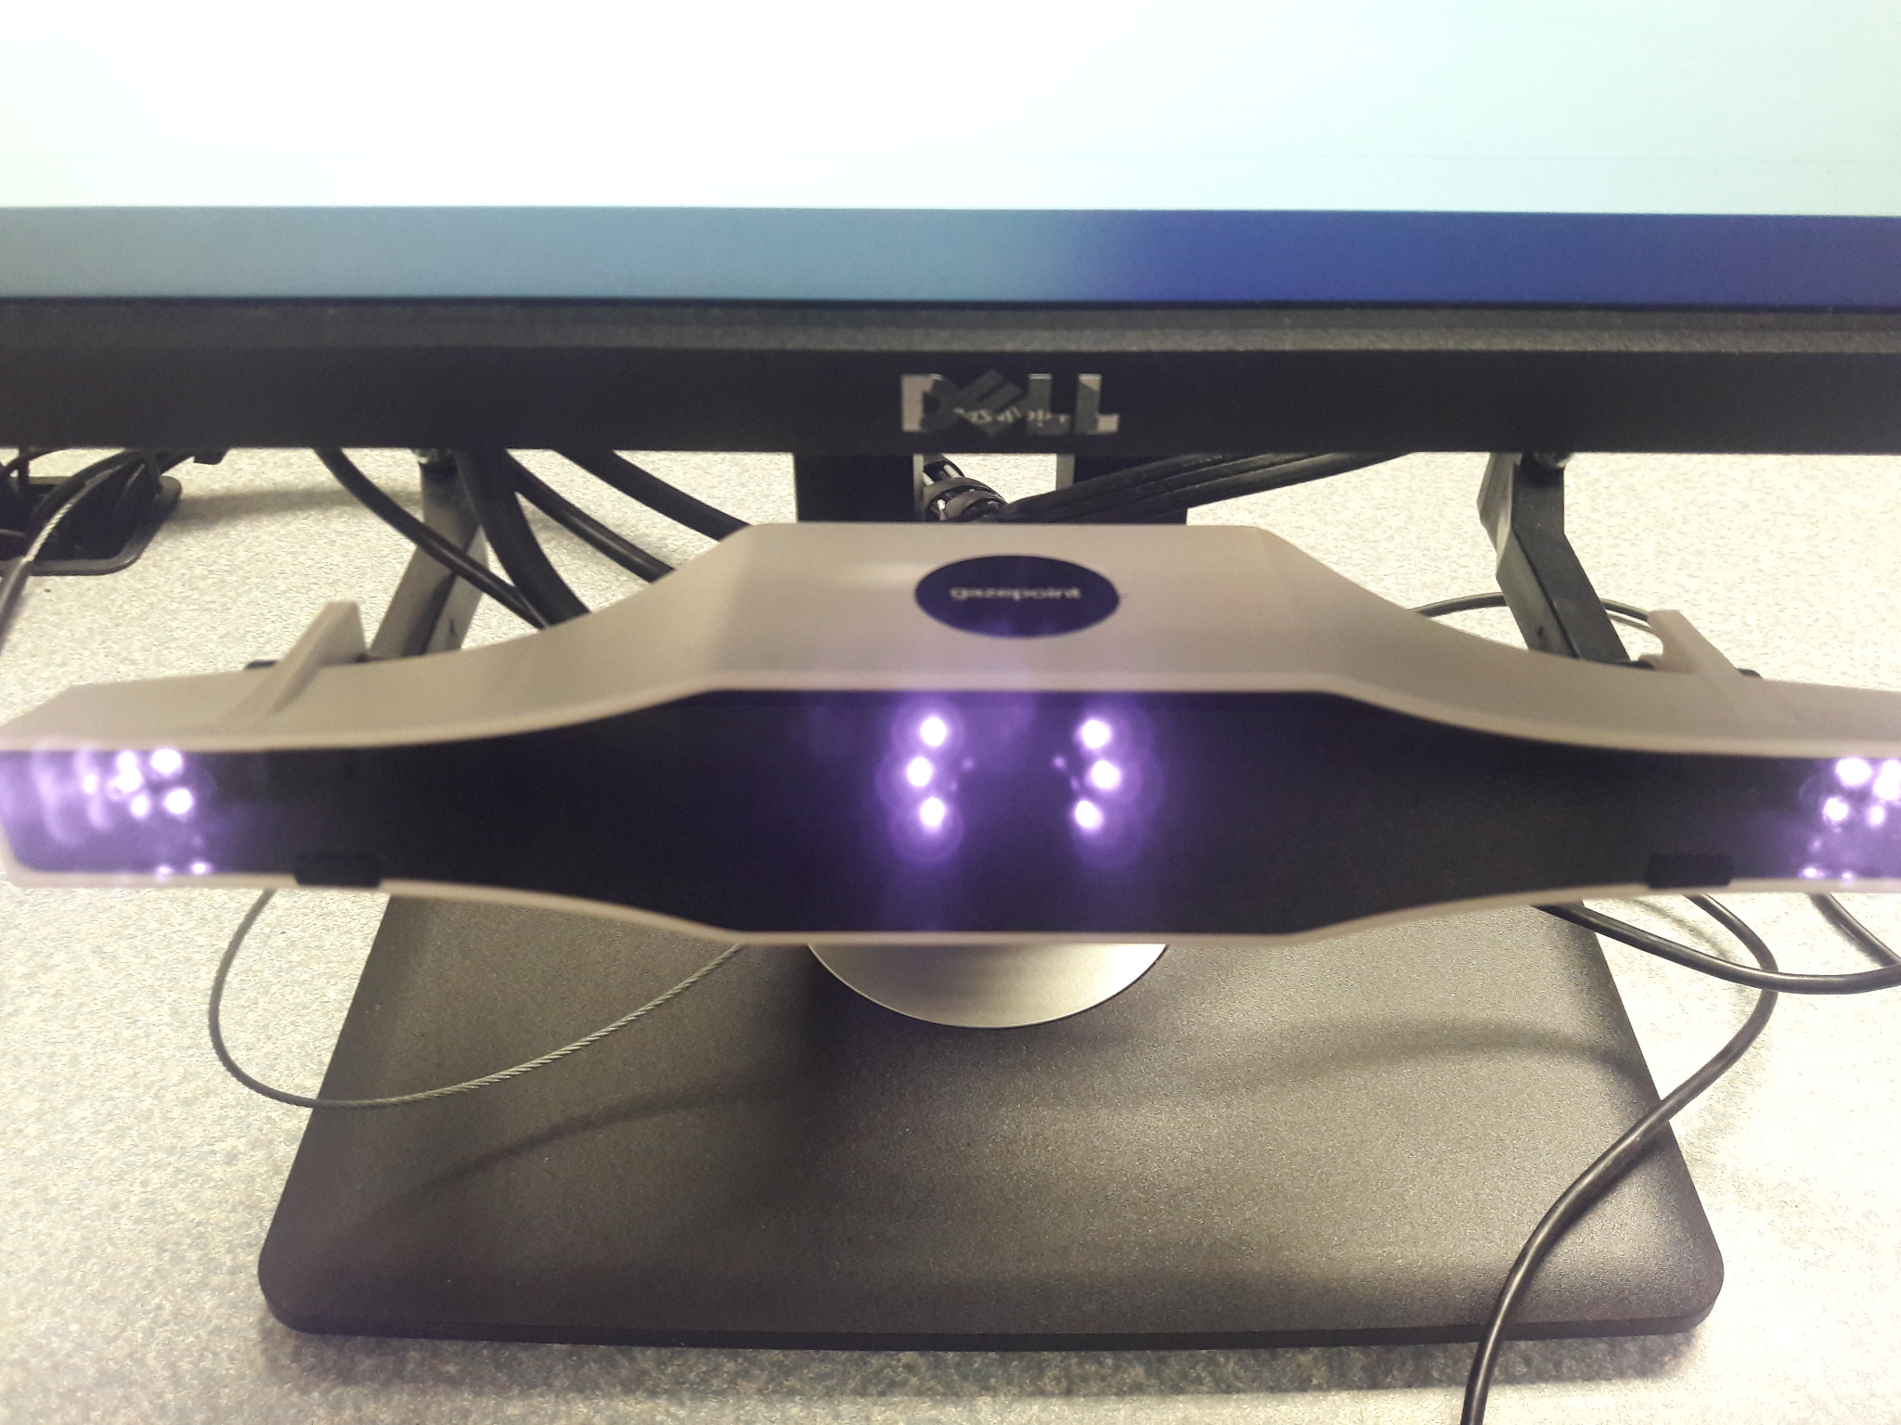
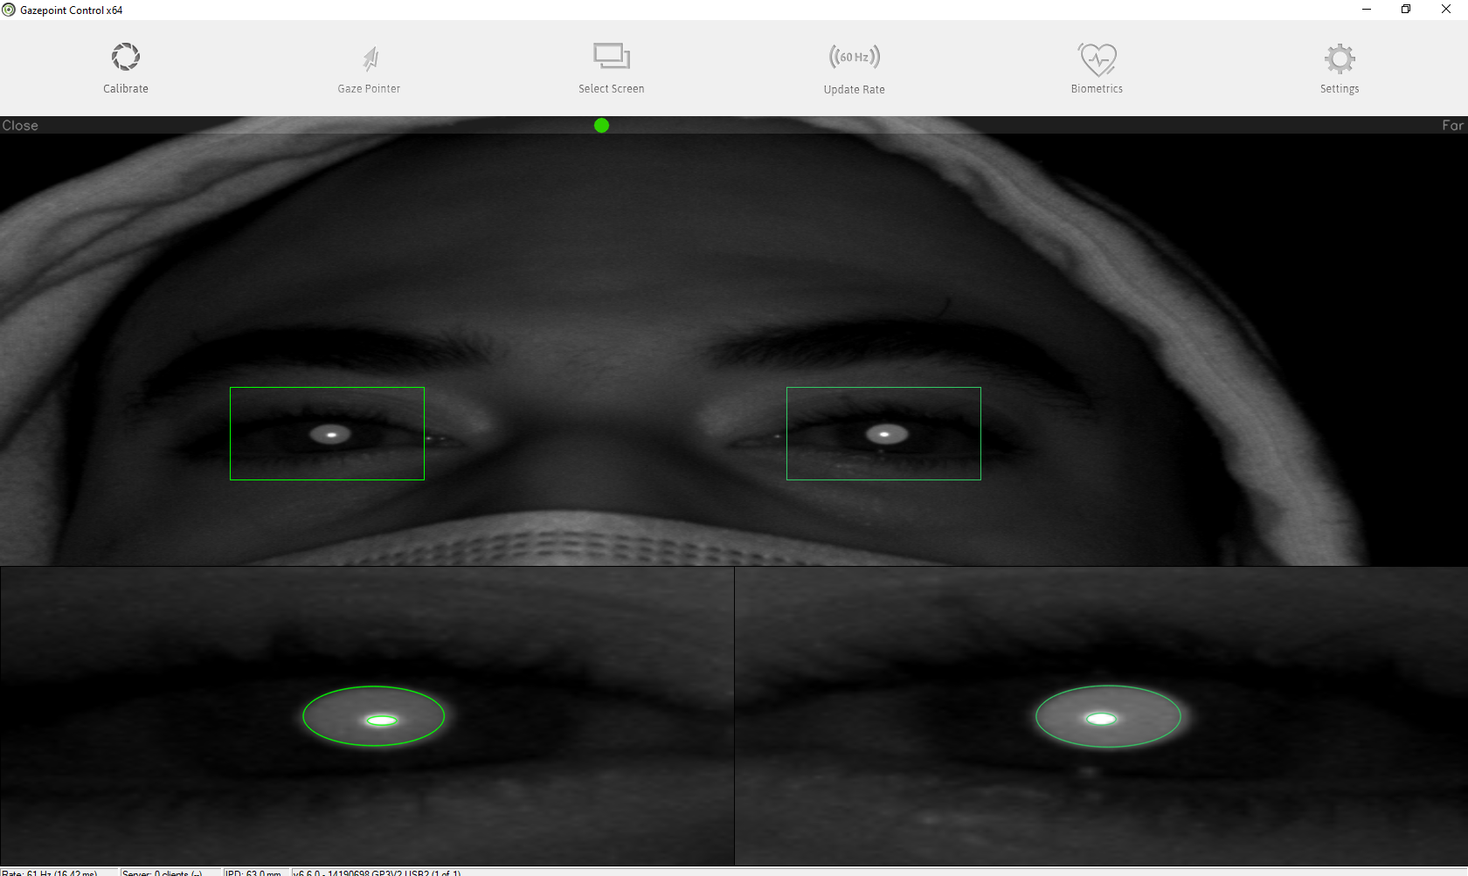
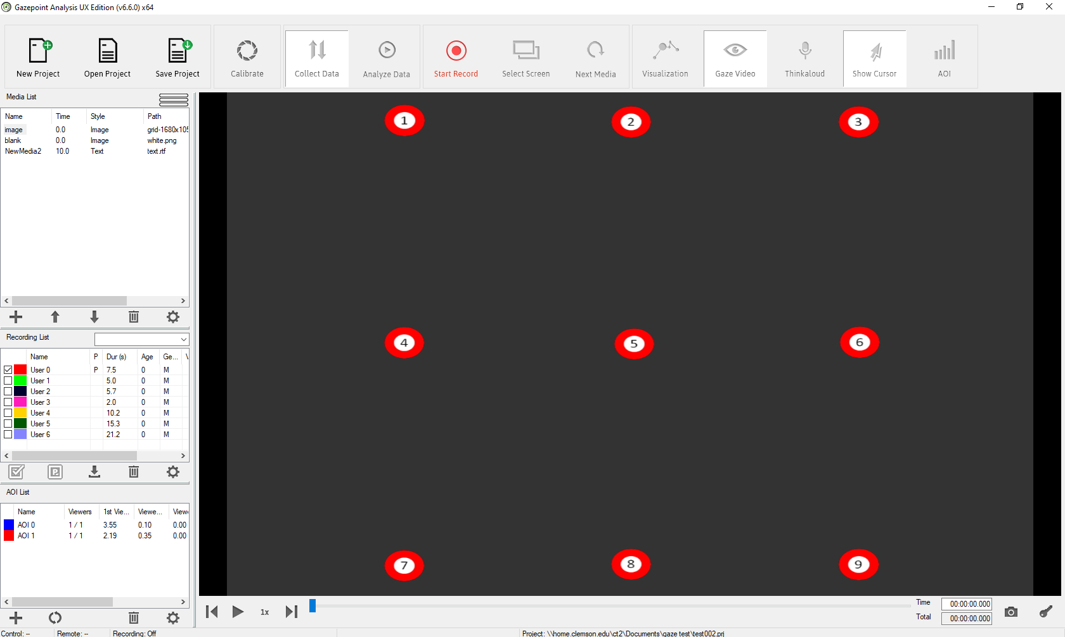
Tools
Dell desktop monitor and computer
Gazepoint GP3 Eye tracking hardware
Gazepoint Control
Gazepoint Analysis

Slide 5
Method
A within subjects experiment
List of items to search for on a Toys“R”Us shelf.
Items were shuffled so no two shelves looked similar
Order of shelves were different for each participant
No time limit
Key items intentionally placed on certain sections of each shelf
Difference between central and corner items

Slide 6
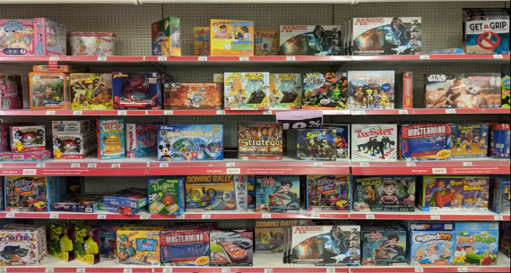

Slide 8
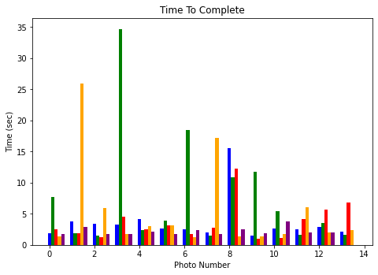
Results
Participants on average took slightly longer to locate items in the corners compared to the center of the shelf
From graph
each color is a different participant
Some outliers where participants took really long to locate items in both scenarios
Central items by photo number are: 0, 2, 9, 12
Far Corner items were: 3, 5, 7, 8, 10
The remainder were mixed on each shelf but neither central or the extreme corners
Would usually search central areas initially

Slide 9
Limitations
Too few participants
Static photo, may be more suited to VR scenarios

Slide 10
End

