Slide 1
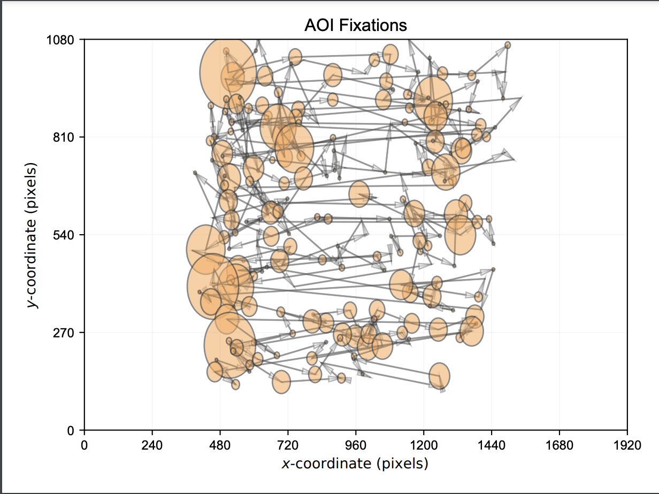
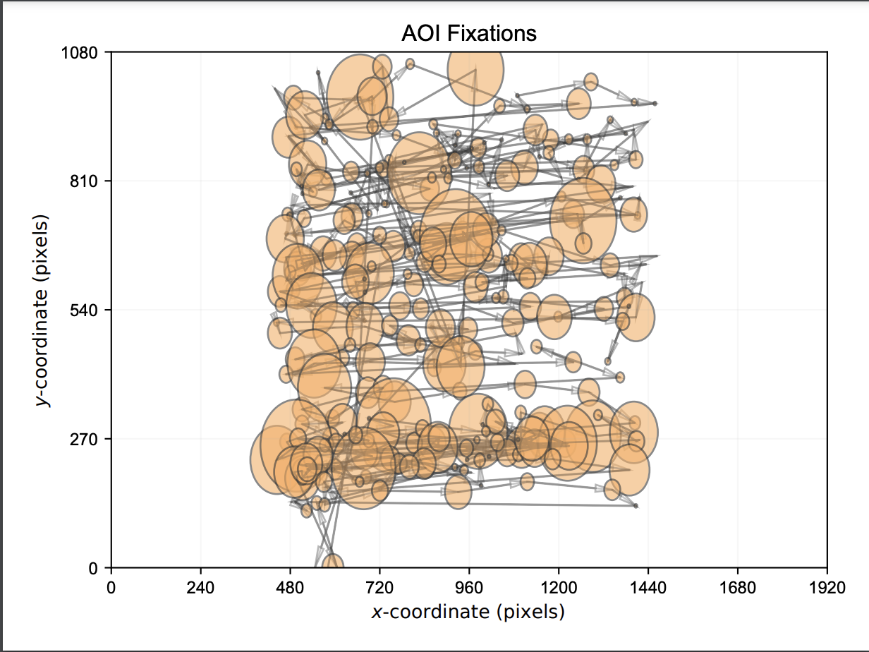
Evaluating
A Speed Reading
Technique using Eye Tracking
Vishwajeet Ransing
Brendan McGuire
Tara Morris

Slide 2
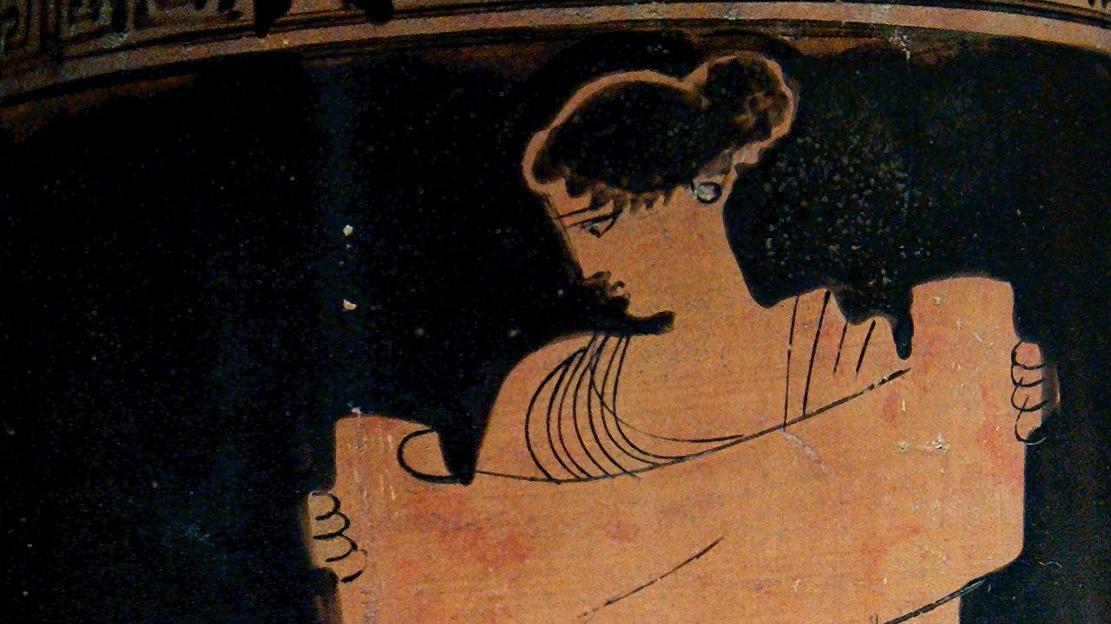
Overview
The research in developing techniques and methodologies to improve reading speed by an order of magnitude without loss of comprehension is important.
Skimming and Scanning is a helpful technique.
In this study, participants read specific passages on a computer screen, and using eye tracking technology, we were able to determine if the participants engaged in speed reading.
Notes:
Tara – Take from abstract

Slide 3
Introduction & Background
Reading speed
Reading at a higher speed may come with some disadvantages such as poor comprehension. (Rayner et al., 2016)
Less than significant difference between comprehension scores of expert speed readers and novice readers. (Miyata et al., 2012)
Comprehension score may go up when speed reading technique is introduced to a novice, but it drops down as the difficulty level of the passage increases. (Rayner et al., 2016)
Positive correlation between reading speed and comprehension when adults start to learn a new language. (Landi, 2010)
Fixations when reading (Tran, 2012)
Readers tend to fixate from word to word and linger on each fixation in normal reading.
Notes:
Vish Speed reading is a technique that increases a reader’s reading speed.
Despite these concerns regarding comprehension, speed reading can be extremely beneficial compared to slow reading in certain scenarios.
This style of reading is labor-intensive and frustrating. Many readers may benefit from using speed reading techniques to make the reading process more engaging and interesting.

Slide 4
Introduction & Background
Techniques
Skimming & scanning- Readers usually search for indicators of main idea (names, facts, ideas) (Masson, 1983)
Reading with text of fixed length and lexicon and reading within vocabulary (Macalister, 2010)
Eye tracking (Jacob & Karn, 2003)
Fixation durations useful in assessing difficulty in reading. (Jacob & Karn, 2003)
Number of fixations useful to understand importance of the passage or a section of the passage. (Jacob & Karn, 2003)
Coefficient K can help us understand the visual information processing in reading task. (Krejtz et al., 2016)
Focal processing (Positive K)
Ambient processing (Negative K)
Notes:
Vish Serial search and parallel search
Serial - longer fixations followed by shorter saccades
Parallel- shorter fixations are followed by longer saccade

Slide 5
Method
Assumptions:
All participants can read beyond a 5th grade level, and are proficient in basic computer operation
We will be able to spot a difference in eye movements between participants normally reading and engaging in speed reading techniques.
Hypothesis: In participants utilizing speed reading will see an increase in reading speed and comprehension, a reduction in number of fixations and fixation duration, and an increase in number of saccades.
Design:
Within-subjects experimental design with 2 levels (normal reading task vs speed reading task)
How to ensure no loss of comprehension? (Rayner, 2016)
Old Metric: WPM * Percentage Score
Sample:
N= 13 (F=4, M=8, O=1; Mean Age = 22.77, SD = 2.8)
Equipment:
23.8” Desktop Monitor with Keyboard and mouse
Desktop mounted eye tracker- Gazepoint GP3 (60 Hz; 0.5-1 deg. accuracy)
Notes:
Bren

Slide 6
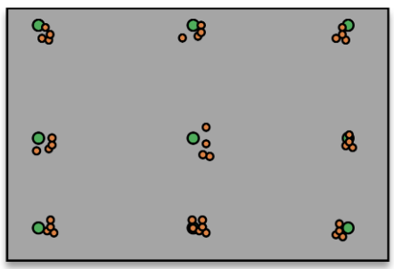
Procedure
Participant completed demographic survey (gender, age, SAT Score, visual impairments)
Seated at computer, calibrated eye tracker
Read passage 1 (normal reading) and complete questionnaire
Received training about eye tracking techniques
Re-calibrated eye tracker
Read passage 2 (speed reading) and complete questionnaire
Notes:
Bren

Slide 7
Training Module
Many Eye Tracking Techniques, we tested skimming and scanning (see video
Training Module:
Participants were given a descriptions on
scanning and shown a video
demonstration of the speed
Reading technique (see right)
Notes:
Tara

Slide 8
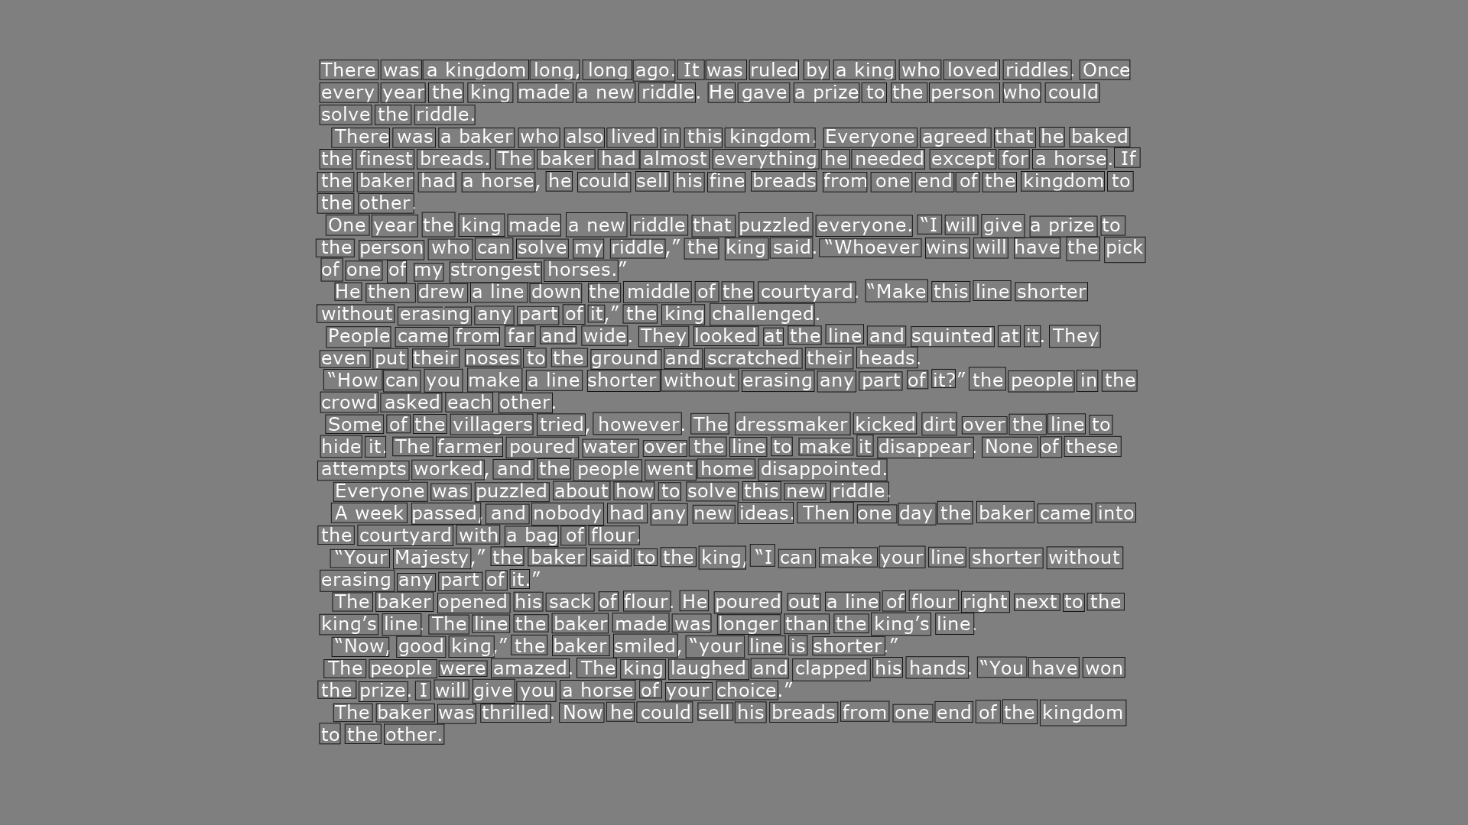
Reading Tasks
Presented elementary-level (grades 3-5) passages from SOLPASS, a standardized test
Participants were asked to read two passages (~400 words)
Answered associated questions for that passage (multiple choice, 4 options)
Example: At the beginning of the story, Marcus thinks he will win the race because he —
Is fast
Has the best bike
Has been in a race before
Rides his bike every day
Notes:
Tara

Slide 9
Note: Data analyzed as between-subjects design due to data corruption of Passage 2 eye tracking metrics
RESULTS & Discussion
Notes:
Bren

Slide 10
Scanpaths
AOIs were created for each word for both passages
We can see a difference in the scanpaths between a participant speed reading and a participant reading normally.
Speed Reading
Untrained/Normal Reading
Notes:
Bren

Slide 11
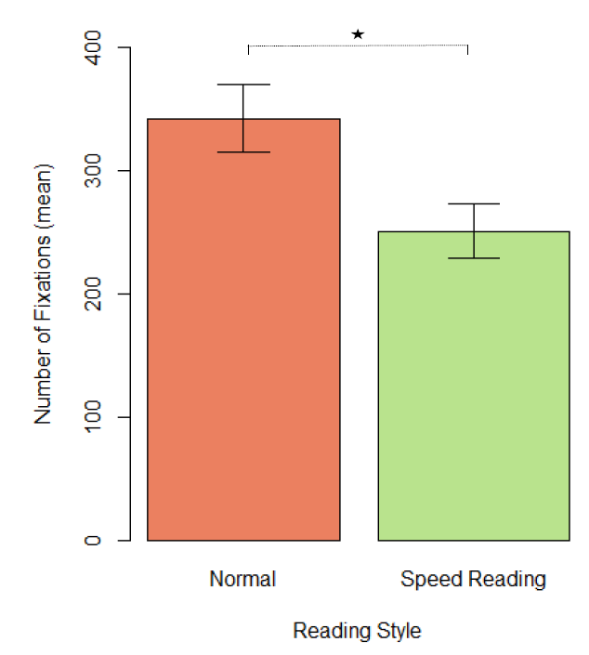
Eye Tracking Metrics
Number of Fixations
Statistically significant decrease in mean number of fixations for participants when speed reading.
Suggests that participants were able to understand the technique through the training module.
The training intervention seems to be effective.
(𝑝 = 0.0254)
Notes:
Vish

Slide 12
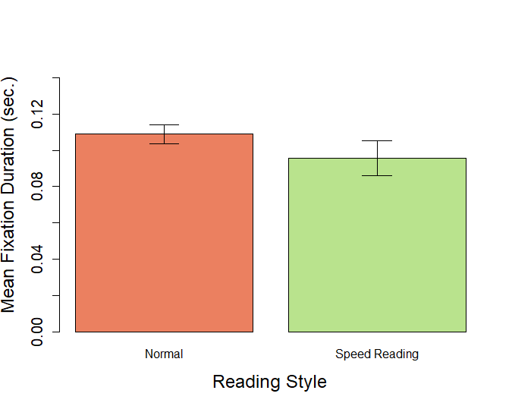
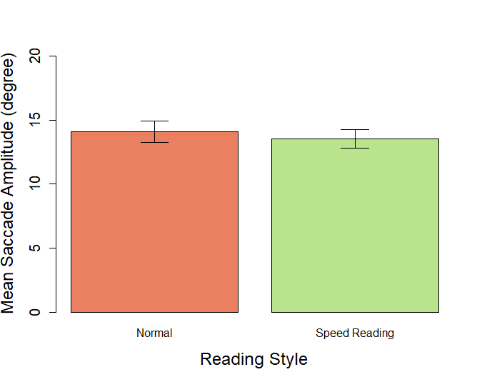
Eye Tracking Metrics
Mean Fixation Duration
No significant effect of speed reading technique / training on reading fixation duration.
Mean fixation duration is shorter during a speed reading task.
(𝑝 = 0.3193)
Mean Saccade Amplitude
No significant effect of speed reading technique / training on saccade amplitude.
May be due to consistent eye movement without re-reading during a speed reading task.
(𝑝 = 0.6377)
Notes:
VIsh
Still need to find if the insignificant effect is due to training or speed reading

Slide 13
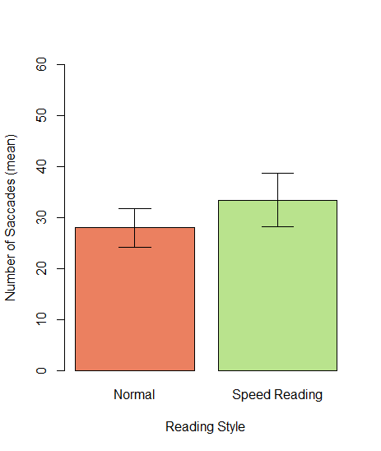
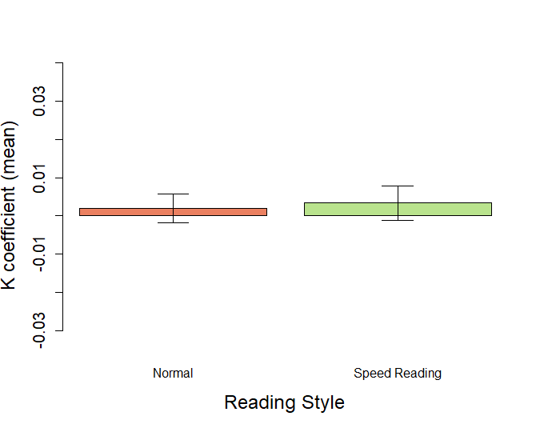
Eye Tracking Metrics
Number of Saccades
No significant effect of speed reading technique / training on number of saccades.
Mean number of saccades higher in a speed reading task. Participants were able to replicate the speed reading technique.
Mean K coefficient
No significant effect of speed reading technique / training on K coefficient.
Scanning used to scan and extract important information quickly in speed reading-
Saccade amplitude to find important information (Shorter saccades)
Fixation duration to focus on that.
Standard error high.
(𝑝 = 0.41)
(𝑝 = 0.83)
Notes:
Vish Still need to find if the insignificant effect is due to training or speed reading

Slide 14
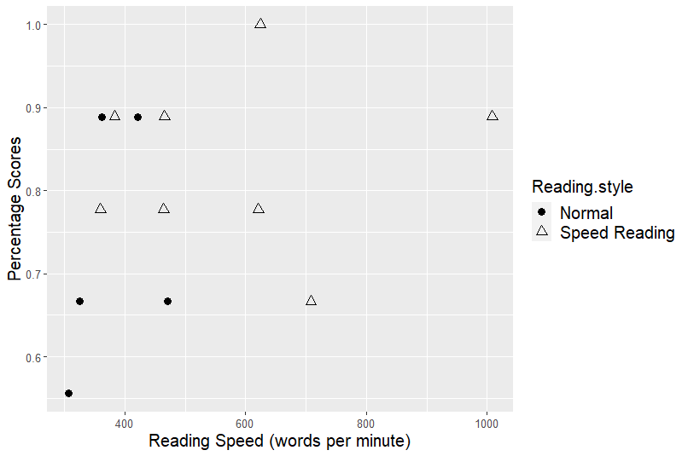
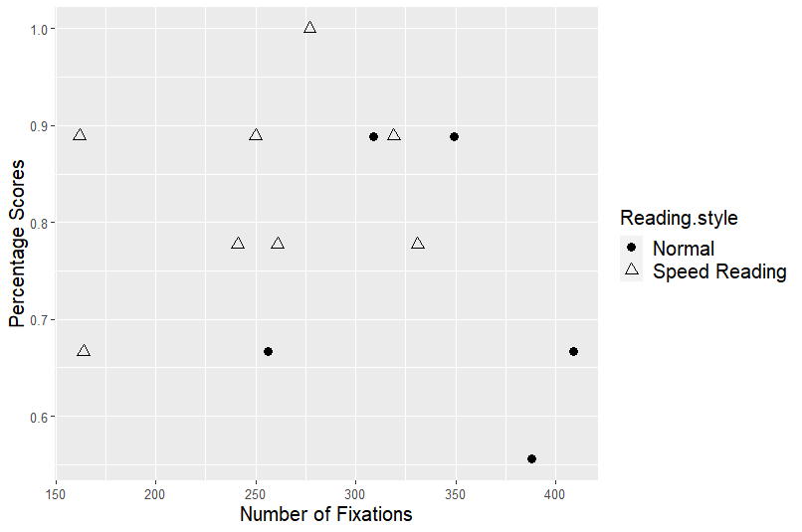
Comprehension Scores
Comprehension questions showed low correlation with
We need to develop better testing paradigms (for example: true or false questions; brief description questions; matching answers)
Reading speed (𝑟 = 0.29; 𝑝 = 0.34) | Number of fixations (𝑟 = −0.23; 𝑝 = 0.46)
Saccade amplitude (𝑟 = 0.11; 𝑝 = 0.72) | Fixation Duration (𝑟 = −0.26; 𝑝 = 0.39)
Notes:
Vish

Slide 15
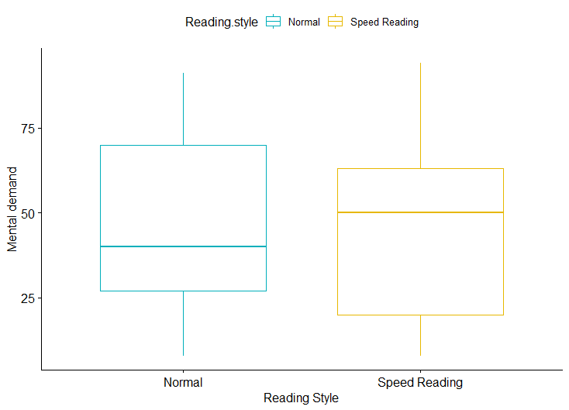
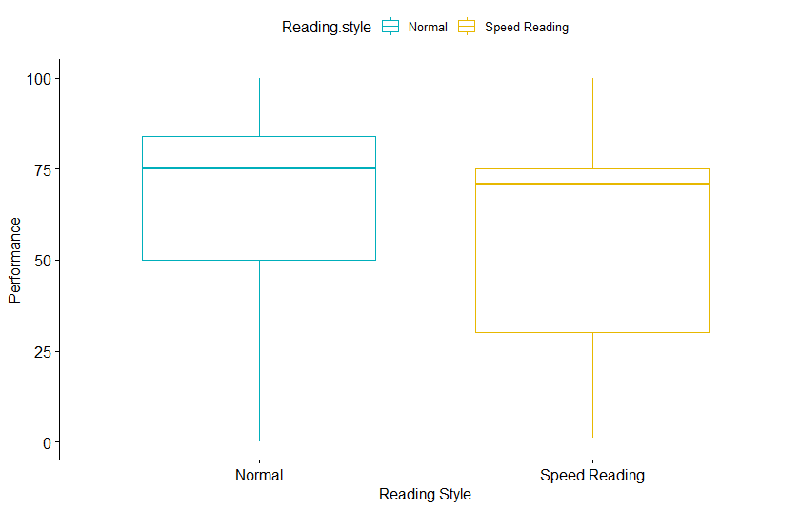
NASA Task Load Index
Perceived Mental Demand
No significant difference (𝑡 (12) = −0.103; 𝑝 = 0.919)
Suggests that participants felt their speed reading task was efficient although mental demand is slightly higher
Perceived Performance
No significant difference (𝑡 (12) = 0.914;
𝑝 = 0.378)
Perceived performance slightly higher in normal reading suggesting better satisfaction with comprehending the passage
Notes:
Visb

Slide 16
Conclusion & Future Work
Participants understood the technique and the simple training intervention was effective.
Lack of significant difference in terms of multiple eye tracking metrics.
Helpful insights provided by coefficient K analysis. Develop better experimental tasks.
Further research to identify the best pedagogical techniques for training speed reading techniques.
Utilize more precise eye tracking technology to make the text size more readable for participants.
Understand the role of satisfaction/Perceived Performance on comprehension scores while reading.
Repeat the experiment with within-subjects design.
Notes:
Bren & Vish & Tara

Slide 17
Reference
Rayner, K., Schotter, E. R., Masson, M. E. J., Potter, M. C., & Treiman, R. (2016). So Much to Read, So Little Time: How Do We Read, and Can Speed Reading Help? Psychological Science in the Public Interest, 17(1), 4–34. https://doi.org/10.1177/1529100615623267
Miyata, H., Minagawa-Kawai, Y., Watanabe, S., Sasaki, T., & Ueda, K. (2012). Reading Speed, Comprehension and Eye Movements While Reading Japanese Novels: Evidence from Untrained Readers and Cases of Speed-Reading Trainees. PLoS ONE, 7(5), e36091. https://doi.org/10.1371/journal.pone.0036091
Tran, Y. (2012). The Effects of a Speed Reading Course and Speed Transfer to Other Types of Texts. RELC Journal, 43, 23–37. https://doi.org/10.1177/0033688212439996
Landi, N. (2010). An examination of the relationship between reading comprehension, higher-level and lower-level reading sub-skills in adults. Reading and Writing, 23(6), 701–717. https://doi.org/10.1007/s11145-009-9180-z
Macalister, J. (2010). Speed reading courses and their effect on reading authentic texts: A preliminary investigation. Reading in a Foreign Language, 22.
Krejtz, K., Duchowski, A., Krejtz, I., Szarkowska, A., & Kopacz, A. (2016). Discerning Ambient/Focal Attention with Coefficient K. ACM Transactions on Applied Perception, 13(3), 1–20. https://doi.org/10.1145/2896452

Slide 18
THANK YOU

