Slide 1
Team 2: Effect of Mood on Food Choice
Nathan Kilcoyne, Patrick Smathers, & Anthony Alvarado
Notes:
Patrick: Hello everyone! Thanks for being here.
Our team’s experiment focused on the effect of mood on food choice, and whether or not it could be measured by gaze.

Slide 2
Team 2: Effect of Mood on Food Choice
Nathan Kilcoyne Researcher
Packaging Science Major, Computer Science Minor
Patrick Smathers Researcher
Computer Science Major
Anthony Alvarado Researcher
Psychology Major
Notes:
<Introductions>

Slide 3
Outline of Presentation
Summary
Objectives
Background
Experimental Design
Participants
Procedure
Apparatus
Results
Limitations & Future Work
Discussion & Conclusion
Notes:
Patrick: In this presentation, we are going to give a quick summary of our experiment, talk to you about our objectives, and describe some of the background research from relating studies. Then we’ll talk about our experimental design, including the participants we targeted, our procedure, and the apparatuses qw used. After that, we’ll get into our results, limitations & future work, before wrapping it up with our discussion and conclusion.

Slide 4
Summary
1
Notes:
Nathan: So let’s talk about an overview of our experiment

Slide 5
VISUAL SUMMARY
Figure 1. Visual Summary of Experiment
Notes:
Nathan: We were focused on using surveys and eye tracking data to correlate mood to food related shopping decisions.

Slide 6
Summary
Mood day-to-day
Stressors
Decision making - food choices
Using eye-tracking to evaluate
Fixation-based
Mood comparisons
Notes:
Nathan: One’s mood deviates from day to day, and different stressors can cause one to have a positive or negative mood. While one’s mood can help determine various decisions in one’s life, it also can determine which foods are more interesting to eat. Using eye-tracking techniques and methodology, we explore what type of foods people tend to fixate on and compare that to a positive or negative mood.

Slide 7
Objectives
2
Notes:
Patrick: Now let’s talk about what we had hoped to accomplish with our research

Slide 8
Objectives
Customer’s mood vs. Food choice when grocery shopping
Correlation between mood & gaze?
Hypothesis: “Users with lower mood levels will choose unhealthy food options, and users with higher mood levels will choose healthy food options.”
Notes:
Patrick: In our research, we wanted to find whether or not there was a correlation between mood and gaze when grocery shopping
We hypothesized that Users with lower mood levels will choose unhealthy options, and users with higher mood levels will choose healthy food options. And we should be able to see this trend from their gaze patterns

Slide 9
Background Research
3
Notes:
Anthony: Now, let’s take a step back and look at some of the related research that has already been done

Slide 10
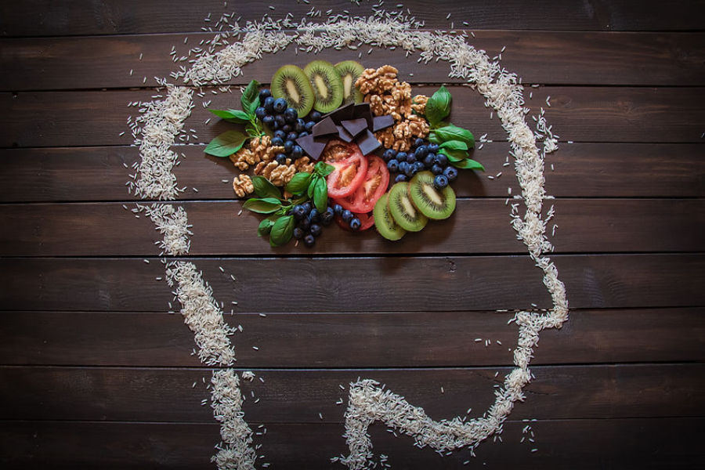
Background
A lower mood tends to gravitate more towards unhealthy food options. Gardner et al. 2014
Users with higher mood levels tended to choose healthier food options. Gardner et al. 2014
There is a link between visual attention and emotion. Schupp et al. 2007
Figure 2: Food Decision Image
Notes:
Anthony: Research has suggested that people with lower moods do indeed tend to go for unhealthier food options while a positive mood can cause a preference for healthier food options. This can be linked to mood management based on the effect on temporal construal. {Temporal Construal Theory: a model stating that people rely on largely abstract representations (high-level construals) of future situations when making decisions for the distant future but on more concrete representations (low-level construals) when making decisions for the near future.}####### 2. Schupp et al. investigated the the relationship between visual attention and emotion. They found that it was linked to survival, reproduction, and procreation. Figure 1: stevegranthealth.com

Slide 11
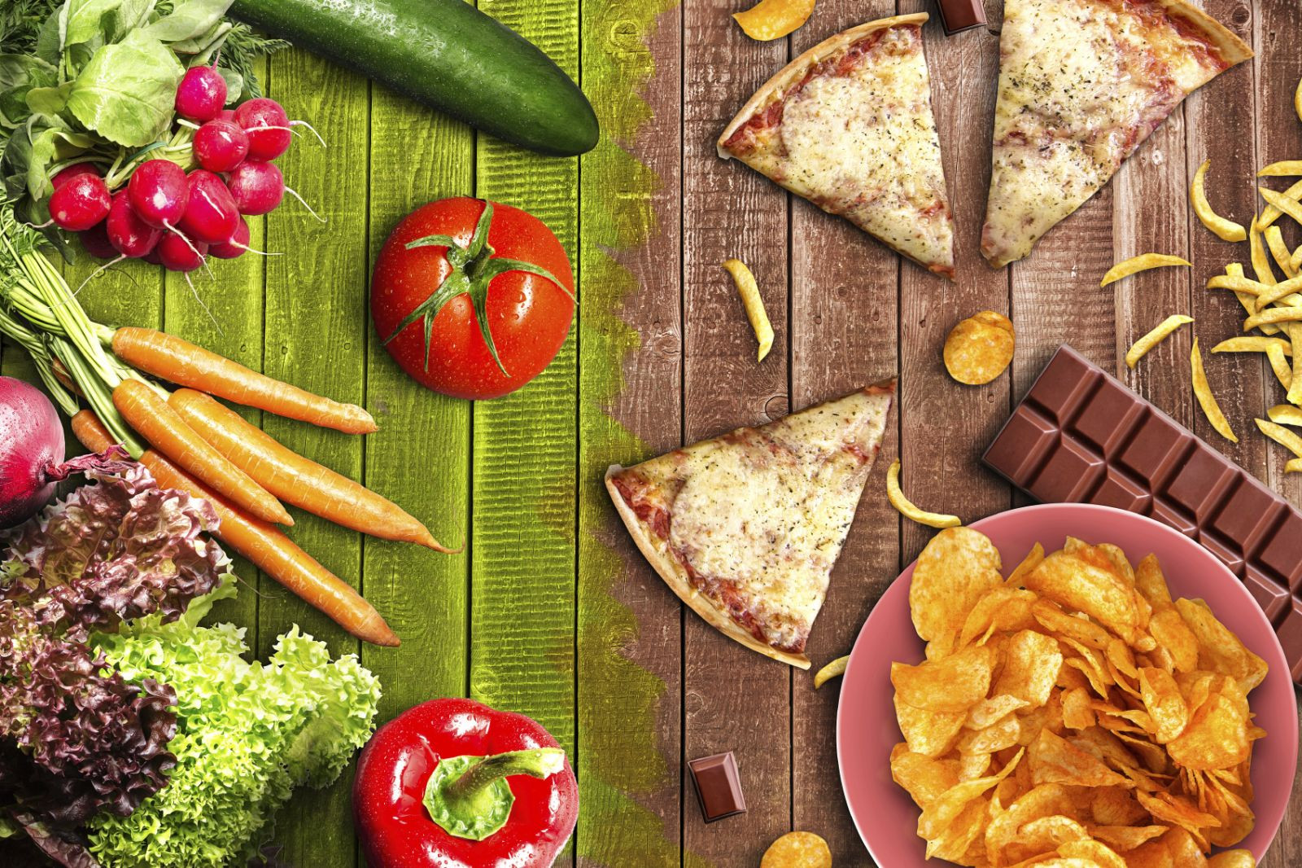
Background
Stress can lead to more unhealthy food choices. Bartkiene et al. 2019
Many parts of the brain work together in order to drive visual attention Evans et al. 2011
Mood can elicit a response that focuses more on rewarding stimuli Tamir and Robinson 2007
Figure 3: Examples of Food
Notes:
Anthony: 1.Literature suggests that stress-related eating has a direct relationship with negative mood states. 2.Visual attention involves multiple parts of the brain in order to drive the visual attention, this can include physical and cognitive traits. 3.The brain will drive behavior that is more rewarding and based on the literature this could tie in with a negative or positive mood. If in a negative mood you might seek out something “rewarding” such as an unhealthy food option. Figure 2: iStock

Slide 12
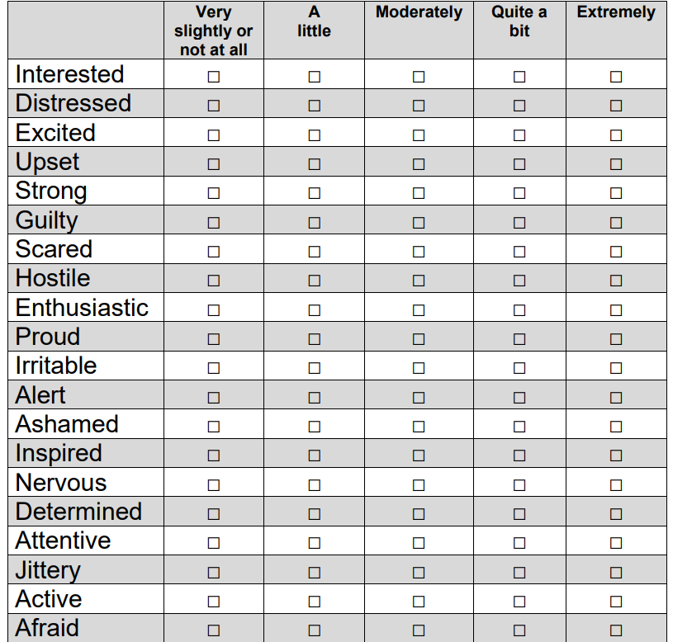
PANAS
Stands for Positive and Negative Affect Schedule
A scale that consists of different words that describe feeling and emotion Magyar-Moe 2009
Has been found to be a reliable and valid tool to assess positive and negative affect Merz et al., 2013
Figure 4: PANAS Form
Notes:
Anthony: We wanted to find an effective and reliable way to measure a participants mood without taking too much time. Affect refers to emotions and expressions. Has been shown to be reliable in different settings and used in clinical environments.

Slide 13
Experimental Design
4
Participants, Procedure, and Apparatus
Notes:
Patrick: Now lets talk about our experiment design, including the participants we targeted, our procedure, and apparatus

Slide 14
Experimental Design Overview
2 x 3 within subjects experimental design
2: (negative and positive affect)
3: (healthy, unhealthy food, and neutral stimuli)
Food products with logos/brands removed removed
Reduce bias
Notes:
Patrick: Our experiment was a 2x3 within subjects experiment. Our independent variables were the negative and positive affect, and our dependent variables were the healthy and unhealthy foods, as well as a neutral stimuli. Any logos or branding of products were removed in an effort to reduce bias within participants.
For healthy and unhealthy food, we chose items that were objectively healthy and unhealthy, such as fruit for healthy and candy bar for unhealthy. The neutral stimuli was used to be sure that people were looking at the food choices and not just focusing on one spot, and further validates our data if they do not fixate much on the neutral stimuli.

Slide 15
Participants
Total of 18 participants
Age range: 18-30 years old
No incentive
Anonymous
Notes:
Patrick: For our participant pool, we targeted individuals between the ages of 18-30 years old and we were able to run the experiment with 18 participants. Most of these participants are college students here at Clemson.
There was no incentive for participation in the experiment and they received no reward. Their identities are anonymous and we assigned them a participant ID for data collection and handling.

Slide 16
Procedure Outline
Pre-Experiment Surveys
Experimentation
Post-Experiment Survey
Notes:
Patrick: Each trial started with the pre-experiment surveys gathering their participant number, age range, gender identity, and the type of corrective lenses, if they wear them. Along with the pre-experiment survey, participants were instructed to fill out the PANAS schedule.
Then we moved into the experimentation phase which included calibration procedures and the experiment itself.
Then we ended the trial by having the participant fill out the post-experiment survey to learn about what appealed to them, what food item they would choose at the moment, and what influences their decision when purchasing food.

Slide 17
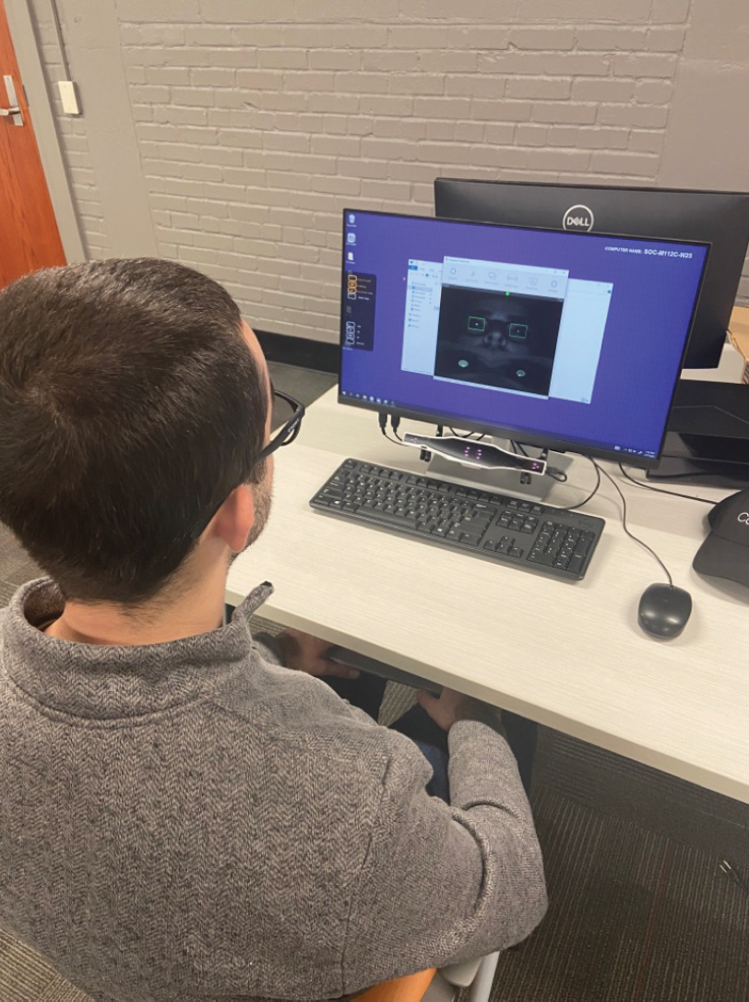
Procedure
Setup
Pre-Experiment Surveys
Basic Survey
PANAS Mood Assessment
Calibration
Gazepoint Control
Figure 5: Subject sitting in-front of computer with Gazepoint Control running.
Notes:
Patrick: At the beginning of the experiment, we will have the computer set up with GazePoint Control and PsychoPy when the participant sits down. We then instructed the participant to complete the pre-experiment survey and to give their consent to participate in the experiment. After the survey, we instructed them to fill out the PANAS mood assessment.
Once the pre-experiment surveys are completed, we begin the calibration procedure using GazePoint control to ensure that they are seated a proper distance away from the eye tracker.

Slide 18
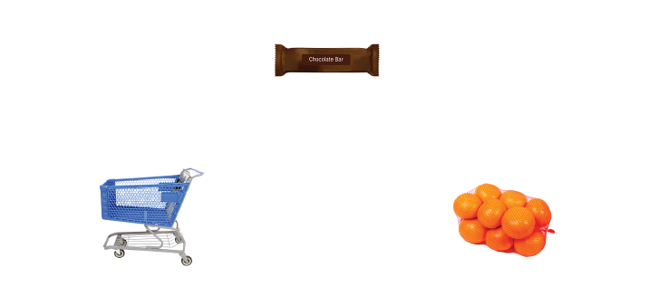
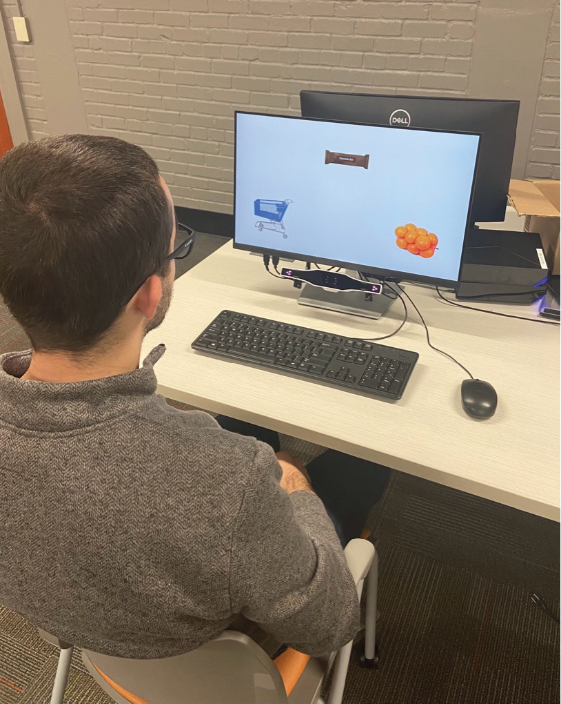
Procedure
4. Conduct Experiment
Launch Experiment in PsychoPy
User completes second calibration in PsychoPy
Experiment begins: User instructed to look at items that are most interesting to them.
Figure 6: Example screen layout
Figure 7: Subject sitting in front of computer with experiment running.
Notes:
Patrick: After the calibration in GazePoint Control, we then launched the PsychoPy experiment which walked the user through a five-point calibration procedure and displayed the average error at the end. Once the error is at an acceptable rate, the user continues on with the experiment and is instructed to read the instructions before continuing.
The user will look at 12 sets of images, with each set having 1 healthy item, 1 unhealthy item, and 1 distraction item, each for 5 seconds

Slide 19
Procedure
Post-Experiment Survey
User prompted at the end to fill out the survey
Notes:
Patrick: After the PsychoPy experiment, the participants were instructed to complete the post-experiment survey before the trial was over.

Slide 20
Apparatus
GazePoint GP3 Eye Tracker
Figure 5: Subject sitting in-front of computer with Gazepoint Control running.
Notes:
Patrick: In this experiment, we used a GazePoint GP3 eye tracker

Slide 21
Apparatus
GazePoint GP3 Eye Tracker
60 hz eye tracker using video based Pupil Center Corneal Reflection (PCCR)
Figure 5: Subject sitting in-front of computer with Gazepoint Control running.
Notes:
Patrick: Which has a 60hz sampling rate and uses video based Pupil Center Corneal Reflection, or (PCCR)

Slide 22
Apparatus
GazePoint GP3 Eye Tracker
60 hz eye tracker using video based Pupil Corneal Reflection (PCR)
1º of Accuracy
Figure 5: Subject sitting in-front of computer with Gazepoint Control running.
Notes:
Patrick: It has 1º of accuracy

Slide 23
Apparatus
GazePoint GP3 Eye Tracker
60 hz eye tracker using video based Pupil Corneal Reflection (PCR)
1º of Accuracy
Mounted below the monitor
Figure 5: Subject sitting in-front of computer with Gazepoint Control running.
Notes:
Patrick: And is mounted below the monitor

Slide 24
Apparatus
Dell monitor
Figure 5: Subject sitting in-front of computer with Gazepoint Control running.
Notes:
Patrick: The displays used in the experiment are Dell monitors

Slide 25
Apparatus
Dell monitor
1920 x 1080 resolution
Figure 5: Subject sitting in-front of computer with Gazepoint Control running.
Notes:
Patrick: That have a 1920 x 1080 resolution

Slide 26
Apparatus
Dell monitor
1920 x 1080 resolution
Diagonal screen size of 60 cm
Figure 5: Subject sitting in-front of computer with Gazepoint Control running.
Notes:
Patrick: And a diagonal screen size of 60cm

Slide 27
Apparatus
Dell monitor
1920 x 1080 resolution
Diagonal screen size of 60 cm
Alienware Desktop with Windows 10
Figure 5: Subject sitting in-front of computer with Gazepoint Control running.
Notes:
Patrick: These monitors are connected to Alienware Desktops using Windows 10

Slide 28
Apparatus
Dell monitor
1920 x 1080 resolution
Diagonal screen size of 60 cm
Alienware Desktop with Windows 10
Running PsychoPy and GazePoint Control softwares specifically
Figure 5: Subject sitting in-front of computer with Gazepoint Control running.
Notes:
Patrick: and are running PsychoPy and GazePoint Control to communicate with and use the GP3 eyetracker.

Slide 29
Apparatus
Dell monitor
1920 x 1080 resolution
Diagonal screen size of 60 cm
Alienware Desktop with Windows 10
Running PsychoPy and GazePoint Control softwares specifically
Table with 2 chairs
Figure 5: Subject sitting in-front of computer with Gazepoint Control running.
Notes:
Patrick: And of course, the desktop, monitor, and eyetracker are on a table and there are two chairs, one for the participant and one for the researcher.

Slide 30
Results
5
Notes:
Nathan: Now, we’ll talk about our results and findings from the study

Slide 31
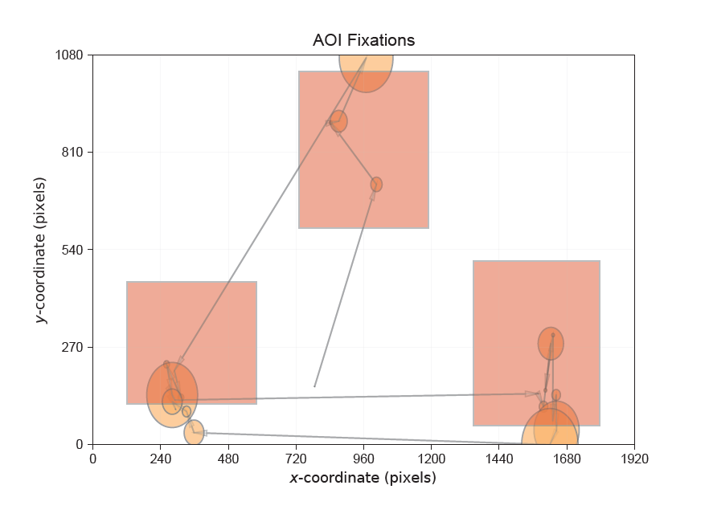
Results
Eye Tracking Data - Inconclusive
Resorted to PANAS Assessment and Post Experiment Survey
Figure 8: Example of a participant’s scan-path for one of the stimuli.
Notes:
Nathan: Unfortunately, due to time constraints and logistics with the experiment setup, our eye tracking data is inconclusive as we did not have enough time to do a deep analysis of the eye tracking data, as well as comparing it to AOI selection. For our results, we resorted to using the PANAS assessment and post-experiment survey.

Slide 32
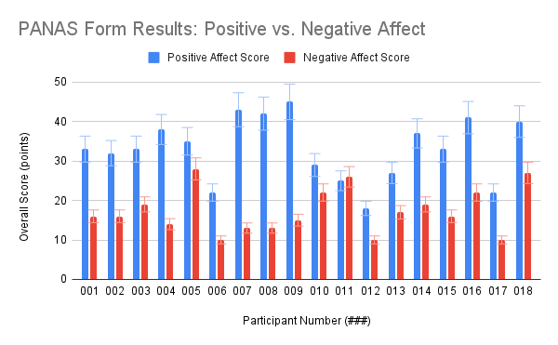
Results
Figure 9: PANAS Form Results: Positive vs. Negative Affect: sum of points for all users moods from the PANAS method before the experiment started.
Notes:
Nathan: Let’s take a look at our PANAS form results. As shown by the graph…

Slide 33
Results
Majority of participants had mostly positive mood (94%)
Figure 9: PANAS Form Results: Positive vs. Negative Affect: sum of points for all users moods from the PANAS method before the experiment started.
Notes:
Nathan: The majority of participants had mostly positive mood…

Slide 34
Results
Majority of participants had mostly positive mood (94%)
Only one participant (011) mostly negative (6%)
Figure 9: PANAS Form Results: Positive vs. Negative Affect: sum of points for all users moods from the PANAS method before the experiment started.
Notes:
Nathan: With just one participant with a mostly negative mood affect,.

Slide 35
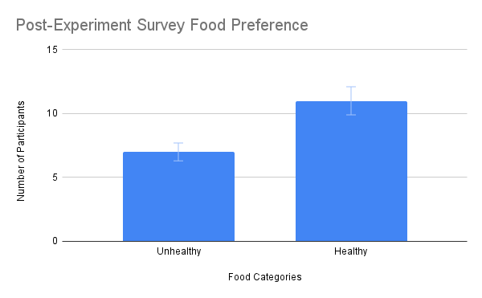
Results
Figure 10: Post-Experiment Survey Food Preference: sum of users who chose unhealthy vs. healthy food choices from a list provided in the Post-Experiment survey.
Notes:
Nathan: Looking at our Post-Experiment survey food preference data, we see that…

Slide 36
Results
7/18 participants (38.89%) said they preferred to eat unhealthy food options after the experiment.
Figure 10: Post-Experiment Survey Food Preference: sum of users who chose unhealthy vs. healthy food choices from a list provided in the Post-Experiment survey.
Notes:
Nathan: 38.89% of participants responded that they preferred to eat unhealthy food options, while…

Slide 37
Results
7/18 participants (38.89%) said they preferred to eat unhealthy food options after the experiment.
11/18 participants (61.11%) said they preferred to eat healthy food options after the experiment.
Figure 10: Post-Experiment Survey Food Preference: sum of users who chose unhealthy vs. healthy food choices from a list provided in the Post-Experiment survey.
Notes:
Nathan: 61.11% of participants said they preferred to eat healthy food options after the experiment.

Slide 38
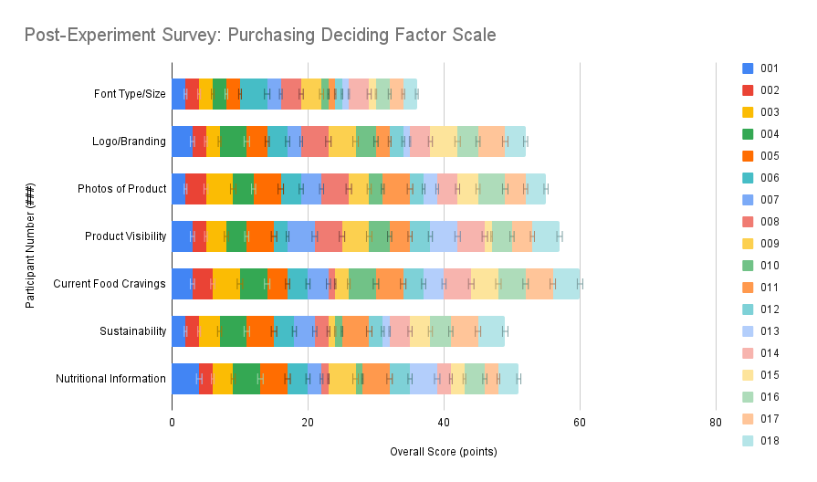
Results
Figure 11: Post-Experiment Survey, Purchasing Deciding Factor Scale: sum of user rankings on scale of 1-4 regarding purchasing deciding
factors based on product packaging.
Notes:
Nathan: In our post-experiment survey, we also asked participants about what factors influence their decision to purchase food items when shopping.

Slide 39
Results
Highest Preference Categories:
Figure 11: Post-Experiment Survey, Purchasing Deciding Factor Scale: sum of user rankings on scale of 1-4 regarding purchasing deciding
factors based on product packaging.
Notes:
Nathan: From the responses, our highest preference categories were..

Slide 40
Results
Highest Preference Categories:
#1 Current Food Cravings
Figure 11: Post-Experiment Survey, Purchasing Deciding Factor Scale: sum of user rankings on scale of 1-4 regarding purchasing deciding
factors based on product packaging.
Notes:
Nathan: Current Food Cravings

Slide 41
Results
Highest Preference Categories:
#1 Current Food Cravings
#2 Product Visibility
Figure 11: Post-Experiment Survey, Purchasing Deciding Factor Scale: sum of user rankings on scale of 1-4 regarding purchasing deciding
factors based on product packaging.
Notes:
Nathan: Product Visibility

Slide 42
Results
Highest Preference Categories:
#1 Current Food Cravings
#2 Product Visibility
#3 Photos of Product
Figure 11: Post-Experiment Survey, Purchasing Deciding Factor Scale: sum of user rankings on scale of 1-4 regarding purchasing deciding
factors based on product packaging.
Notes:
Nathan: Photos of the product

Slide 43
Results
Highest Preference Categories:
#1 Current Food Cravings
#2 Product Visibility
#3 Photos of Product
#4 Logo/Branding
Figure 11: Post-Experiment Survey, Purchasing Deciding Factor Scale: sum of user rankings on scale of 1-4 regarding purchasing deciding
factors based on product packaging.
Notes:
Nathan: Logo and Branding

Slide 44
Results
Highest Preference Categories:
#1 Current Food Cravings
#2 Product Visibility
#3 Photos of Product
#4 Logo/Branding
#5 Nutritional Information
Figure 11: Post-Experiment Survey, Purchasing Deciding Factor Scale: sum of user rankings on scale of 1-4 regarding purchasing deciding
factors based on product packaging.
Notes:
Nathan: And nutritional information

Slide 45
Selected Food Item After Experiment | Mood Level Before Experiment | Hypothesis Supported?
Healthy | Mostly Positive | Yes
Healthy | Mostly Positive | Yes
Unhealthy | Mostly Positive | No
Unhealthy | Mostly Positive | No
Healthy | Mostly Positive | Yes
Unhealthy | Mostly Positive | No
Healthy | Mostly Positive | Yes
Unhealthy | Mostly Positive | No
Unhealthy | Mostly Positive | No
Healthy | Mostly Positive | Yes
Unhealthy | Mostly Negative | Yes
Healthy | Mostly Positive | Yes
Healthy | Mostly Positive | Yes
Healthy | Mostly Positive | Yes
Unhealthy | Mostly Positive | No
Healthy | Mostly Positive | Yes
Healthy | Mostly Positive | Yes
Healthy | Mostly Positive | Yes
Important Note:
Green = hypothesis supported
Red = hypothesis not supported
Figure 12: Cross-Comparison of Survey Data and Hypothesis Determination
Notes:
Nathan: In our hypothesis, we stated that healthy food preferences aligned with users having a mostly positive mood level, whereas unhealthy food preferences aligned with users having a mostly negative mood level. In this chart, we outlined which survey responses supported our hypothesis, denoted in green, and which survey responses did not support our hypothesis, denoted in red.

Slide 46
Selected Food Item After Experiment | Mood Level Before Experiment | Hypothesis Supported?
Healthy | Mostly Positive | Yes
Healthy | Mostly Positive | Yes
Unhealthy | Mostly Positive | No
Unhealthy | Mostly Positive | No
Healthy | Mostly Positive | Yes
Unhealthy | Mostly Positive | No
Healthy | Mostly Positive | Yes
Unhealthy | Mostly Positive | No
Unhealthy | Mostly Positive | No
Healthy | Mostly Positive | Yes
Unhealthy | Mostly Negative | Yes
Healthy | Mostly Positive | Yes
Healthy | Mostly Positive | Yes
Healthy | Mostly Positive | Yes
Unhealthy | Mostly Positive | No
Healthy | Mostly Positive | Yes
Healthy | Mostly Positive | Yes
Healthy | Mostly Positive | Yes
12/18 participants' survey data supported our hypothesis (66.67%)
6/18 participants' survey data did not support our hypothesis (33.33%)
Figure 12: Cross-Comparison of Survey Data and Hypothesis Determination
Notes:
Nathan: After calculations, we found that 66.67% of the survey data supported our hypothesis, while the remaining 33.33% did not.

Slide 47
Limitations & Future Work
6
Notes:
Nathan: Our next section will be regarding limitations of this experiment and future work that can be studied

Slide 48
Limitations & Future Work
Limited number of participants
Future Study: Include more participants
Participants were generally had positive mood
Future Study: Include more participants of negative mood affect, introduce stress
PANAS form was only given before the experiment
Future Study: Make participants complete the PANAS form again at end of experiment
Notes:
Nathan: One of our limitations for this experiment includes the limited number of participants. However, this could be explored more in a future study by including a greater pool of participants in order to gain a better and more accurate understanding of the effect of mood on food cravings. Another limitation regarding the participants is that most had a generally positive mood, which limited our study on participants who had a negative mood effect. This could be expanded upon in future studies by including more participants with a negative mood; and to ensure this would happen within the participants, a stressful task that the user must complete before the experiment could be added.
We also found that since the PANAS form was only provided at the beginning of the experiment, we had no method to evaluate the participants’ moods at the end of the experiment; in the future, we would recommend including a second PANAS form for the participants to complete once the experiment is over.

Slide 49
Limitations & Future Work
Simulated Environment
Future Study: Attempt to create a more natural in-person shopping environment
Timeline for experiment
Notes:
Nathan: Our study examined a simulated environment with the user looking at a digital screen, which doesn’t necessarily emulate the best in-person shopping experience. A future study could provide a more natural in-person shopping environment to emulate a grocery store, for example, instead of just placing images onto the screen.
Lastly, the timeline available to conduct the experiment and analyze results was too short for the amount of time that we needed to properly obtain a quantitative analysis of the eye tracking data. Given more time for debugging and script writing, more analysis of the eye tracking could have been completed.

Slide 50
Discussion & Conclusion
7
Notes:
Anthony: Now, for our last section, let’s talk about our discussion and conclusion

Slide 51
Discussion & Conclusion
One’s mood can be a factor in whether one chooses to purchase healthy or unhealthy food
Gardner et al. [2014].
Purpose of Study: Explore the use of eye tracking to determine whether one can find a significance in mood and food choice
Eye tracking fixation duration and survey analysis
Preference Categories: Healthy, Unhealthy
Notes:
Anthony: In conclusion, we know that one’s mood can be a factor in whether they choose to purchase healthy or unhealthy food, So we tried to explore if there is a significant correlation between the general mood of a person, and their preference for healthy or unhealthy foods. Our intention was to use eye tracking to determine user preference based on the category of items that the user fixated upon most.

Slide 52
Discussion & Conclusion
Eye tracking results came out inconclusive
From survey analysis:
66% of participants' survey data supported our hypothesis
33% of participants' survey data did not support our hypothesis
Results are purely correlational
Leaves groundwork for future studies to build upon
Notes:
Anthony: As discussed before our eye tracking data was inconclusive, but this experiment has laid the groundwork for others to be built off of as we identify areas of improvement. We still found that 66% of participants survey responses supported our hypothesis, while 33% mentioned healthy options appealing to them, but chose an unhealthy option in the post-survey results.

Slide 53
THANK YOU
Any questions?

Slide 54
References
Bartkiene, E., Steibliene, V., Adomaitiene, V., Gražina, J., Cernauskas, D., Lele, V., Klupsaite, D., Zadeike, D., Jarutiene, L., and
Guiné, R. (2019). Factors affecting consumer food preferences: Food taste and depression-based evoked emotional
expressions with the use of face reading technology. BioMed Research International, 2019:1–10.
Evans, K. K., Horowitz, T. S., Howe, P., Pedersini, R., Reijnen, E., Pinto, Y., Kuzmova, Y., and Wolfe, J. M. (2011). Visual attention.
WIREs Cognitive Science, 2(5):503–514.
Gardner, M., Wansink, B., Kim, J., and Park, S.-B. (2014). Better moods for better eating?: How mood influences food choice.
Journal of Consumer Psychology, 24.
Schupp, H. T., Stockburger, J., Codispoti, M., Junghöfer, M.,Weike, A. I., and Hamm, A.O. (2007). Selective visual attention to
emotion. Journal of Neuroscience, 27(5):1082–1089. Tamir, M. and Robinson, M. D. (2007). The happy spotlight: Positive
mood and selective attention to rewarding information. Personality and Social Psychology Bulletin, 33(8):1124–1136.
PMID: 17578934.
Figures: istock

