Slide 1
Chapter 1
_{What is interaction design?}

Slide 2
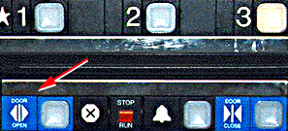
Bad designs
  Elevator controls and labels on the bottom row all look the same, so it is easy to push a label by mistake instead of a control button
  People do not make same mistake for the labels and buttons on the top row. Why not?
From: www.baddesigns.com
Notes:
2

Slide 3
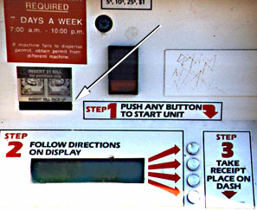
Why is this vending machine so bad?
Need to push button first to activate reader
Normally insert bill first before making selection
Contravenes well known convention
From: www.baddesigns.com
Notes:
3

Slide 4
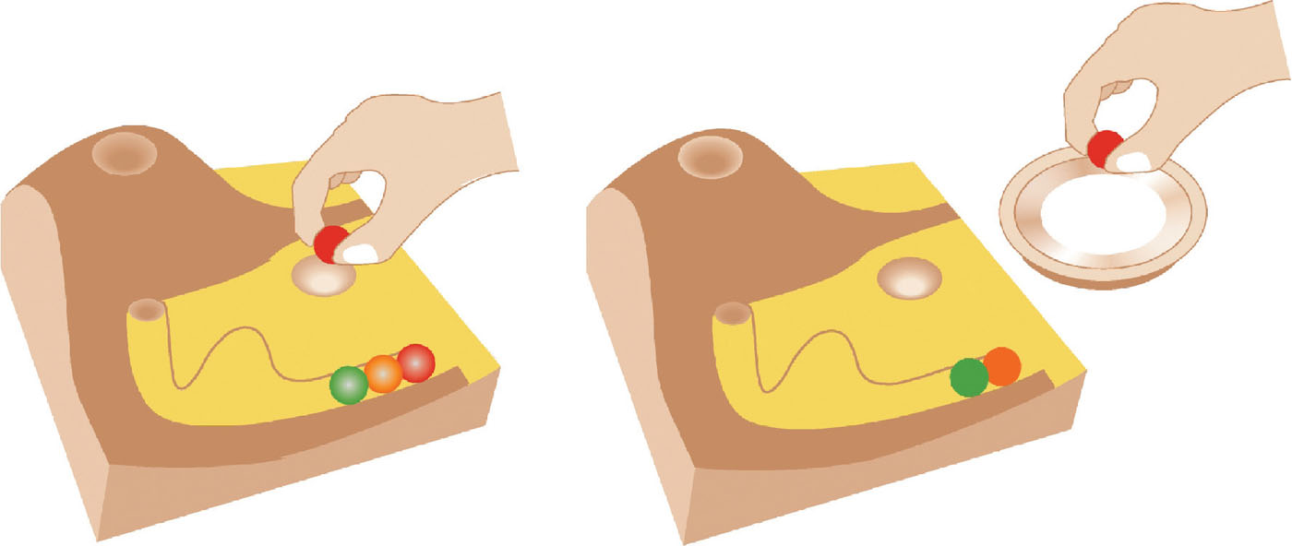
Good design
Marble answering machine (Bishop, 1995)
Based on how everyday objects behave
Easy, intuitive and a pleasure to use
Only requires one-step actions to perform core tasks
Notes:
4

Slide 5
Good and bad design
What is wrong with the remote on the right?
Why is the TiVo remote so much better designed?
  Peanut shaped to fit in hand
  Logical layout and color-coded, distinctive buttons
  Easy to locate buttons
Notes:
5

Slide 6
What to design
Need to take into account:
  Who the users are
  What activities are being carried out
  Where the interaction is taking place
Need to optimize the interactions users have with a product
  So that they match the users’ activities and needs
Notes:
6

Slide 7
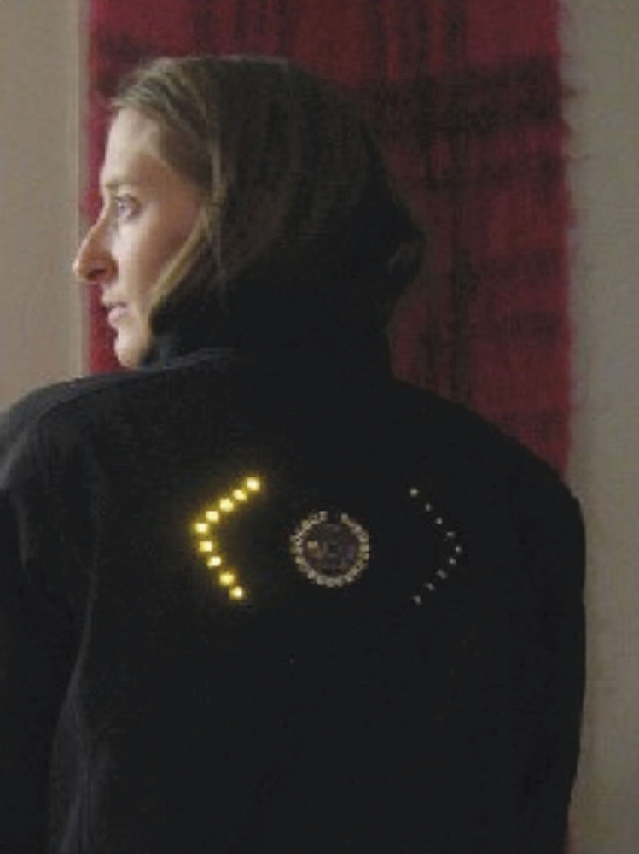
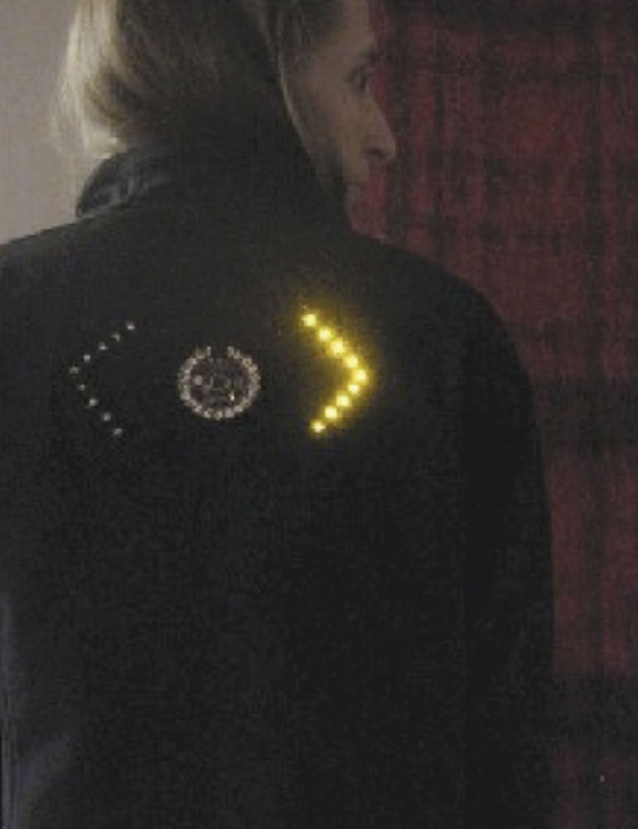
Novel interface
Notes:
Figure 1.3

Slide 8
Understanding users’ needs
Need to take into account what people are good and bad at
Consider what might help people in the way they currently do things
Think through what might provide quality user experiences
Listen to what people want and get them involved
Use tried and tested user-centered methods
Notes:
8

Slide 9

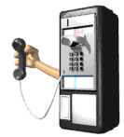
Activity
How does making a call differ when using a:
  Cell phone
  Public phone box?
Consider the kinds of user, type of activity and context of use
Notes:
9

Slide 10
What is interaction design?
Designing interactive products to support the way people communicate and interact in their everyday and working lives
      Sharp, Rogers and Preece (2011)
The design of spaces for human communication and interaction
      Winograd (1997)
Notes:
10

Slide 11
Goals of interaction design
Develop usable products
  Usability means easy to learn, effective to use and provide an enjoyable experience
Involve users in the design process
Notes:
11

Slide 12
Which kind of design?
Number of other terms used emphasizing what is being designed, e.g.
  user interface design, software design, user-centered design, product design, web design, experience design (UX)
Interaction design is the umbrella term covering all of these aspects
  fundamental to all disciplines, fields, and approaches concerned with researching and designing computer-based systems for people
Notes:
12

Slide 13
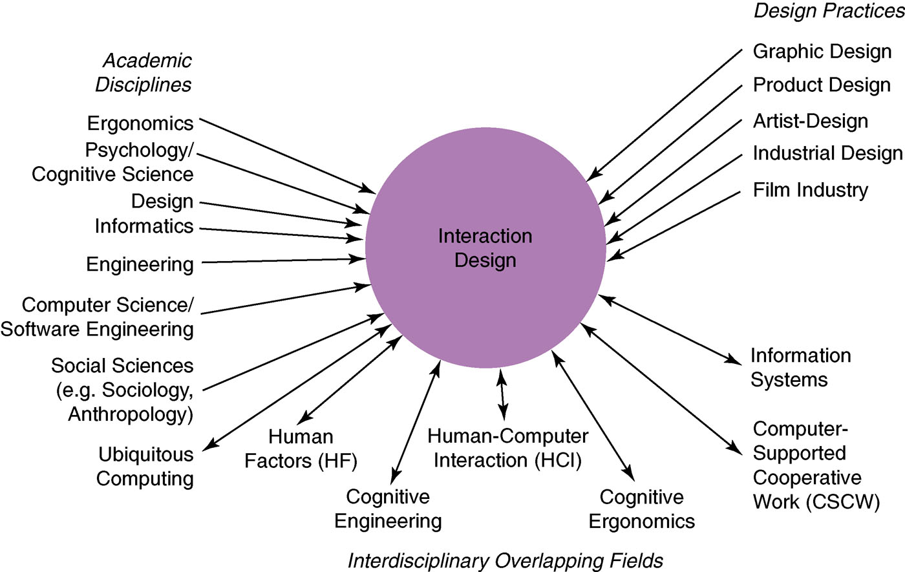
HCI and interaction design
Notes:
13

Slide 14
Relationship between ID, HCI and other fields
Academic disciplines contributing to ID:
  Psychology
  Social Sciences
  Computing Sciences
  Engineering
  Ergonomics
  Informatics
Notes:
14

Slide 15
Relationship between ID, HCI and other fields
Design practices contributing to ID:
  Graphic design
  Product design
  Artist-design
  Industrial design
  Film industry
Notes:
15

Slide 16
Relationship between ID, HCI and other fields
Interdisciplinary fields in interaction design:
  HCI
  Ubiquitous Computing
  Human Factors
  Cognitive Engineering
  Cognitive Ergonomics
  Computer Supported Co-operative Work
  Information Systems
Notes:
16

Slide 17
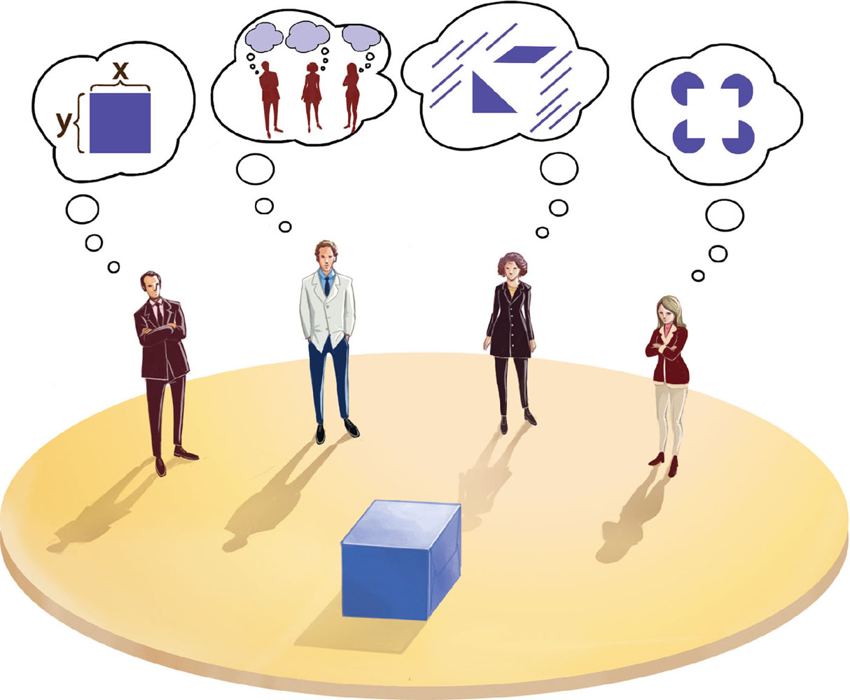
Working in multidisciplinary teams
Many people from different
backgrounds involved
Different perspectives
and ways of seeing
and talking about things
Benefits
  more ideas and designs
  generated
Disadvantages
  difficult to communicate and
  progress forward the designs being create
Notes:
17

Slide 18

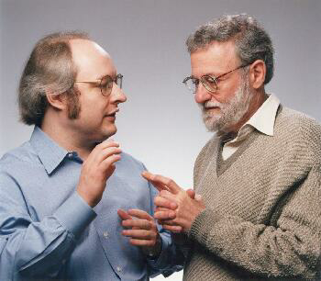


Interaction design in business
Increasing number of ID consultancies, examples of well known ones include:
  Nielsen Norman Group: “help companies enter the age of the consumer, designing human-centered products and services”
  Cooper: ”From research and product to goal-related design”
  Swim: “provides a wide range of design services, in each case targeted to address the product development needs at hand”
  IDEO: “creates products, services and environments for companies pioneering new ways to provide value to their customers”
Notes:
18

Slide 19
What do professionals do in the ID business?
interaction designers - people involved in the design of all the interactive aspects of a product
usability engineers - people who focus on evaluating products, using usability methods and principles
web designers - people who develop and create the visual design of websites, such as layouts
information architects - people who come up with ideas of how to plan and structure interactive products
user experience designers (UX) - people who do all the above but who may also carry out field studies to inform the design of products
Notes:
19

Slide 20
The User Experience
How a product behaves and is used by people in the real world
  the way people feel about it and their pleasure and satisfaction when using it, looking at it, holding it, and opening or closing it
  “every product that is used by someone has a user experience: newspapers, ketchup bottles, reclining armchairs, cardigan sweaters.” (Garrett, 2003)
Cannot design a user experience, only design for a user experience
Notes:
20

Slide 21
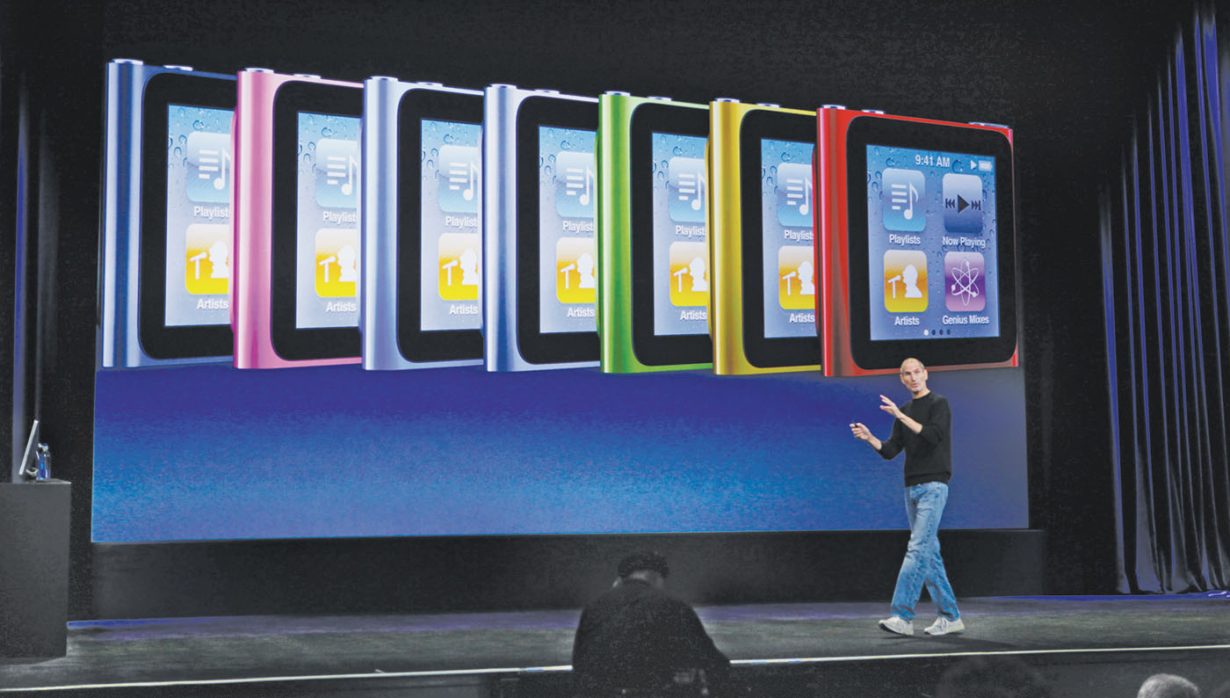
The iPod Nano Touch

Slide 22
Why was the iPod user experience such a success?
Quality user experience from the start
Simple, elegant, distinct brand, pleasurable, must have fashion item, catchy names, cool, etc.,
Notes:
22

Slide 23
What is involved in the process of interaction design
Establishing requirements
Developing alternatives
Prototyping
Evaluating
Notes:
23

Slide 24
Core characteristics of interaction design
users should be involved through the development of the project
specific usability and user experience goals need to be identified, clearly documented and agreed at the beginning of the project
iteration is needed through the core activities
Notes:
24

Slide 25
Why go to this length?
Help designers:
  understand how to design interactive products that fit with what people want, need and may desire
  appreciate that one size does not fit all
    e.g., teenagers are very different to grown-ups
  identify any incorrect assumptions they may have about particular user groups
    e.g., not all old people want or need big fonts
  be aware of both people’s sensitivities and their capabilities
Notes:
25

Slide 26
Are cultural differences important?
5/21/2012 versus 21/5/2012?
  Which should be used for international services and online forms?
Why is it that certain products, like the iPod, are universally accepted by people from all parts of the world whereas websites are reacted to differently by people from different cultures?
Notes:
26

Slide 27
Anna, IKEA online sales agent
Designed to be
different for UK and US
customers
What are the differences
and which is which?
What should Anna’s
appearance be like
for other countries,
like India, South Africa,
or China?
Notes:
27

Slide 28
Usability goals
Effective to use
Efficient to use
Safe to use
Have good utility
Easy to learn
Easy to remember how to use
Notes:
28

Slide 29

Activity on usability
How long should it take and how long does it actually take to:
  Using a DVD to play a movie?
  Use a DVD to pre-record two programs?
  Using a web browser tool to create a website?
Notes:
29

Slide 30
User experience goals
Desirable aspects
satisfying helpful fun
enjoyable motivating provocative
engaging challenging surprising
pleasurable enhancing sociability rewarding
exciting supporting creativity emotionally fulfilling
entertaining cognitively stimulating
Undesirable aspects
boring unpleasant
frustrating patronizing
making one feel guilty making one feel stupid
annoying cutesy
childish gimmicky
Notes:
30

Slide 31
Usability and user experience goals
Selecting terms to convey a person’s feelings, emotions, etc., can help designers understand the multifaceted nature of the user experience
How do usability goals differ from user experience goals?
Are there trade-offs between the two kinds of goals?
  e.g. can a product be both fun and safe?
How easy is it to measure usability versus user experience goals?
Notes:
31

Slide 32
Design principles
Generalizable abstractions for thinking about different aspects of design
The do’s and don’ts of interaction design
What to provide and what not to provide at the interface
Derived from a mix of theory-based knowledge, experience and common-sense
Notes:
32

Slide 33

Visibility
• This is a control panel for an elevator
• How does it work?
• Push a button for the floor you want?
• Nothing happens. Push any other button? Still nothing. What do you need to do?
It is not visible as to what to do!
From: www.baddesigns.com
Notes:
33

Slide 34
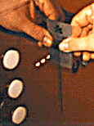
Visibility
      …you need to insert your room card in the slot by the buttons to get the elevator to work!
      How would you make this action more visible?
      • make the card reader more obvious
      • provide an auditory message, that says what to do (which language?)
      • provide a big label next to the card reader that flashes when someone enters
  • make relevant parts visible
  • make what has to be done obvious
Notes:
34

Slide 35
What do I do if I am wearing black?
Invisible automatic
controls can make it
more difficult
to use
Notes:
35

Slide 36
Feedback
Sending information back to the user about what has been done
Includes sound, highlighting, animation and combinations of these
  e.g. when screen button clicked on provides sound or red highlight feedback:
“ccclichhk”
Notes:
36

Slide 37
Constraints
Restricting the possible actions that can be performed
Helps prevent user from selecting incorrect options
Physical objects can be designed to constrain things
  e.g. only one way you can insert a key into a lock
Notes:
37

Slide 38
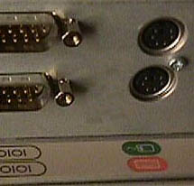
Logical or ambiguous design?
Where do you plug the mouse?
Where do you plug the keyboard?
top or bottom connector?
Do the color coded icons help?
From: www.baddesigns.com
Notes:
38

Slide 39


How to design them more logically
(i) A provides direct adjacent mapping between icon and connector
(ii) B provides color coding to associate the connectors with the labels
From: www.baddesigns.com
Notes:
39

Slide 40
Consistency
Design interfaces to have similar operations and use similar elements for similar tasks
For example:
  always use ctrl key plus first initial of the command for an operation – ctrl+C, ctrl+S, ctrl+O
Main benefit is consistent interfaces are easier to learn and use
Notes:
40

Slide 41
When consistency breaks down
What happens if there is more than one command starting with the same letter?
  e.g. save, spelling, select, style
Have to find other initials or combinations of keys, thereby breaking the consistency rule
  e.g. ctrl+S, ctrl+Sp, ctrl+shift+L
Increases learning burden on user, making them more prone to errors
Notes:
41

Slide 42
Internal and external consistency
Internal consistency refers to designing operations to behave the same within an application
  Difficult to achieve with complex interfaces
External consistency refers to designing operations, interfaces, etc., to be the same across applications and devices
  Very rarely the case, based on different designer’s preference
Notes:
42

Slide 43
Keypad numbers layout
A case of external inconsistency
(a) phones, remote controls
(b) calculators, computer keypads
1
2
3
7
8
9
4
5
6
4
5
6
7
8
9
1
2
3
0
0
Notes:
43

Slide 44
Affordances: to give a clue
Refers to an attribute of an object that allows people to know how to use it
  e.g. a mouse button invites pushing, a door handle affords pulling
Norman (1988) used the term to discuss the design of everyday objects
Since has been much popularised in interaction design to discuss how to design interface objects
  e.g. scrollbars to afford moving up and down, icons to afford clicking on
Notes:
44

Slide 45
What does ‘affordance’ have to offer interaction design?
Interfaces are virtual and do not have affordances like physical objects
Norman argues it does not make sense to talk about interfaces in terms of ‘real’ affordances
Instead interfaces are better conceptualized as ‘perceived’ affordances
  Learned conventions of arbitrary mappings between action and effect at the interface
  Some mappings are better than others
Notes:
45

Slide 46


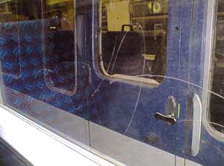

Activity
  Physical affordances:
    How do the following physical objects afford? Are they obvious?
Notes:
46

Slide 47
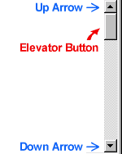



Activity
  Virtual affordances
    How do the following screen objects afford?
    What if you were a novice user?
    Would you know what to do with them?
Notes:
47

Slide 48
Key points
Interaction design is concerned with designing interactive products to support the way people communicate and interact in their everyday and working lives
It is concerned with how to create quality user experiences
It requires taking into account a number of interdependent factors, including context of use, type of activities, cultural differences, and user groups
It is multidisciplinary, involving many inputs from wide-reaching disciplines and fields
Notes:
48

