Slide 1
Chapter 2
_{Understanding and}
_{Conceptualizing interaction}

Slide 2
Recap
HCI has moved beyond designing interfaces for desktop machines
About extending and supporting all manner of human activities in all manner of places
Facilitating user experiences through designing interactions
    Make work effective, efficient and safer
    Improve and enhance learning and training
    Provide enjoyable and exciting entertainment
    Enhance communication and understanding
    Support new forms of creativity and expression
Notes:
2

Slide 3
Understanding the problem space
  What do you want to create?
  What are your assumptions?
  Will it achieve what you hope it will?
Notes:
3

Slide 4
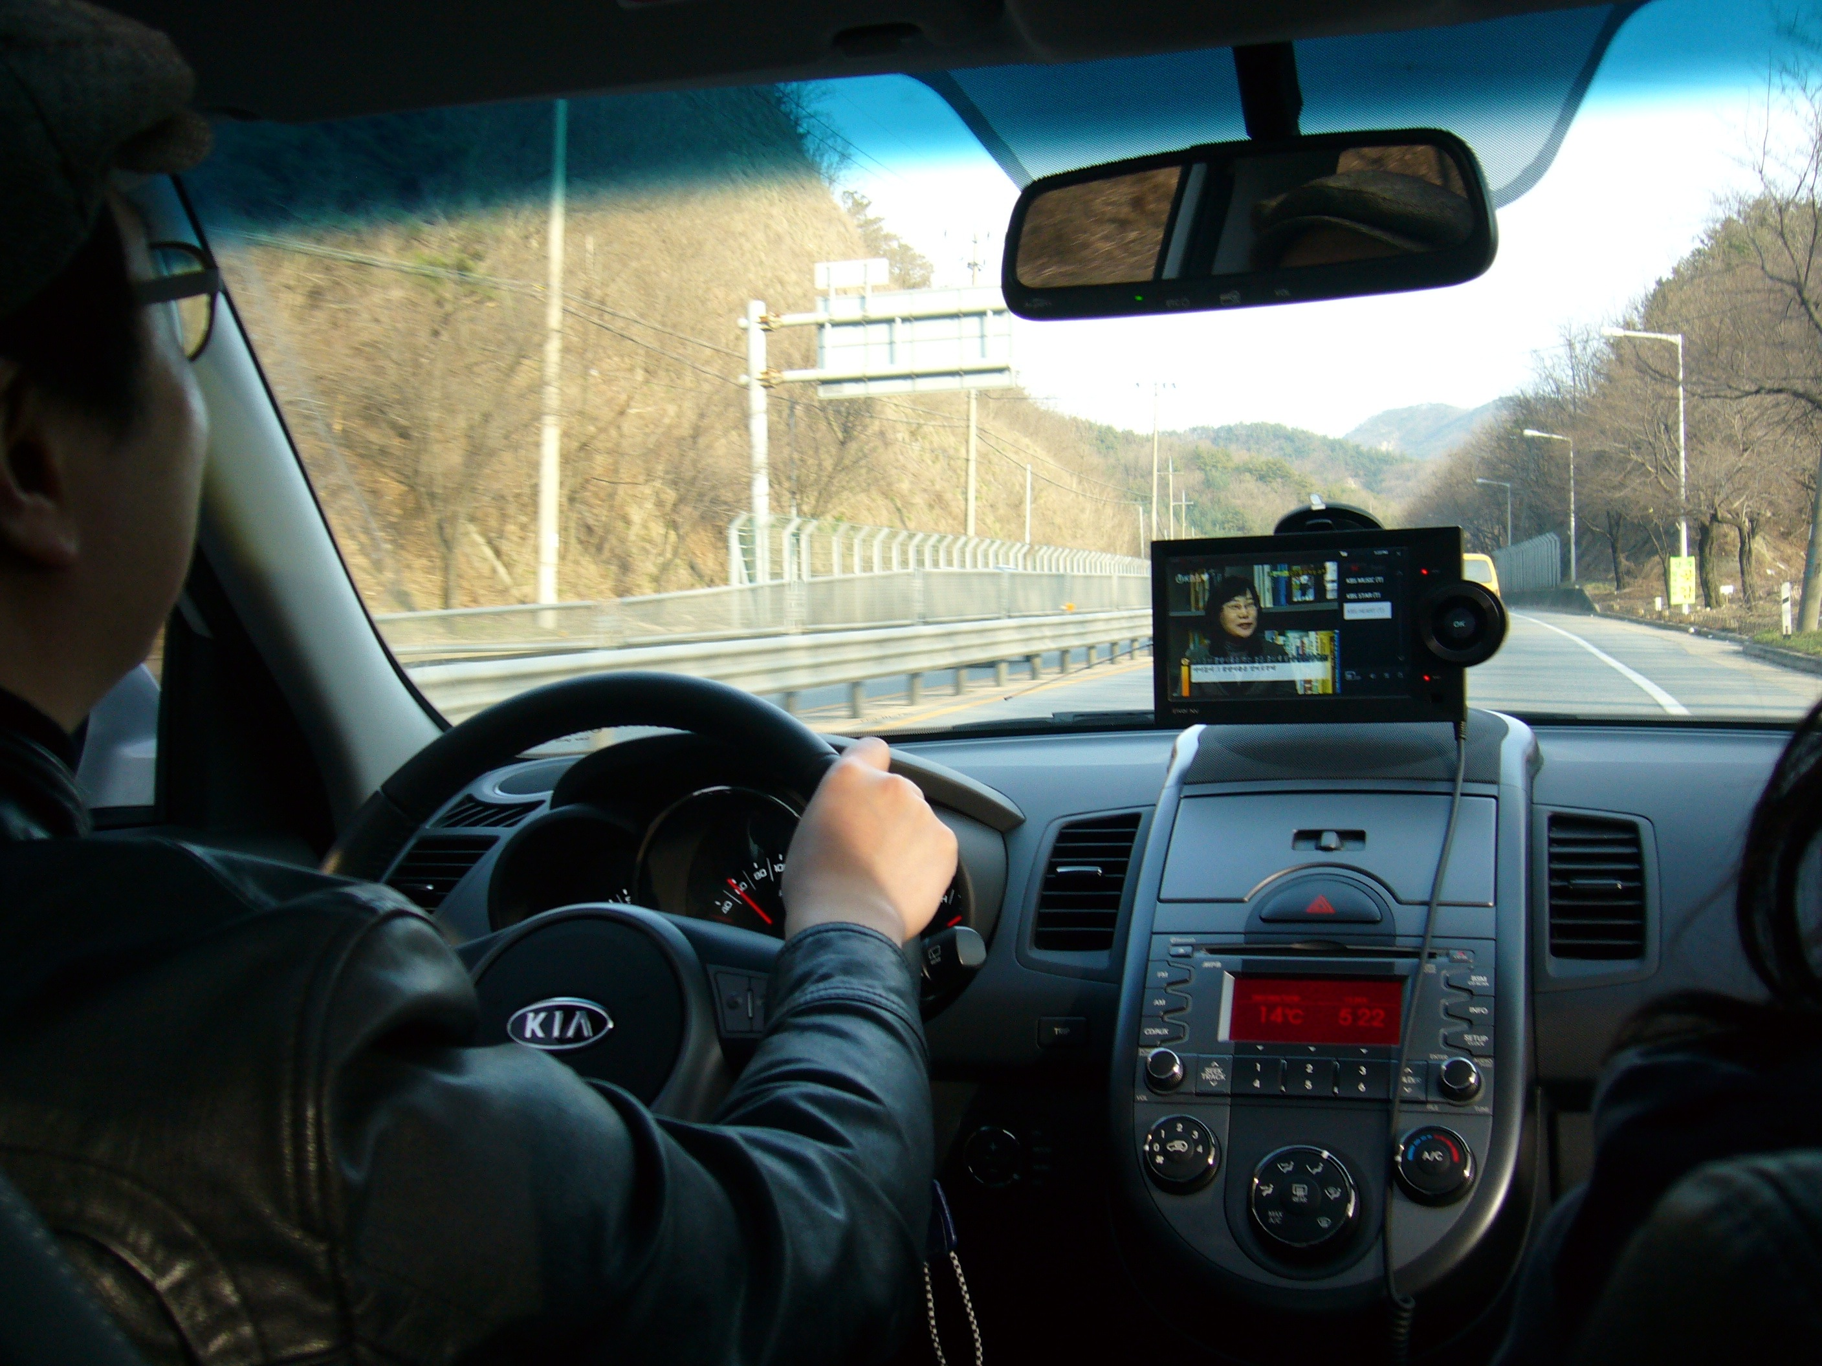
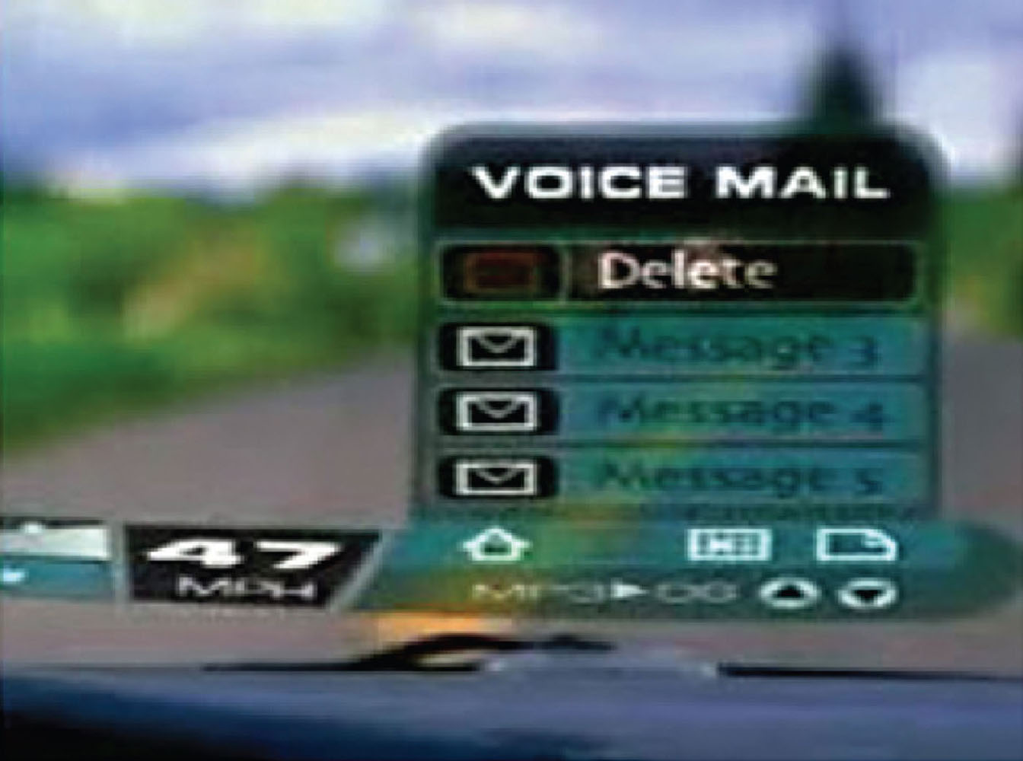
What is an assumption?
taking something for granted when it needs further investigation
  e.g. people will want to watch TV while driving

Slide 5
What is a claim?
stating something to be true when it is still open to question
  e.g. a multimodal style of interaction for controlling GPS — one that involves speaking while driving — is safe
Notes:
Writing down your assumptions and claims and then trying to defend and support them can highlight those that are vague or wanting. In so doing, poorly constructed design ideas can be reformulated. Explicating people’s assumptions and claims about why they think something might be a good idea (or not) enables the design team as a whole to view multiple perspectives on the problem space and in so doing reveal conflicting and problematic ones.
5

Slide 6
A framework for analysing the problem space
Are there problems with an existing product or user experience? If so, what are they?
Why do you think there are problems?
How do you think your proposed design ideas might overcome these?
If you are designing for a new user experience how do you think your proposed design ideas support, change, or extend current ways of doing things?

Slide 7
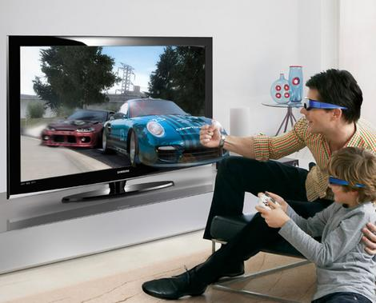
Activity
What are the assumptions and claims made about 3D TV?
Notes:
3D TV first went on sale in 2010. There was much hype and fanfare about the enhanced user experience it would offer, especially when watching movies, sport’s events and dramas. An assumption was that people would not mind wearing the glasses that are needed to see in 3D, nor would they mind paying a lot more for a new 3D-enabled TV screen. A claim was that people would really enjoy the enhanced clarity and color detail provided by 3D, based on the favourable feedback received worldwide when viewing 3D films, such as Avatar, at a cinema.
But the unanswered question was: could the enhanced cinema experience become a desired living room experience? There is no existing problem to overcome – what is being proposed is a new way of experiencing TV. A user experience question is how will people take to wearing the special glasses in their living room? Will it become the norm for people to carry around their own set of personalized glasses (cf to the iPod earbuds that many people wear under their clothing), and don them when watching TV at home or when visiting their family or friends? Could they even be designed to become a fashion item?
7

Slide 8
Assumptions: realistic or wish-list?
People would not mind wearing the glasses that are needed to see in 3D in their living rooms - reasonable
People would not mind paying a lot more for a new 3D-enabled TV screen- not reasonable
People would really enjoy the enhanced clarity and color detail provided by 3D - reasonable
People will be happy carrying around their own special glasses - reasonable only for a very select bunch of users
Notes:
8

Slide 9
Benefits of conceptualising
Orientation
  enables design teams to ask specific questions about how the conceptual model will be understood
Open-minded
  prevents design teams from becoming narrowly focused early on
Common ground
  allows design teams to establish a set of commonly agreed terms
Id-book.com 9 ©2011

Slide 10
From problem space to design space
Having a good understanding of the problem space can help inform the design space
  e.g. what kind of interface, behavior, functionality to provide
But before deciding upon these it is important to develop a conceptual model
Notes:
There is also an assumption that all images will be better when viewed in 3D. But whilst it may be a joy to see your team score a goal, will it by the same token, be more painful to watch the opponents score? And what about those who like to catch up on the news whilst eating breakfast and reading email on their laptop? Will it be unpleasant having to constantly switch between the real world, a 2D display and a 3D TV? Or will it become second nature?
10

Slide 11
Conceptual model
A conceptual model is:
  “a high-level description of how a system is organized and operates” (Johnson and Henderson, 2002, p 26)
Enables
  “designers to straighten out their thinking before they start laying out their widgets” (p 28)

Slide 12
Components
Metaphors and analogies
  understand what a product is for and how to use it for an activity
Concepts that people are exposed to through the product
  task–domain objects, their attributes, and operations (e.g. saving, revisiting, organizing)
Relationship and mappings between these concepts

Slide 13
First steps in formulating a conceptual model
What will the users be doing when carrying out their tasks?
How will the system support these?
What kind of interface metaphor, if any, will be appropriate?
What kinds of interaction modes and styles to use?
  always keep in mind when making design decisions how the user will understand the underlying conceptual model

Slide 14
Conceptual models
Many kinds and ways of classifying them
We describe them in terms of core activities and objects
Also in terms of interface metaphors
Notes:
The best conceptual models are those that appear obvious; the operations they support being intuitive to use. However, sometimes applications can end up being based on overly complex conceptual models, especially if they are the result of a series of upgrades, where more and more functions and ways of doing something are added to the original conceptual model. Most interface applications are actually based on well-established conceptual models. For example, a conceptual model based on the core aspects of the customer experience when at a shopping mall underlies most online shopping websites.
Interface metaphors are intended to provide familiar entities that enable people to readily understand the underlying conceptual model and know what to do at an interface. However, they can also contravene people’s expectations about how things should be, such as the recycle bin (trashcan) that used to sit on the desktop. Logically and culturally (i.e. in the real world) it should have been placed under the desk. But users would not have been able to see it because it would be occluded by the desktop surface. So it needed to go on the desktop. Some users find this irksome but most did not find it to be a problem. Once they understood why the bin icon was on the desktop they simply accepted it being there.
14

Slide 15
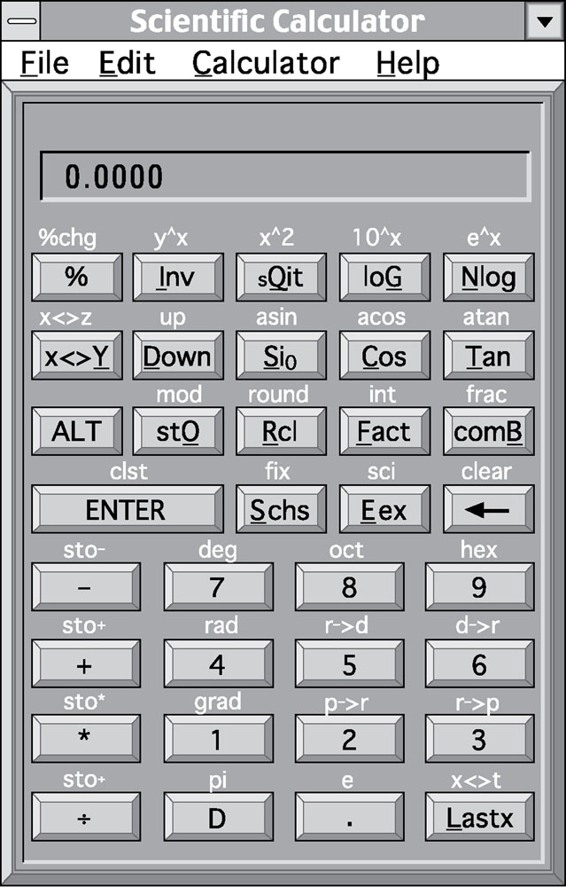
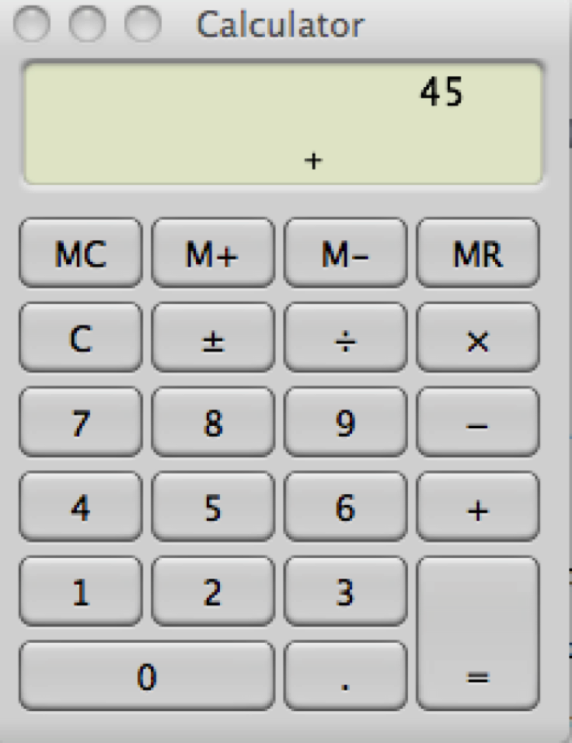
Interface metaphors
Notes:
Which is best and why?
In many cases, new interfaces metaphors rapidly become integrated into common parlance, as witnessed by they way people talk about them. People surf the net, poke their friends and leave messages on their wall in the same way they would talk about winning an argument or saving time. As such, the interface metaphors are no longer talked about as familiar terms to describe less familiar computer-based actions; they have become everyday terms in their own right. Moreover, it is hard not to use metaphorical terms when talking about technology use, as they have become so ingrained in the language we use to express ourselves.
15

Slide 16
Interface metaphors
Conceptualizing what we are doing, e.g. surfing the web
A conceptual model instantiated at the interface, e.g. the desktop metaphor
Visualising an operation,
  e.g. an icon of a shopping cart for placing items into

Slide 17
Activity
Describe the components of the conceptual model underlying most online shopping websites, e.g.
  Shopping cart
  Proceeding to check-out
  1-click
  Gift wrapping
  Cash till?
Notes:
These include the placement of items a customer wishes to purchase into a shopping cart or basket and proceeding to checkout when ready to make the purchase. A variation – which is also based on what happens in a physical store – is making a booking, where new items are added, before proceeding to pay.
Making a purchase online is an undertaking with risks and people want to feel they are making the right choice. Designing the interface to have a familiar metaphor (with icon of a shopping cart/basket – although not a cash till!) makes it easier for people to know what to do at the different stages of making a purchase. Importantly, placing an item in the basket does not commit the customer to purchase it there and then. It also enables them to browse further and select other items – as they might in a physical store
17

Slide 18
Interface metaphors
Interface designed to be similar to a physical entity but also has own properties
  e.g. desktop metaphor, web portals
Can be based on activity, object or a combination of both
Exploit user’s familiar knowledge, helping them to understand ‘the unfamiliar’
Conjures up the essence of the unfamiliar activity, enabling users to leverage of this to understand more aspects of the unfamiliar functionality

Slide 19
Benefits of interface metaphors
Makes learning new systems easier
Helps users understand the underlying conceptual model
Can be very innovative and enable the realm of computers and their applications to be made more accessible to a greater diversity of users

Slide 20
Problems with interface metaphors
Break conventional and cultural rules
  e.g. recycle bin placed on desktop
Can constrain designers in the way they conceptualize a problem space
Conflict with design principles
Forces users to only understand the system in terms of the metaphor
Designers can inadvertently use bad existing designs and transfer the bad parts over
Limits designers’ imagination in coming up with new conceptual models

Slide 21
Interaction types
Instructing
  issuing commands and selecting options
Conversing
  interacting with a system as if having a conversation
Manipulating
  interacting with objects in a virtual or physical space by manipulating them
Exploring
  moving through a virtual environment or a physical space
Notes:
21

Slide 22
1. Instructing
Where users instruct asystem and tell it what to do
  e.g. tell the time, print a file, save a file
Very common conceptual model, underlying a diversity of devices and systems
  e.g. word processors, VCRs, vending machines
Main benefit is that instructing supports quick and efficient interaction
  good for repetitive kinds of actions performed on multiple objects

Slide 23
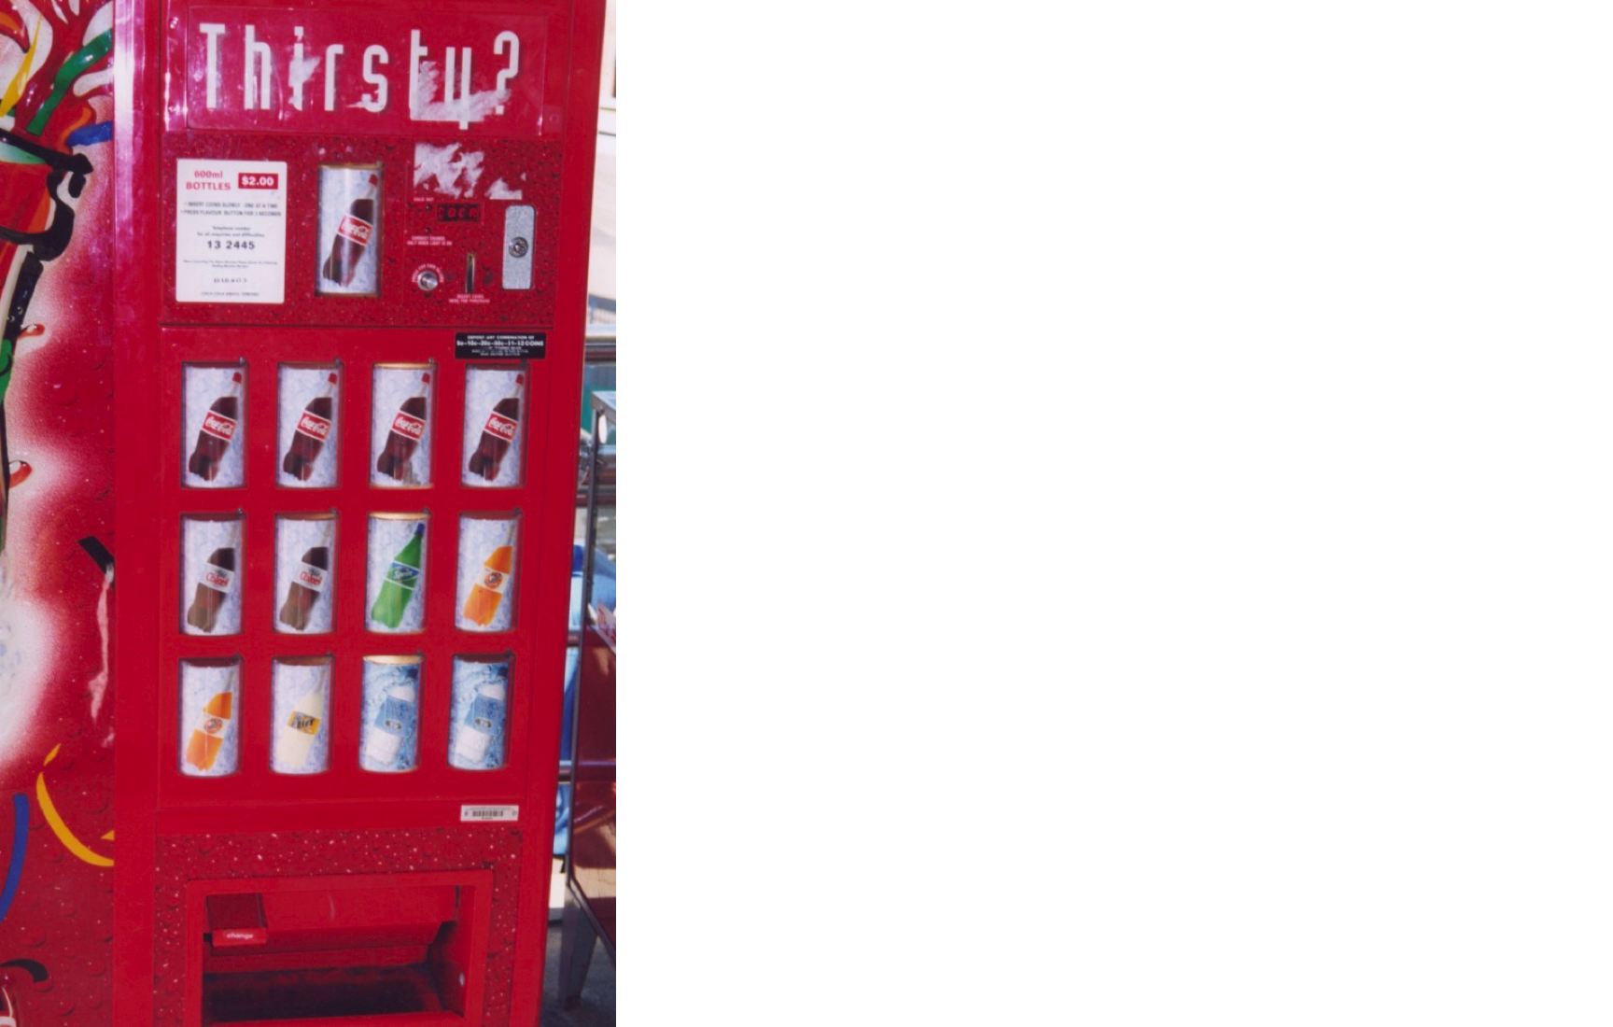
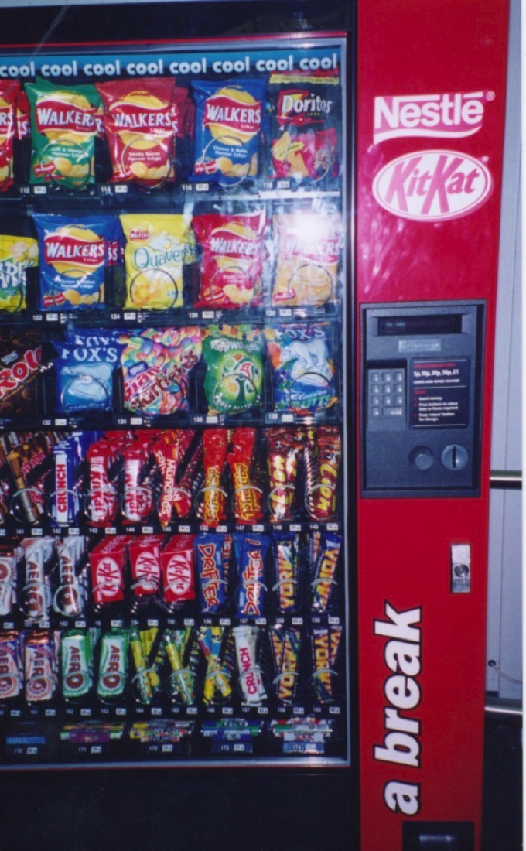
Which is easiest and why?
Id-book.com 23 ©2011
Notes:
The first vending machine has been designed using simple instructions. There is a small number of drinks to choose from and each is represented by a large button displaying the label of each drink. The user simply has to press one button and this should have the effect of returning the selected drink. The second machine is more complex, offering a wider range of snacks. The trade-off for providing more choices, however, is that the user can no longer instruct the machine by using a simple one-press action but is required to use a more complex process, involving: (i) reading off the code (e.g., C12) under the item chosen, then (ii) keying this into the number pad adjacent to the displayed items, and (iii) checking the price of the selected option and ensuring that the amount of money inserted is the same or greater (depending on whether or not the machine provides change). Problems that can arise from this type of interaction are the customer misreading the code and or miskeying in the code, resulting in the machine not issuing the snack or providing the wrong item.
A better way of designing an interface for a large number of choices of variable cost might be to continue to use direct mapping, but use buttons that show miniature versions of the snacks placed in a large matrix (rather than showing actual versions). This would use the available space at the front of the vending machine more economically. The customer would need only to press the button of the object chosen and put in the correct amount of money. There is less chance of error resulting from pressing the wrong code or keys. The trade-off for the vending company, however, is that the machine is less flexible in terms of which snacks it can sell. If a new product line comes out they will also need to replace part of the physical interface to the machine – which would be costly.
23

Slide 24
2. Conversing
Underlying model of having a conversation with another human
Range from simple voice recognition menu-driven systems to more complex ‘natural language’ dialogs
Examples include timetables, search engines, advice-giving systems, help systems
Also virtual agents, toys and pet robots designed to converse with you
Notes:
24

Slide 25
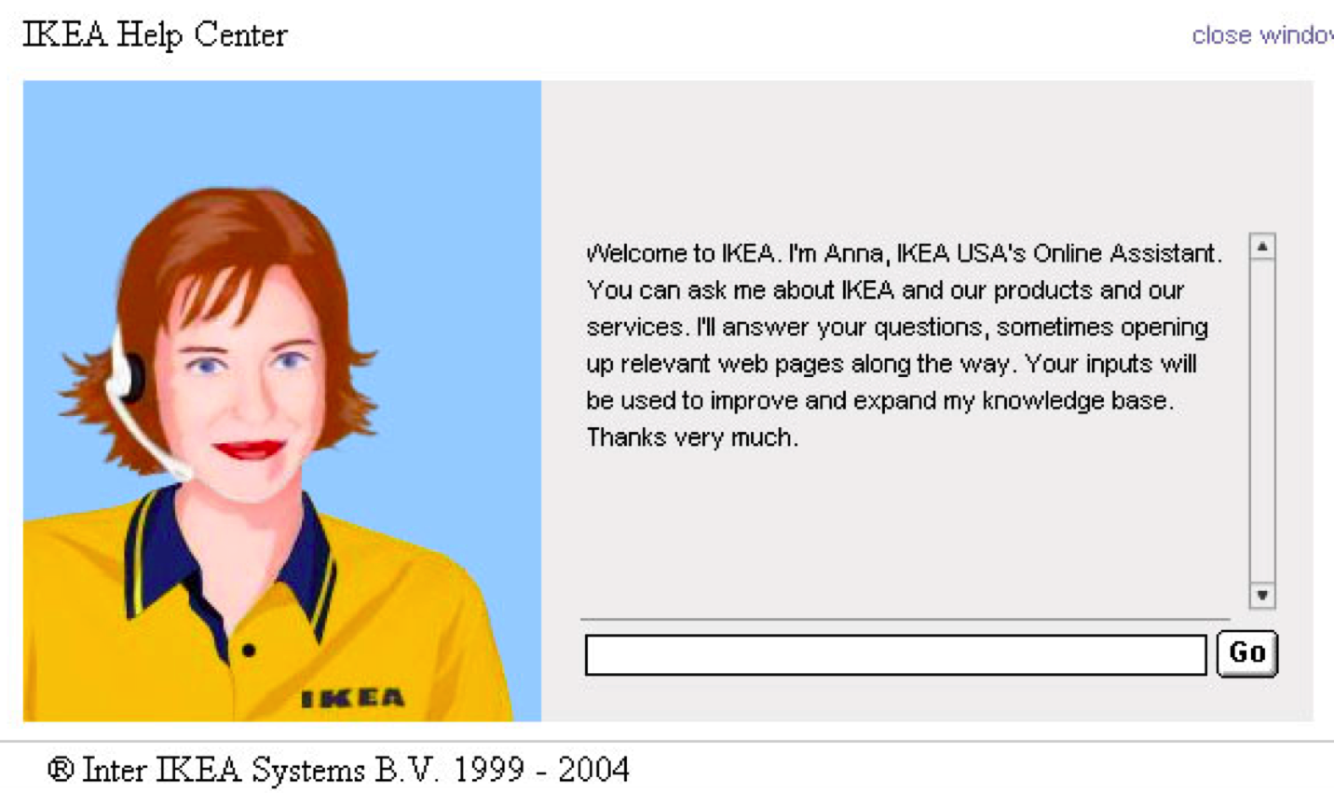
Would you talk with Anna?
Id-book.com 25 ©2011

Slide 26
Pros and cons of conversational model
Allows users, especially novices and technophobes, to interact with the system in a way that is familiar
  makes them feel comfortable, at ease and less scared
Misunderstandings can arise when the system does not know how to parse what the user says

Slide 27
3. Manipulating
Involves dragging, selecting, opening, closing and zooming actions on virtual objects
Exploit’s users’ knowledge of how they move and manipulate in the physical world
Can involve actions using physical controllers (e.g. Wii) or air gestures (e.g. Kinect) to control the movements of an on screen avatar
Tagged physical objects (e.g. balls) that are manipulated in a physical world result in physical/digital events (e.g. animation)
Notes:
27

Slide 28
Direct Manipulation
Shneiderman (1983) coined the term DM, came from his fascination with computer games at the time
  Continuous representation of objects and actions of interest
  Physical actions and button pressing instead of issuing commands with complex syntax
  Rapid reversible actions with immediate feedback on object of interest
Notes:
28

Slide 29
Why are DM interfaces so enjoyable?
Novices can learn the basic functionality quickly
Experienced users can work extremely rapidly to carry out a wide range of tasks, even defining new functions
Intermittent users can retain operational concepts over time
Error messages rarely needed
Users can immediately see if their actions are furthering their goals and if not do something else
Users experience less anxiety
Users gain confidence and mastery and feel in control
Notes:
29

Slide 30
What are the disadvantages with DM?
Some people take the metaphor of direct manipulation too literally
Not all tasks can be described by objects and not all actions can be done directly
Some tasks are better achieved through delegating
  e.g. spell checking
Can become screen space ‘gobblers’
Moving a mouse around the screen can be slower than pressing function keys to do same actions
Notes:
30

Slide 31
4. Exploring
Involves users moving through virtual or physical environments
Physical environments with embedded sensor technologies
  Context aware

Slide 32
Which conceptual model is best?
Direct manipulation is good for ‘doing’ types of tasks, e.g. designing, drawing, flying, driving, sizing windows
Issuing instructions is good for repetitive tasks, e.g. spell-checking, file management
Having a conversation is good for children, computer-phobic, disabled users and specialised applications (e.g. phone services)
Hybrid conceptual models are often employed, where different ways of carrying out the same actions is supported at the interface - but can take longer to learn
Notes:
32

Slide 33
Conceptual models: interaction and interface
Interaction type:
  what the user is doing when interacting with a system, e.g. instructing, talking, browsing or other
Interface type:
  the kind of interface used to support the mode, e.g. speech, menu-based, gesture

Slide 34
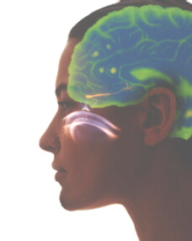
Many kinds of interface types available…
Command
Speech
Data-entry
Form fill-in
Query
Graphical
Web
Pen
Augmented reality
Gesture
  (for more see chapter 6)

Slide 35
Which interaction type to choose?
Need to determine requirements and user needs
Take budget and other constraints into account
Also will depend on suitability of technology for activity being supported
This is covered in course when designing conceptual models

Slide 36
Paradigm
Inspiration for a conceptual model
General approach adopted by a community for carrying out research
  shared assumptions, concepts, values, and practices
  e.g. desktop, ubiquitous computing, in the wild

Slide 37
Examples of new paradigms
Ubiquitous computing (mother of them all)
Pervasive computing
Wearable computing
Tangible bits, augmented reality
Attentive environments
Transparent computing
  and many more….

Slide 38
Theory
Explanation of a phenomenon
  e.g. information processing that explains how the mind, or some aspect of it, is assumed to work
Can help identify factors
  e.g. cognitive, social, and affective, relevant to the design and evaluation of interactive products

Slide 39
Models
A simplification of an HCI phenomenon
  intended to make it easier for designers to predict and evaluate alternative designs
  abstracted from a theory coming from a contributing discipline, e.g. psychology, e.g. keystroke model

Slide 40
Framework
Set of interrelated concepts and/or specific questions for ‘what to look for’
Many in interaction design
  e.g. Norman’s conceptual models, Benford’s trajectories
Provide advice on how to design
  e.g. steps, questions, concepts, challenges, principles, tactics and dimensions

Slide 41
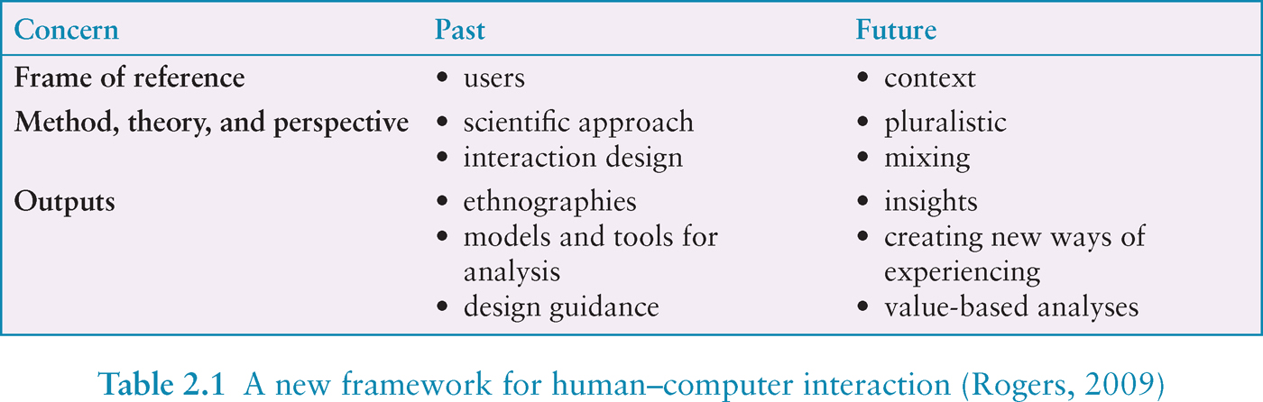

Slide 42
Summary
Important to have a good understanding of the problem space
Fundamental aspect of interaction design is to develop a conceptual model
Interaction modes and interface metaphors provide a structure for thinking about which kind of conceptual model to develop
Interaction styles are specific kinds of interfaces that are instantiated as part of the conceptual model
Paradigms, theories, models and frameworks can also shape a conceptual model

