Slide 1
Chapter 3
_{Cognitive aspects}

Slide 2
Overview
What is cognition?
What are users good and bad at?
Describe how cognition has been applied to interaction design
Mental Models
Internals classic theories of cognition
More recent external theories of cognition
Notes:
2

Slide 3
Why do we need to understand users?
Interacting with technology is cognitive
Need to take into account cognitive processes involved and cognitive limitations of users
Provides knowledge about what users can and cannot be expected to do
Identifies and explains the nature and causes of problems users encounter
Supply theories, modelling tools, guidance and methods that can lead to the design of better interactive products
Notes:
3

Slide 4
Cognitive processes
Attention
Perception and recognition
Memory
Learning
Reading, speaking and listening
Problem-solving, planning, reasoning and decision-making
Notes:
4
It is important to note that many of these cognitive processes are interdependent: several may be involved for a given activity. It is rare for one to occur in isolation. For example, when you try to learn material for an exam, you need to attend to the material, perceive and recognize it, read it, think about it, and try to remember it. Below we describe the various kinds in more detail, followed by a summary box highlighting core design implications for each. Most relevant for interaction design are attention and memory which we describe in greatest detail.

Slide 5
Attention
Selecting things to concentrate on at a point in time from the mass of stimuli around us
Allows us to to focus on information that is relevant to what we are doing
Involves audio and/or visual senses
Focussed and divided attention enables us to be selective in terms of the mass of competing stimuli but limits our ability to keep track of all events
Information at the interface should be structured to capture users’ attention, e.g. use perceptual boundaries (windows), colour, reverse video, sound and flashing lights
Notes:
5

Slide 6
Activity: Find the price of a double room at the Holiday Inn in Bradley
Notes:
6

Slide 7
Activity: Find the price for a double room at the Quality Inn in Columbia
Notes:
7

Slide 8
Activity
Tullis (1987) found that the two screens produced quite different results
  1st screen - took an average of 5.5 seconds to search
  2nd screen - took 3.2 seconds to search
Why, since both displays have the same density of information (31%)?
Spacing
  In the 1st screen the information is bunched up together, making it hard to search
  In the 2nd screen the characters are grouped into vertical categories of information making it easier
Notes:
8

Slide 9
Multitasking and attention
Is it possible to perform multiple tasks without one or more of them being detrimentally affected?
Ophir et al (2009) compared heavy vs light multi-taskers
  heavy were more prone to being distracted than those who infrequently multitask
  heavy multi-taskers are easily distracted and find it difficult to filter irrelevant information

Slide 10
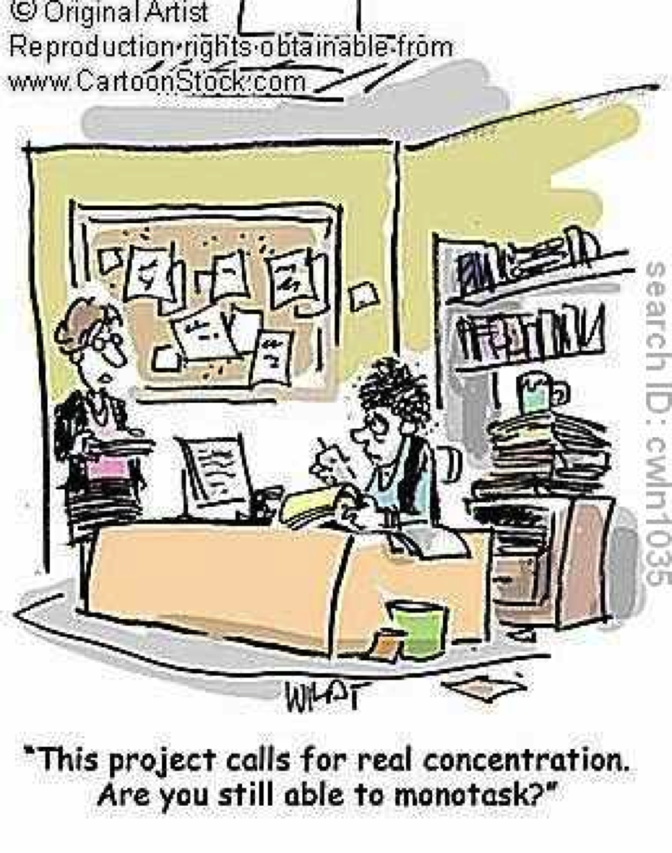

Slide 11
Design implications for attention
Make information salient when it needs attending to
Use techniques that make things stand out like color, ordering, spacing, underlining, sequencing and animation
Avoid cluttering the interface with too much information
Avoid using too much because the software allows it
Notes:
11

Slide 12
An example of over-use of graphics
Notes:
12

Slide 13
Perception
How information is acquired from the world and transformed into experiences
Obvious implication is to design representations that are readily perceivable, e.g.
  Text should be legible
  Icons should be easy to distinguish and read
Notes:
13

Slide 14
Is color contrast good? Find italian
Notes:
14

Slide 15
Are borders and white space better? Find french
Notes:
15

Slide 16
Activity
Weller (2004) found people took less time to locate items for information that was grouped
  using a border (2nd screen) compared with using color contrast (1st screen)
Some argue that too much white space on web pages is detrimental to search
  Makes it hard to find information
Do you agree?
Notes:
16

Slide 17

Which is easiest to read and why?
What is the time?
What is the time?
What is the time?
What is the time?
What is the time?
Notes:
17

Slide 18
Design implications
  Icons should enable users to readily distinguish their meaning
  Bordering and spacing are effective visual ways of grouping information
  Sounds should be audible and distinguishable
  Speech output should enable users to distinguish between the set of spoken words
  Text should be legible and distinguishable from the background
  Tactile feedback should allow users to recognize and distinguish different meanings
Notes:
18

Slide 19
Memory
Involves first encoding and then retrieving knowledge
We don’t remember everything - involves filtering and processing what is attended to
Context is important in affecting our memory (i.e. where, when)
We recognize things much better than being able to recall things
Notes:
19

Slide 20
Processing in memory
Encoding is first stage of memory
  determines which information is attended to in the environment and how it is interpreted
The more attention paid to something…
The more it is processed in terms of thinking about it and comparing it with other knowledge…
The more likely it is to be remembered
  e.g. when learning about HCI, it is much better to reflect upon it, carry out exercises, have discussions with others about it, and write notes than just passively read a book, listen to a lecture or watch a video about it
Notes:
20

Slide 21
Context is important
Context affects the extent to which information can be subsequently retrieved
Sometimes it can be difficult for people to recall information that was encoded in a different context:
  “You are on a train and someone comes up to you and says hello. You don’t recognize him for a few moments but then realize it is one of your neighbors. You are only used to seeing your neighbor in the hallway of your apartment block and seeing him out of context makes him difficult to recognize initially”
Notes:
21

Slide 22
Activity
Try to remember the dates of your grandparents’ birthday
Try to remember the cover of the last two DVDs you bought or rented
Which was easiest? Why?
People are very good at remembering visual cues about things
  e.g. the color of items, the location of objects and marks on an object
They find it more difficult to learn and remember arbitrary material
  e.g. birthdays and phone numbers
Notes:
22

Slide 23
Recognition versus recall
Command-based interfaces require users to recall from memory a name from a possible set of 100s
GUIs provide visually-based options that users need only browse through until they recognize one
Web browsers, MP3 players, etc., provide lists of visited URLs, song titles etc., that support recognition memory
Notes:
23

Slide 24
The problem with the classic ‘7±2’
George Miller’s (1956) theory of how much information people can remember
People’s immediate memory capacity is very limited
Many designers think this is useful finding for interaction design
But…
Notes:
24

Slide 25
What some designers get up to…
Present only 7 options on a menu
Display only 7 icons on a tool bar
Have no more than 7 bullets in a list
Place only 7 items on a pull down menu
Place only 7 tabs on the top of a website page
      But this is wrong? Why?
Notes:
25

Slide 26
Why?
Inappropriate application of the theory
People can scan lists of bullets, tabs, menu items for the one they want
They don’t have to recall them from memory having only briefly heard or seen them
Sometimes a small number of items is good
But depends on task and available screen estate
Notes:
26

Slide 27
Personal information management
Personal information management is a growing problem for many users
  vast numbers of documents, images, music files, video clips, emails, attachments, bookmarks, etc.,
  where and how to save them all, then remembering what they were called and where to find them again
  naming most common means of encoding them
  but can be difficult to remember, especially when have 1000s and 1000s
  How might such a process be facilitated taking into account people’s memory abilities?
Notes:
27

Slide 28
Personal information management
Memory involves 2 processes
  recall-directed and recognition-based scanning
File management systems should be designed to optimize both kinds of memory processes
  e.g. Search box and history list
Help users encode files in richer ways
  Provide them with ways of saving files using colour, flagging, image, flexible text, time stamping, etc
Notes:
28

Slide 29
Is Apple’s Spotlight search tool any good?
Notes:
29

Slide 30
Memory aids
SenseCam developed by Microsoft Research Labs
a wearable device that intermittently takes photos without any user intervention while worn
digital images taken are stored and revisited using special software
Has been found to improve people’s memory, suffering from Alzheimers

Slide 31
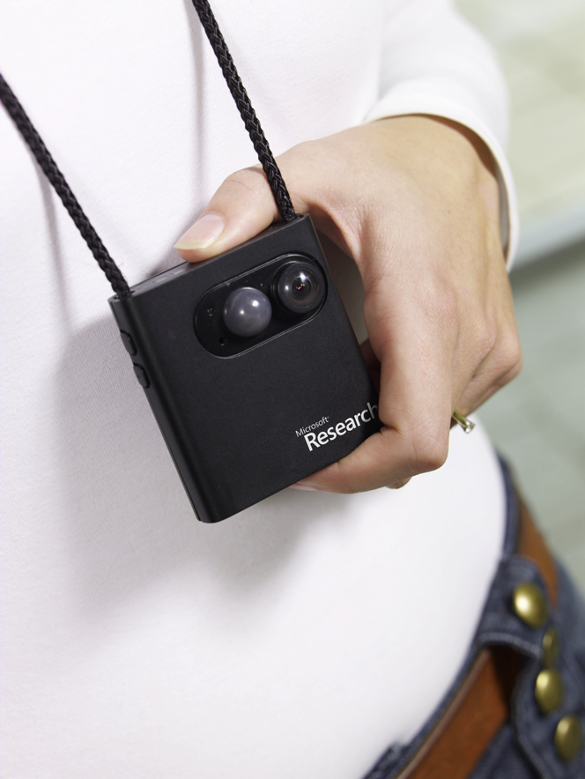
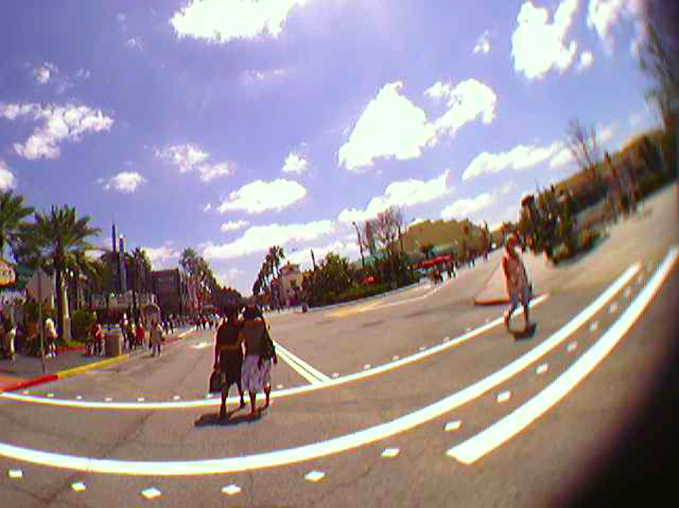
SenseCam

Slide 32
Design implications
Don’t overload users’ memories with complicated procedures for carrying out tasks
Design interfaces that promote recognition rather than recall
Provide users with various ways of encoding information to help them remember
  e.g. categories, color, flagging, time stamping
Notes:
32

Slide 33
Learning
How to learn to use a computer-based application
Using a computer-based application to understand a given topic
People find it hard to learn by following instructions in a manual
    prefer to learn by doing

Slide 34
Design implications
Speech-based menus and instructions should be short
Accentuate the intonation of artificially generated speech voices
  they are harder to understand than human voices
Provide opportunities for making text large on a screen

Slide 35
Reading, speaking, and listening
The ease with which people can read, listen, or speak differs
  Many prefer listening to reading
  Reading can be quicker than speaking or listening
  Listening requires less cognitive effort than reading or speaking
  Dyslexics have difficulties understanding and recognizing written words

Slide 36
Applications
Speech-recognition systems allow users to interact with them by using spoken commands
  e.g. Google Voice Search app
Speech-output systems use artificially generated speech
e.g. written-text-to-speech systems for the blind
Natural-language systems enable users to type in questions and give text-based responses
  e.g. Ask search engine

Slide 37
Design implications
Design interfaces that encourage exploration
Design interfaces that constrain and guide learners
Dynamically linking concepts and representations can facilitate the learning of complex material

Slide 38
Problem-solving, planning, reasoning and decision-making
All involves reflective cognition
  e.g. thinking about what to do, what the options are, and the consequences
Often involves conscious processes, discussion with others (or oneself), and the use of artifacts
  e.g. maps, books, pen and paper
May involve working through different scenarios and deciding which is best option

Slide 39
Design implications
Provide additional information/functions for users who wish to understand more about how to carry out an activity more effectively
Use simple computational aids to support rapid decision-making and planning for users on the move

Slide 40
Mental models
Users develop an understanding of a system through learning about and using it
Knowledge is sometimes described as a mental model:
  How to use the system (what to do next)
  What to do with unfamiliar systems or unexpected situations (how the system works)
People make inferences using mental models of how to carry out tasks
Notes:
40

Slide 41
Mental models
Craik (1943) described mental models as:
  internal constructions of some aspect of the external world enabling predictions to be made
Involves unconscious and conscious processes
  images and analogies are activated
Deep versus shallow models
  e.g. how to drive a car and how it works
Notes:
41

Slide 42
Everyday reasoning and mental models
You arrive home on a cold winter’s night to a cold house. How do you get the house to warm up as quickly as possible? Set the thermostat to be at its highest or to the desired temperature?
(b) You arrive home starving hungry. You look in the fridge and find all that is left is an uncooked pizza. You have an electric oven. Do you warm it up to 375 degrees first and then put it in (as specified by the instructions) or turn the oven up higher to try to warm it up quicker?
Notes:
42

Slide 43
Heating up a room or oven that is thermostat-controlled
Many people have erroneous mental models (Kempton, 1996)
Why?
  General valve theory, where ‘more is more’ principle is generalised to different settings (e.g. gas pedal, gas cooker, tap, radio volume)
  Thermostats based on model of on-off switch model
Notes:
43

Slide 44
Heating up a room or oven that is thermostat-controlled
Same is often true for understanding how interactive devices and computers work:
  poor, often incomplete, easily confusable, based on inappropriate analogies and superstition (Norman, 1983)
  e.g. elevators and pedestrian crossings - lot of people hit the button at least twice
  Why? Think it will make the lights change faster or ensure the elevator arrives!
Notes:
44

Slide 45
Exercise: ATMs
Write down how an ATM works
  How much money are you allowed to take out?
  What denominations?
  If you went to another machine and tried the same what would happen?
  What information is on the strip on your card? How is this used?
  What happens if you enter the wrong number?
  Why are there pauses between the steps of a transaction? What happens if you try to type during them?
  Why does the card stay inside the machine?
  Do you count the money? Why?
Notes:
45

Slide 46
How did you fare?
Your mental model
  How accurate?
  How similar?
  How shallow?
Payne (1991) did a similar study and found that people frequently resort to analogies to explain how they work
People’s accounts greatly varied and were often ad hoc
Notes:
46

Slide 47
Gulfs of execution and evaluation
Norman, 1986; Hutchins et al, 1986
The ‘gulfs’ explicate the gaps that exist between the user and the interface
The gulf of execution
  the distance from the user to the physical system
The gulf of evaluation
  the distance from the physical system to the user
Bridging the gulfs can reduce cognitive effort required to perform tasks
Notes:
47

Slide 48
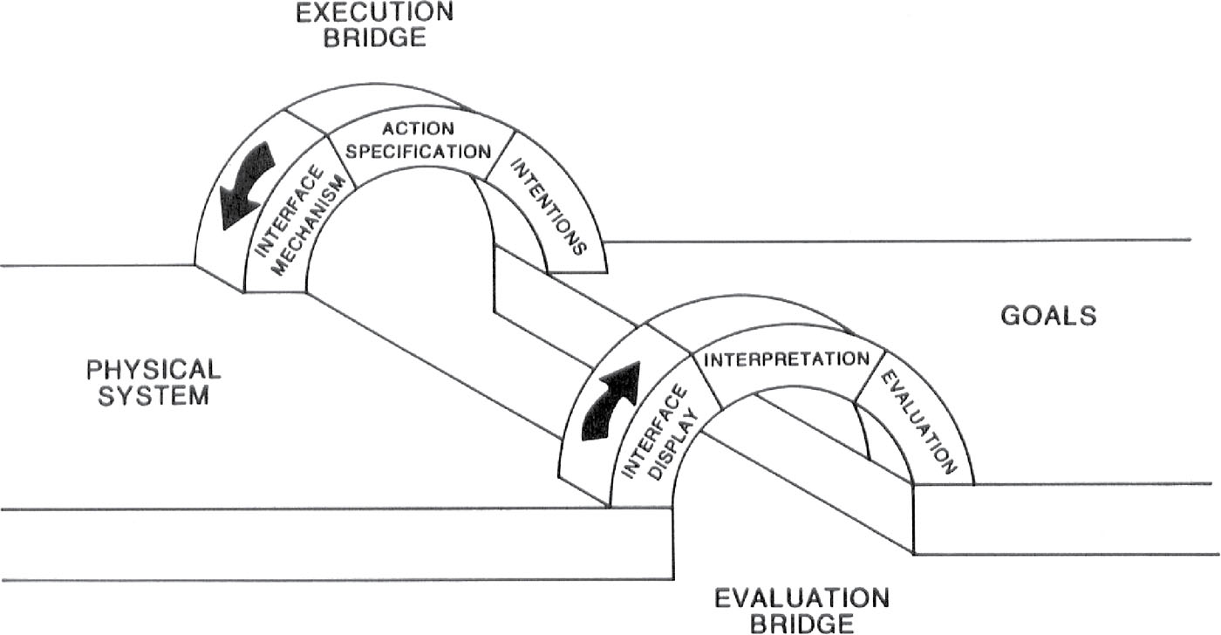
Bridging the gulfs
Notes:
Figure 3.8

Slide 49
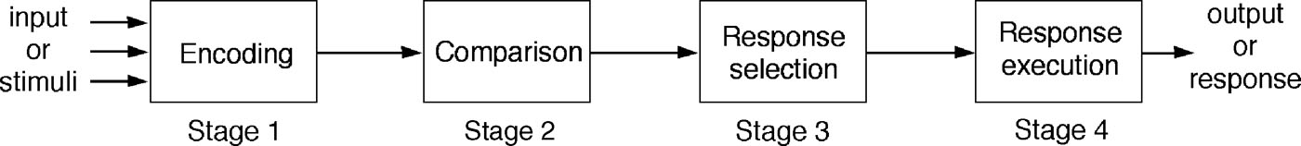
Information processing
Conceptualizes human performance in metaphorical terms of information processing stages
Notes:
49
A number of comparisons have been made, including conceptualizing the mind as a reservoir, a telephone network, and a digital computer. One prevalent metaphor from cognitive psychology is the idea that the mind is an information processor. Information is thought to enter and exit the mind through a series of ordered processing stages. Within these stages, various processes are assumed to act upon mental representations. Processes include comparing and matching. Mental representations are assumed to comprise images, mental models, rules, and other forms of knowledge.

Slide 50
Model Human processor (Card et al, 1983)
Models the information processes of a user interacting with a computer
Predicts which cognitive processes are involved when a user interacts with a computer
Enables calculations to be made of how long a user will take to carry out a task
Notes:
50

Slide 51
The human processor model
Notes:
51

Slide 52
Limitations
based on modeling mental activities that happen exclusively inside the head
do not adequately account for how people interact with computers and other devices in real world

Slide 53
External cognition
Concerned with explaining how we interact with external representations (e.g. maps, notes, diagrams)
What are the cognitive benefits and what processes involved
How they extend our cognition
What computer-based representations can we develop to help even more?
Notes:
53

Slide 54
Externalizing to reduce memory load
Diaries, reminders, calendars, notes, shopping lists, to-do lists
  written to remind us of what to do
Post-its, piles, marked emails
  where placed indicates priority of what to do
External representations:
  Remind us that we need to do something (e.g. to buy something for mother’s day)
  Remind us of what to do (e.g. buy a card)
  Remind us when to do something (e.g. send a card by a certain date)
Notes:
54

Slide 55
Computational offloading
When a tool is used in conjunction with an external representation to carry out a computation (e.g. pen and paper)
Try doing the two sums below (a) in your head, (b) on a piece of paper and c) with a calculator.
  234 x 456 =??
  CCXXXIIII x CCCCXXXXXVI = ???
Which is easiest and why? Both are identical sums
Notes:
55

Slide 56
Annotation and cognitive tracing
Annotation involves modifying existing representations through making marks
  e.g. crossing off, ticking, underlining
Cognitive tracing involves externally manipulating items into different orders or structures
  e.g. playing Scrabble, playing cards
Notes:
56

Slide 57
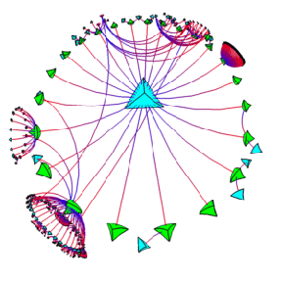
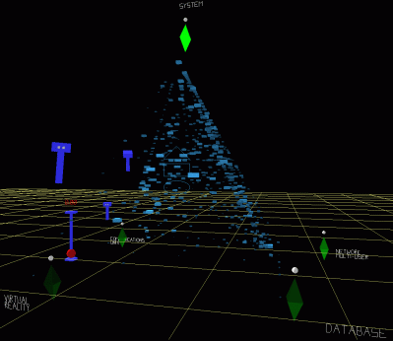
Design implication
Provide external representations at the interface that reduce memory load and facilitate computational offloading
e.g. Information visualizations have been designed to allow people to make sense and rapid decisions about masses of data
Notes:
57

Slide 58
Distributed cognition
Concerned with the nature of cognitive phenomena across individuals, artifacts, and internal and external representations (Hutchins, 1995)
Describes these in terms of propagation across representational state
Information is transformed through different media (computers, displays, paper, heads)
Notes:
58

Slide 59
How it differs from information processing
Notes:
59

Slide 60
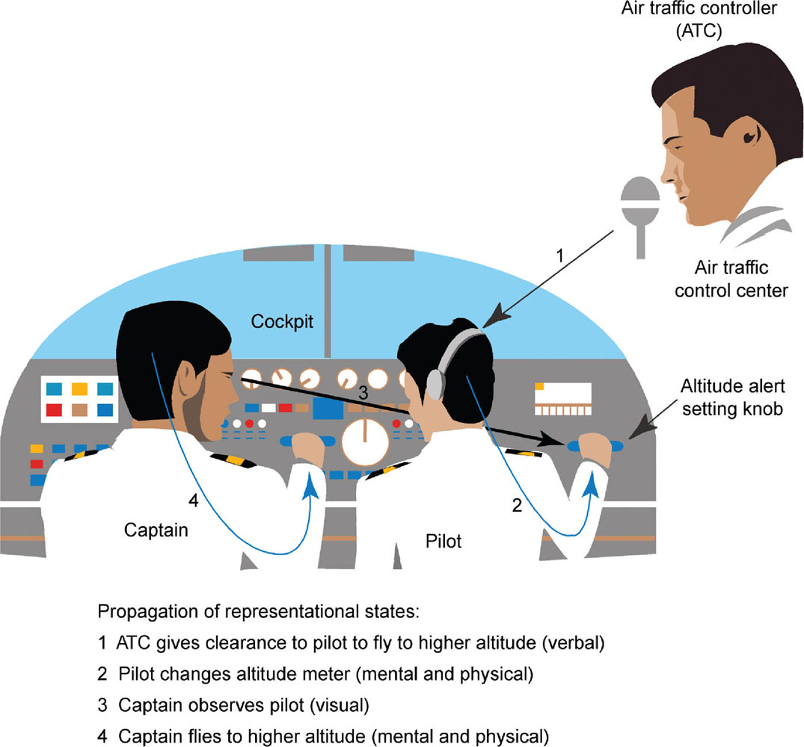

Slide 61
What’s involved
The distributed problem-solving that takes place
The role of verbal and non-verbal behavior
The various coordinating mechanisms that are used (e.g. rules, procedures)
The communication that takes place as the collaborative activity progresses
How knowledge is shared and accessed
Notes:
61

Slide 62
Summary
Cognition involves several processes including attention, memory, perception and learning
The way an interface is designed can greatly affect how well users can perceive, attend, learn and remember how to do their tasks
Theoretical frameworks, such as mental models and external cognition, provide ways of understanding how and why people interact with products
This can lead to thinking about how to design better products
Notes:
62

