Slide 1
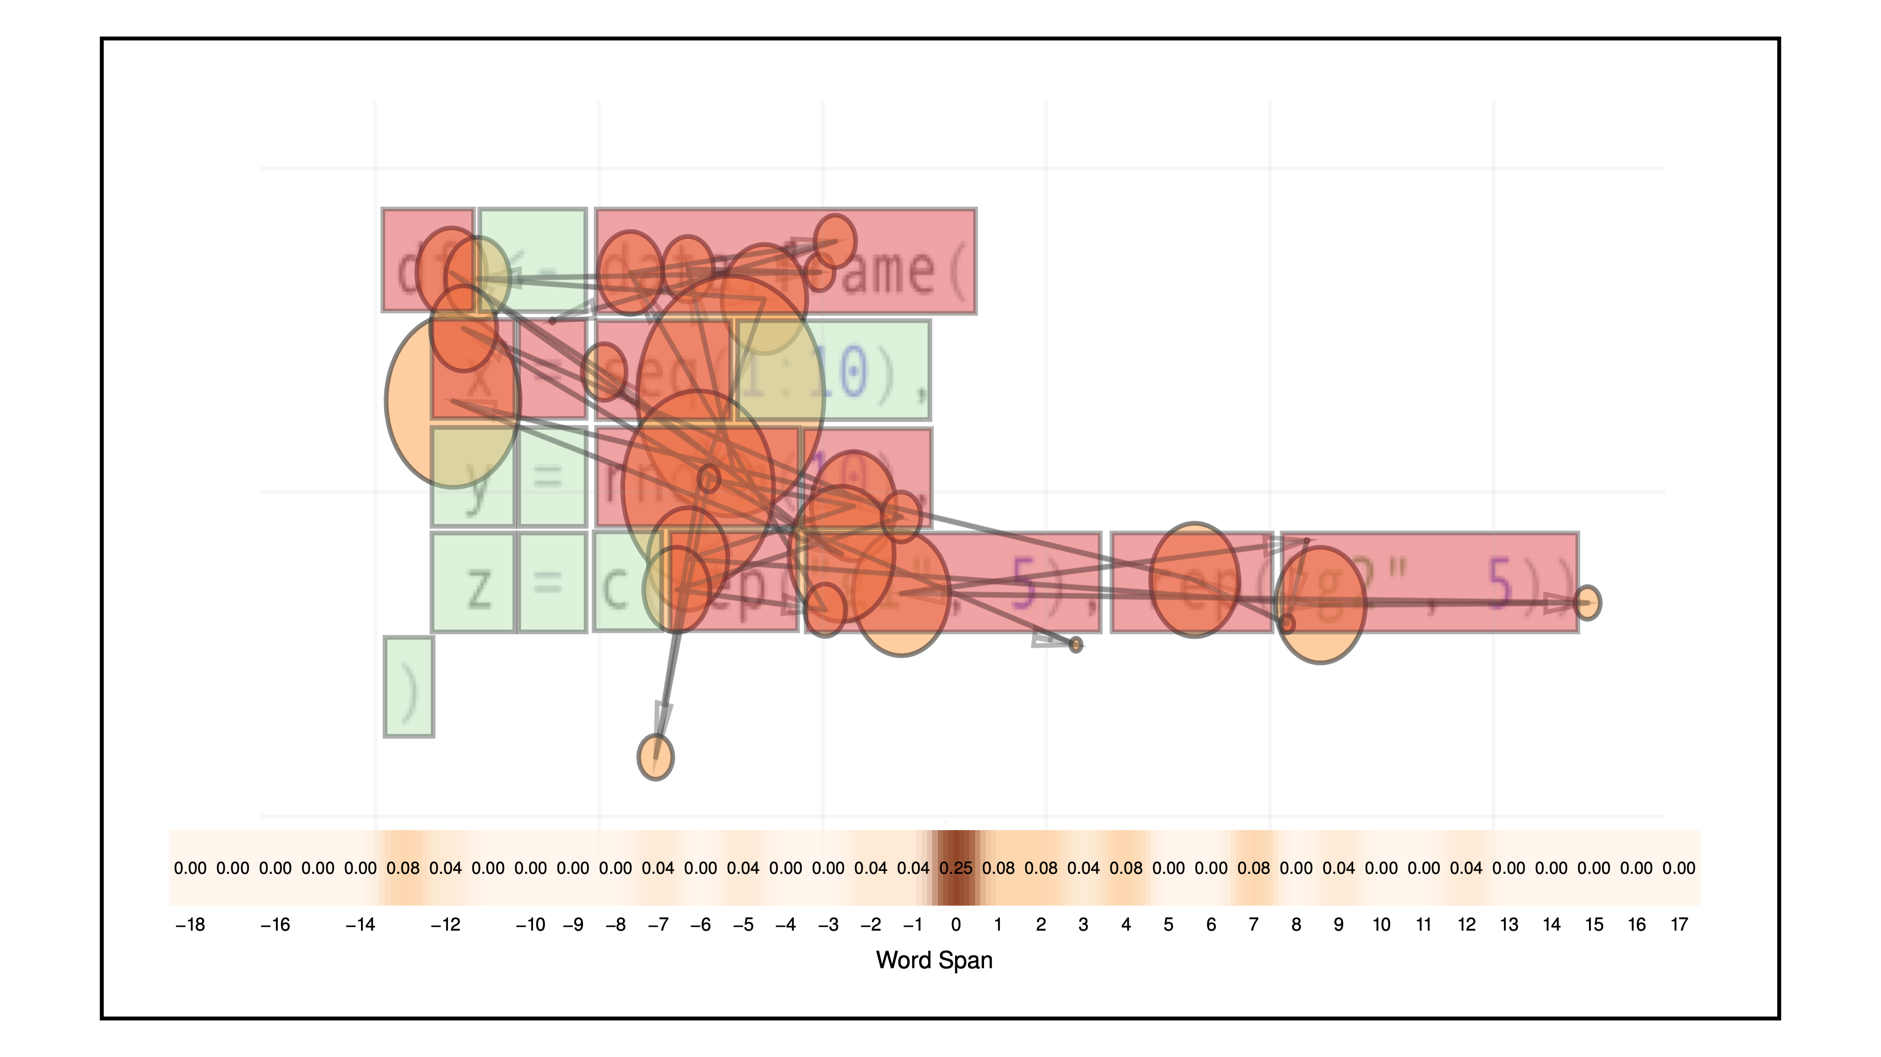
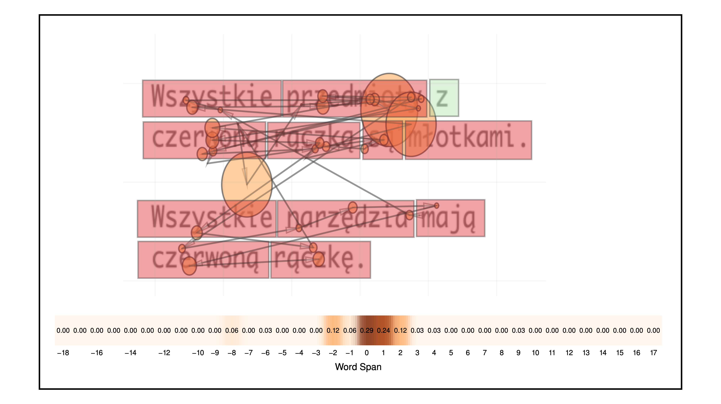
Entropy of Eye Movements While Reading Code or Text
Krzysztof Krejtz, Katarzyna Wisiecka, Izabela Krejtz
SWPS University of Social Sciences and Humanities
Warsaw, Poland
Andrew T. Duchowski
Clemson University
Clemson, SC, USA

Slide 2
Acknowledgements
Funding
National Science Foundation (grant IIS-1748380)
Polish National Science Center, PRELUDIUM 11 grant (2016/21/N/HS6/02845)
Donations
NVidia Corp

Slide 3
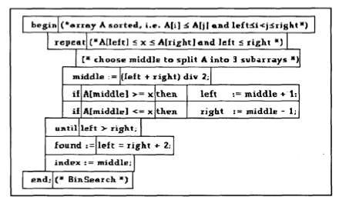
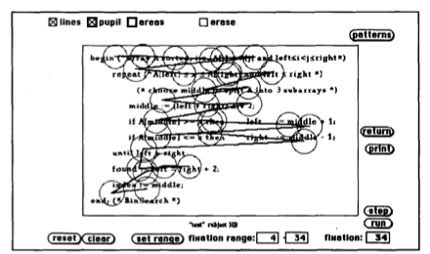
Introduction
Eye Movements in Programming
Dates back at least to Crosby and Stelovsky [1990]
used Pascal and English description of binary search algorithm
found visual scanning differences in code- vs. comment-oriented participants
compared expert/novice programmers (former looked more at complex statements)

Slide 4
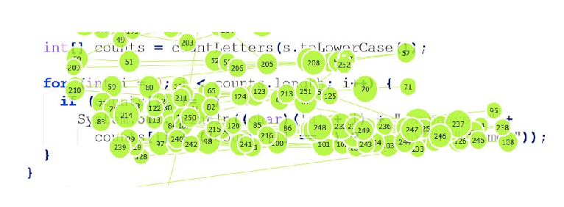
Introduction
Eye Movements in Programming
More recently Sharafi et al. [2015] review various metrics
traditional metrics include fixations, fixation durations, pupil size, blink rate
scanpath comparison including Levenshtein distance also available
collectively, except for Levenshtein similarity, these are first-order analyses

Slide 5
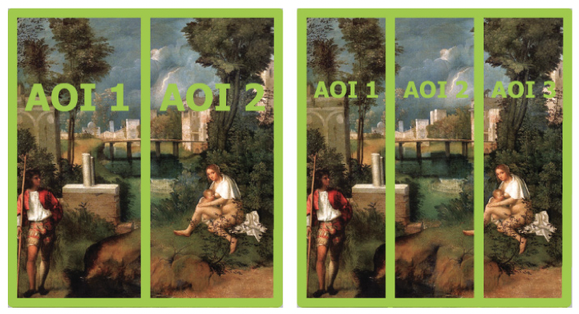
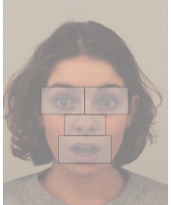
Background
Gaze-transition Entropy
Gaze-transition entropy [Krejtz et al. 2015]
typically used to represent 2D gaze transitions between source and destination AOIs
uniform grids or other sensibly defined AOIs suffice
gaze transition probabilities yield transition matrices from which entropy is computed

Slide 6
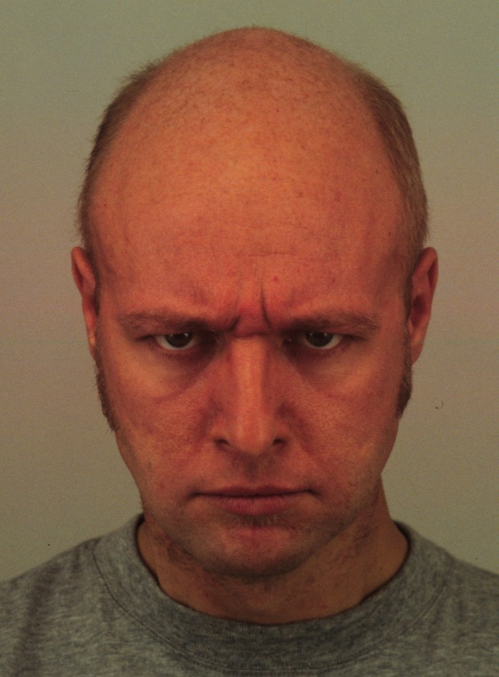
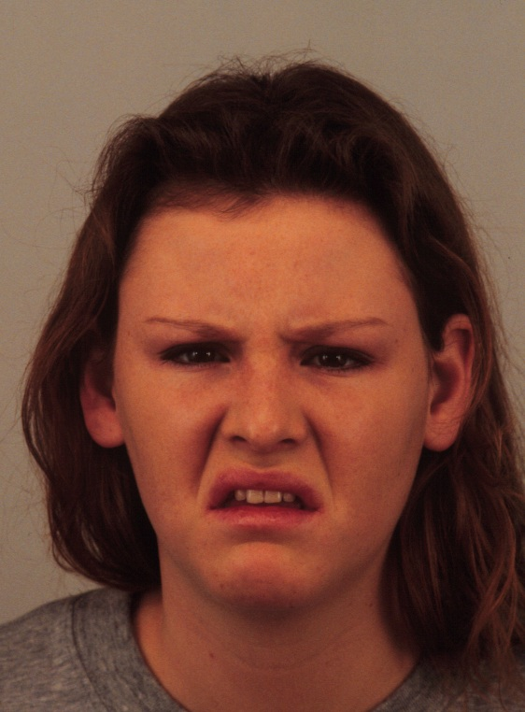
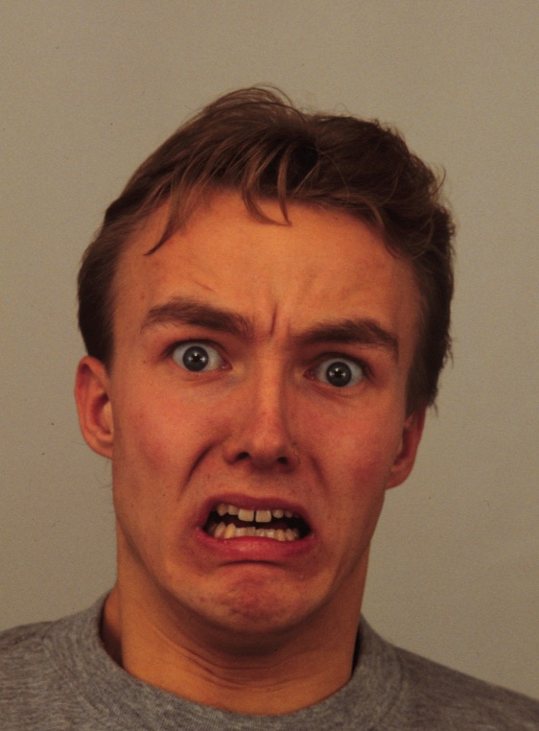
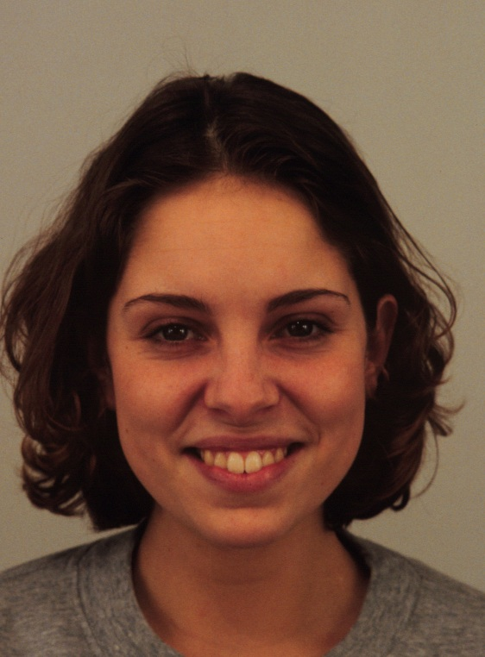
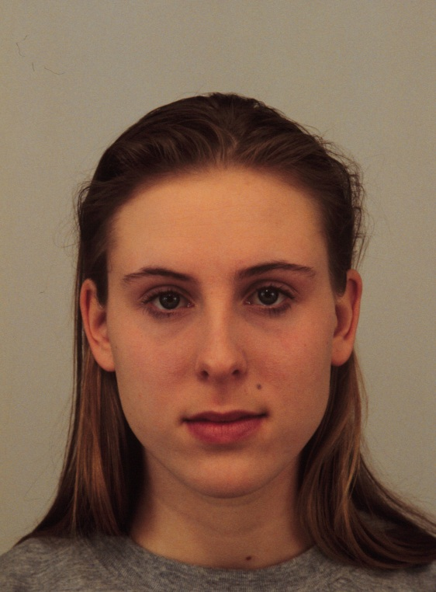
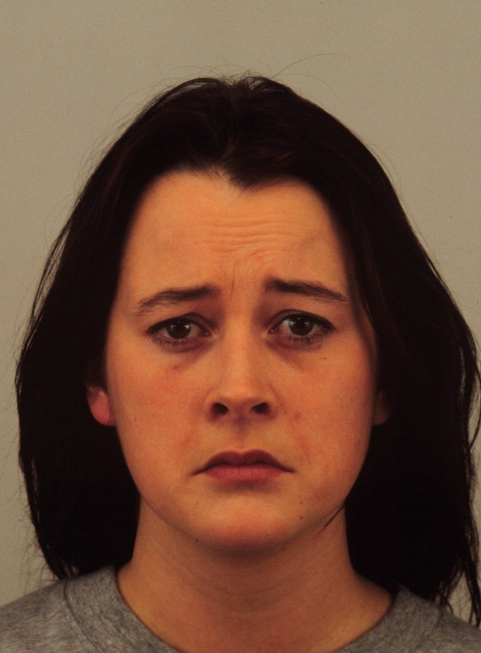
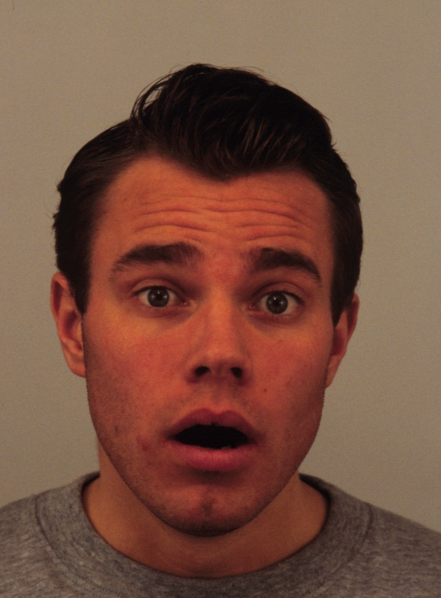
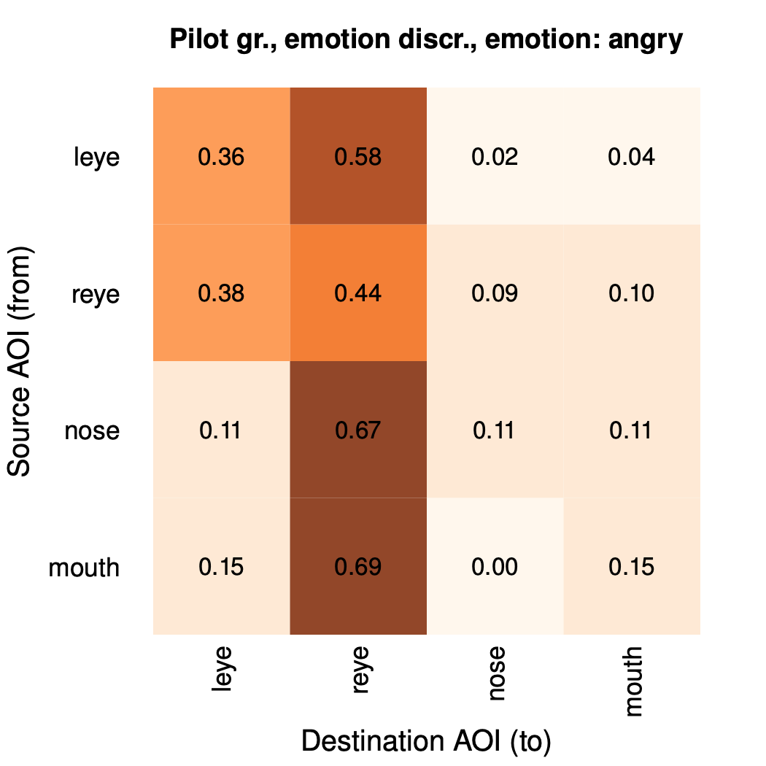
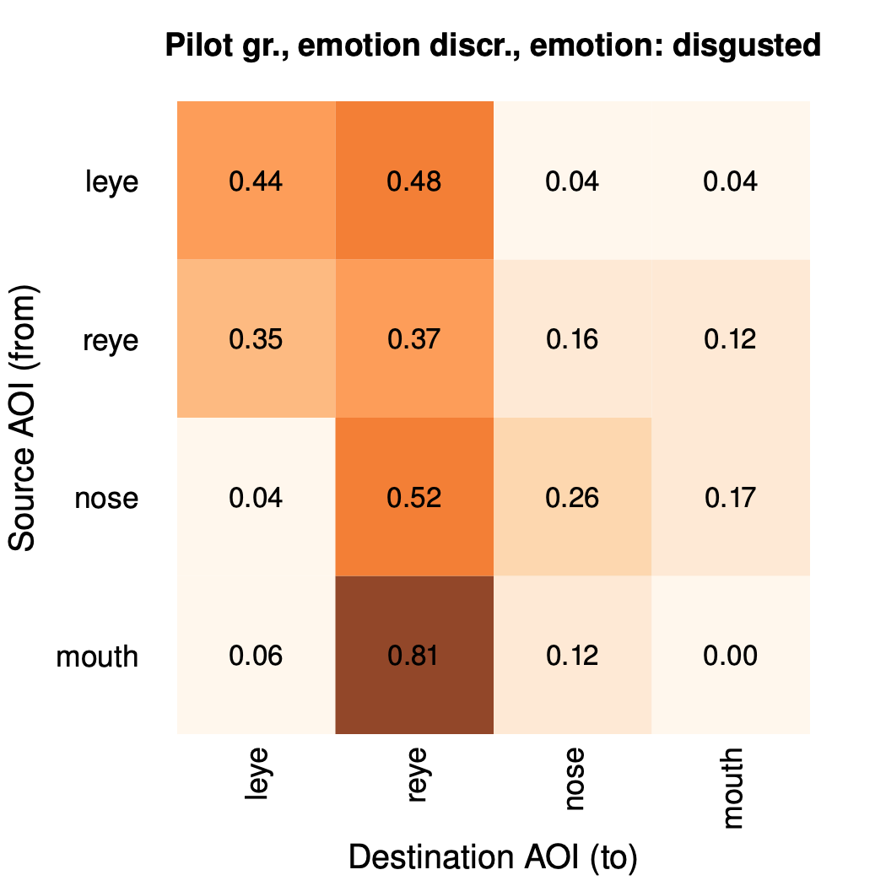
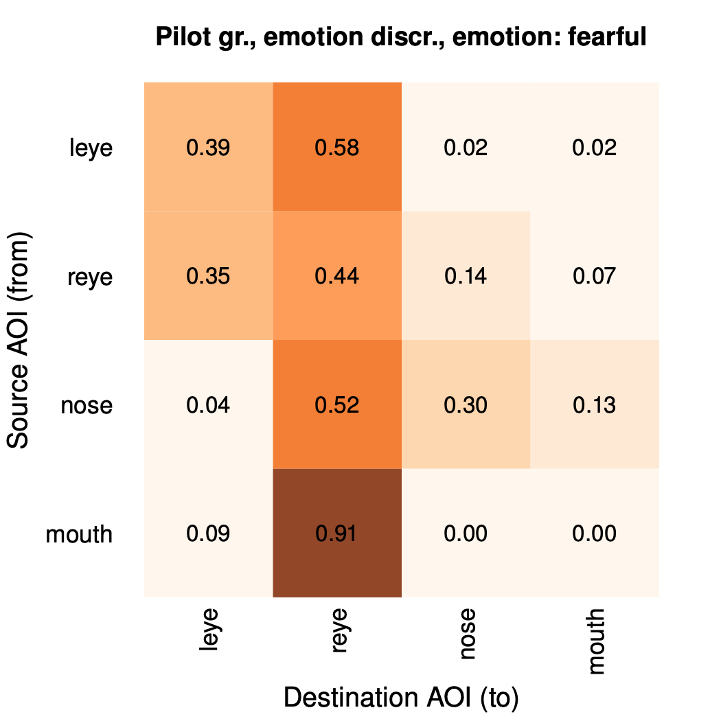
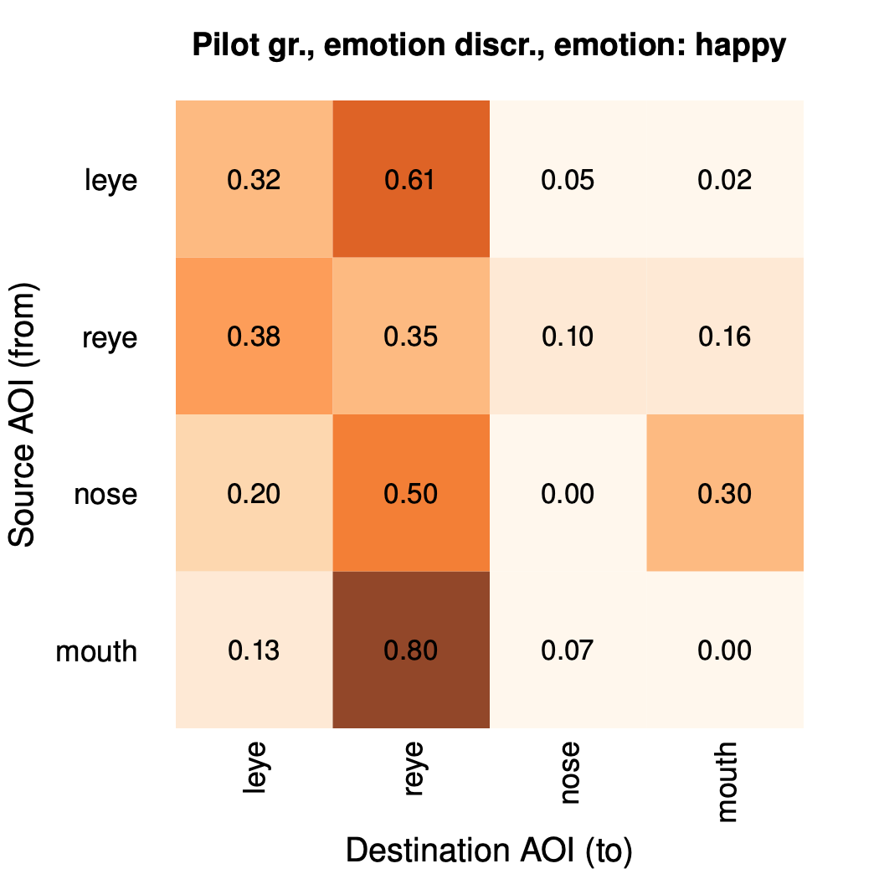
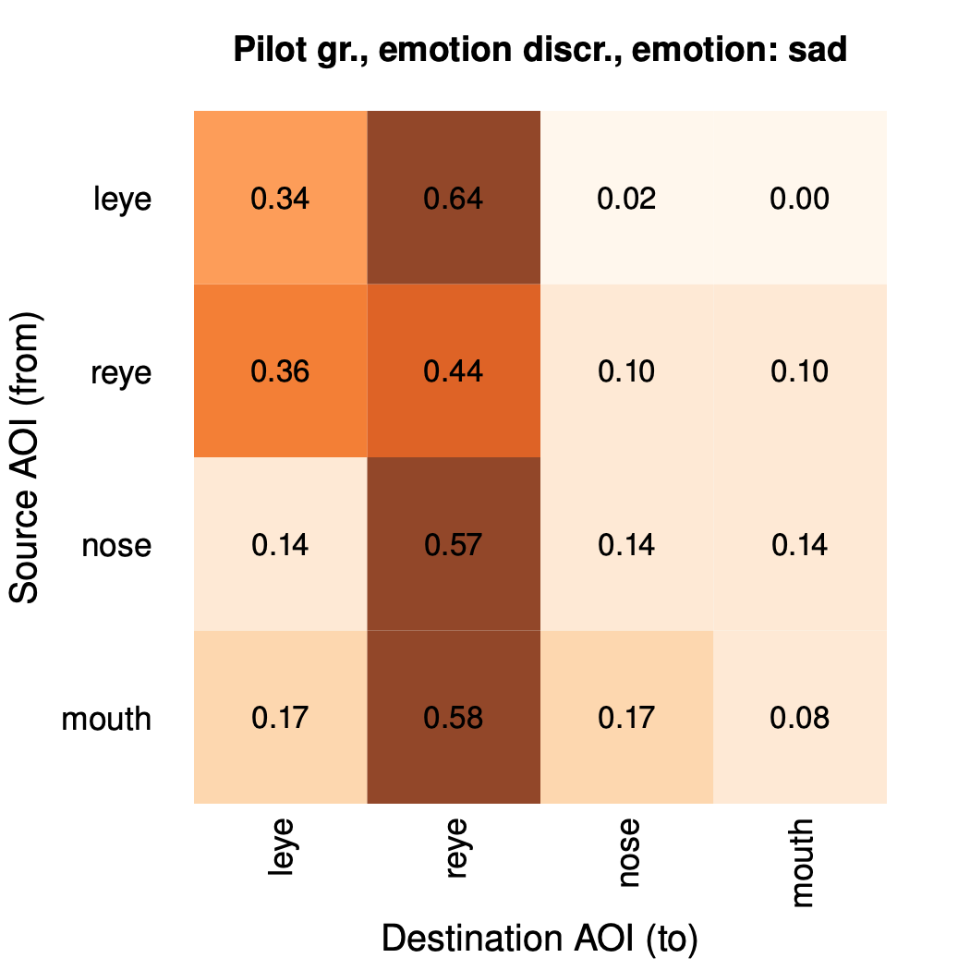
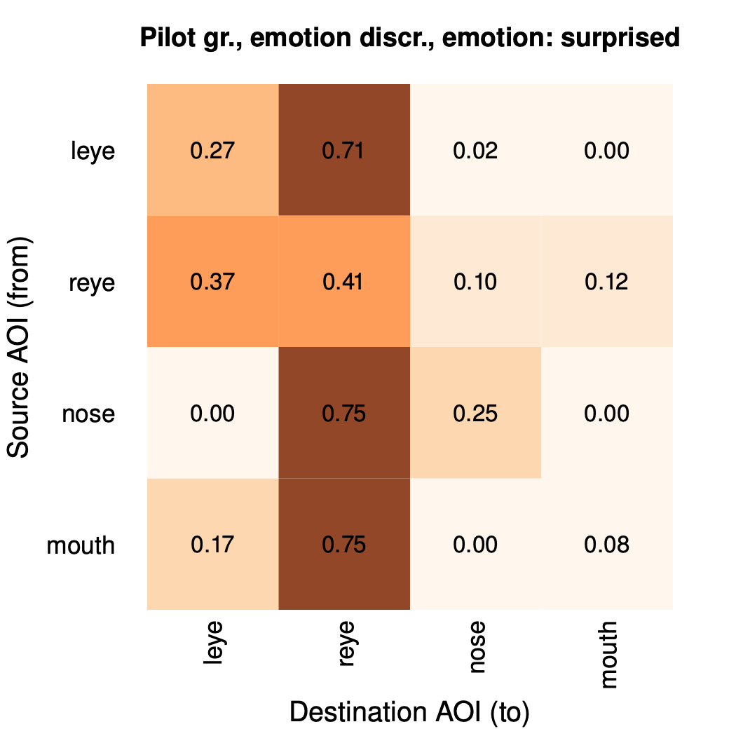
Background
Gaze-transition Entropy
angry
disgusted
fearful
happy
neutral
sad
surprised
Gaze-transition entropy
transition matrices are intuitively easy to understand
they are also useful for gaze synthesis [Duchowski et al. 2019]
defines normalized entropy for set of AOIs

Slide 7
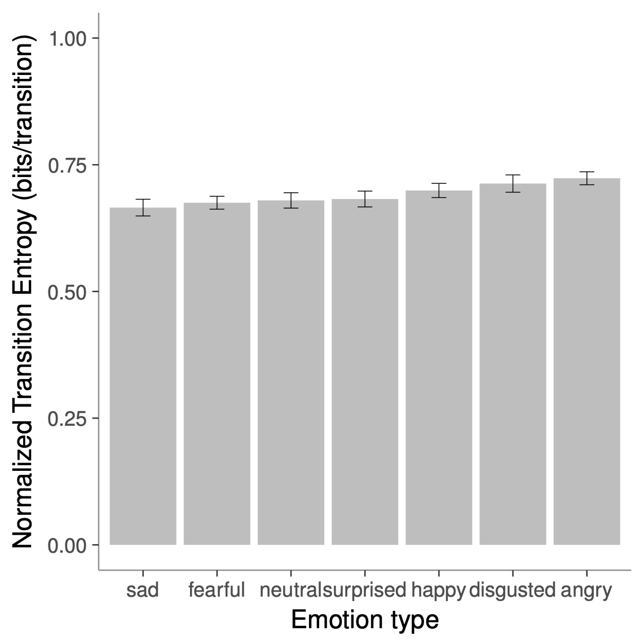
Background
Gaze-transition Entropy
Gaze-transition entropy
entropy allows comparison of transition matrices
e.g., Duchowski et al. [2019] showed sig. different scanning faces (F(4,97) = 2.83, p < 0.05)
lower entropy means lower variance (“surprise”), less “chaotic” scanning

Slide 8
Background
Second-order Metrics
We introduce word span entropy based on Rayner’s [1998] model
reading consists of re-fixations, skips forward, or regressions backwards
most reading models are expressed in similar terms of span distribution [Thibadeau et al. 1982]
reading models can include lexical analysis (e.g., SWIFT or EZ-READER)

Slide 9
Background
Second-order Metrics
reading code
reading text
Word span entropy
codifies re-fixations, skips, or regressions numerically as probability of jumping words
regressions, re-fixations, skips
observed probability, is used to compute entropy

Slide 10
Method
Experimental Design, Stimuli & AOI definitions
Code (R language for statistical analysis) reading task exemplary stimuli with AOIs
Text (logical proposition) reading task exemplary stimuli with AOIs
mixed experimental design with within-subjects reading task (code vs. text) and between-subjects prior experience with R (yes vs. no)
Experimental sample N = 22 (17 F) social science students
Reading tasks (code vs text syllogism) assumed logical reasoning processes involved

Slide 11
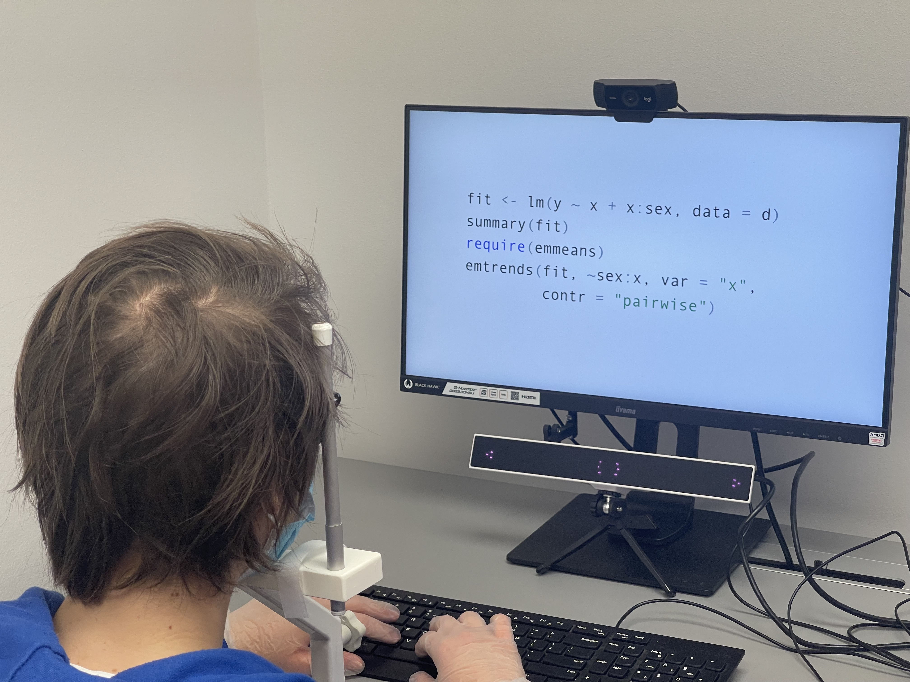
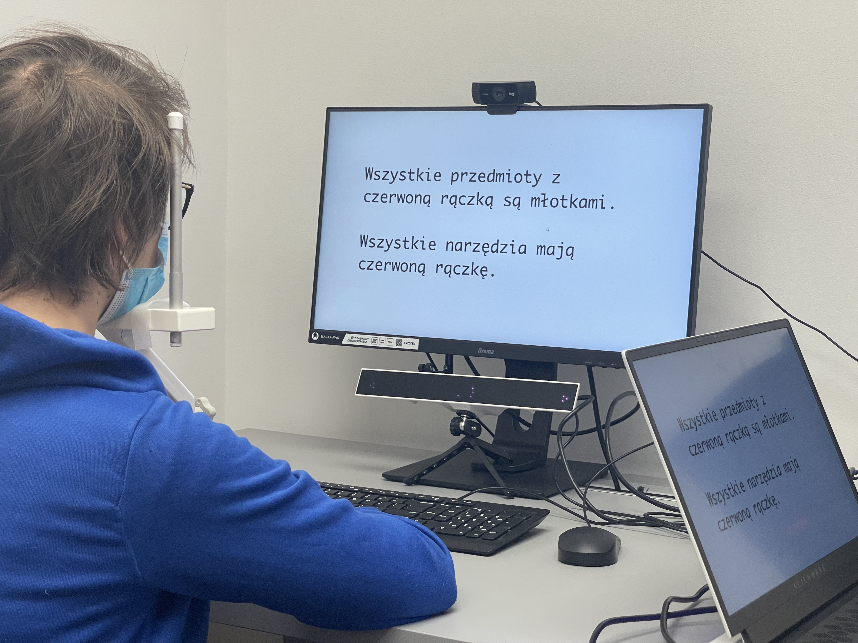
Methodology
Apparatus
Table-mounted eye tracker (Gazepoint HD)
150 Hz sampling rate, screen
procedure implemented in PsychoPy
fixation target, reading task, questionnaire

Slide 12
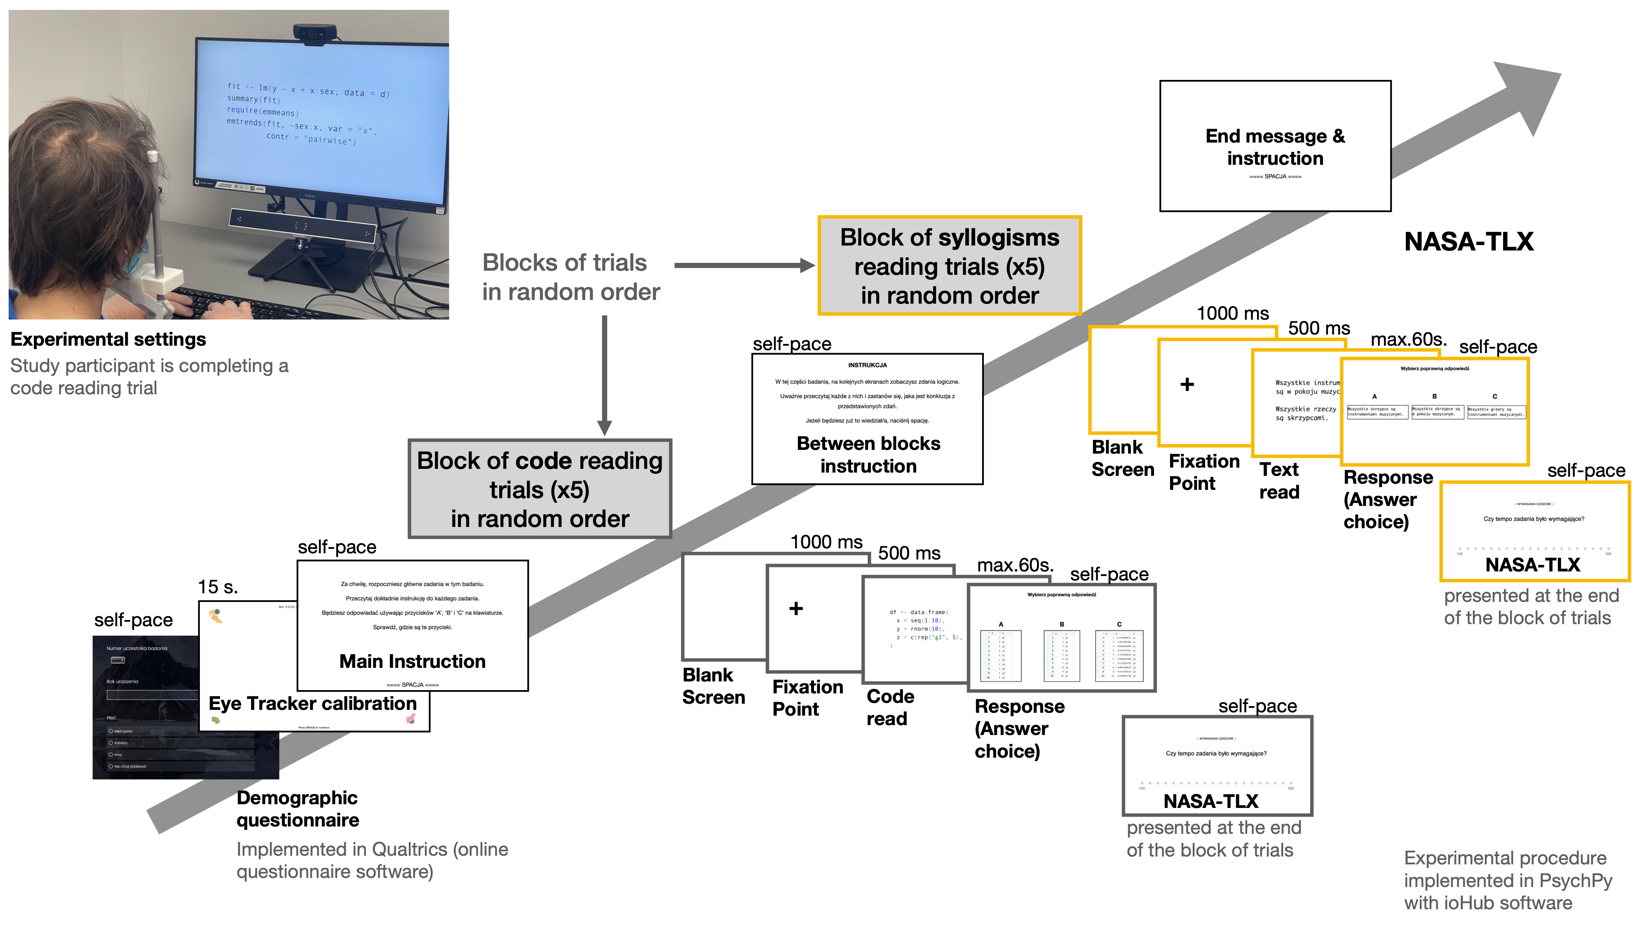
Method
Procedure and experimental settings
Table-mounted Gazepoint HD eye tracker (150 Hz),
1980 x 1080 screen

Slide 13
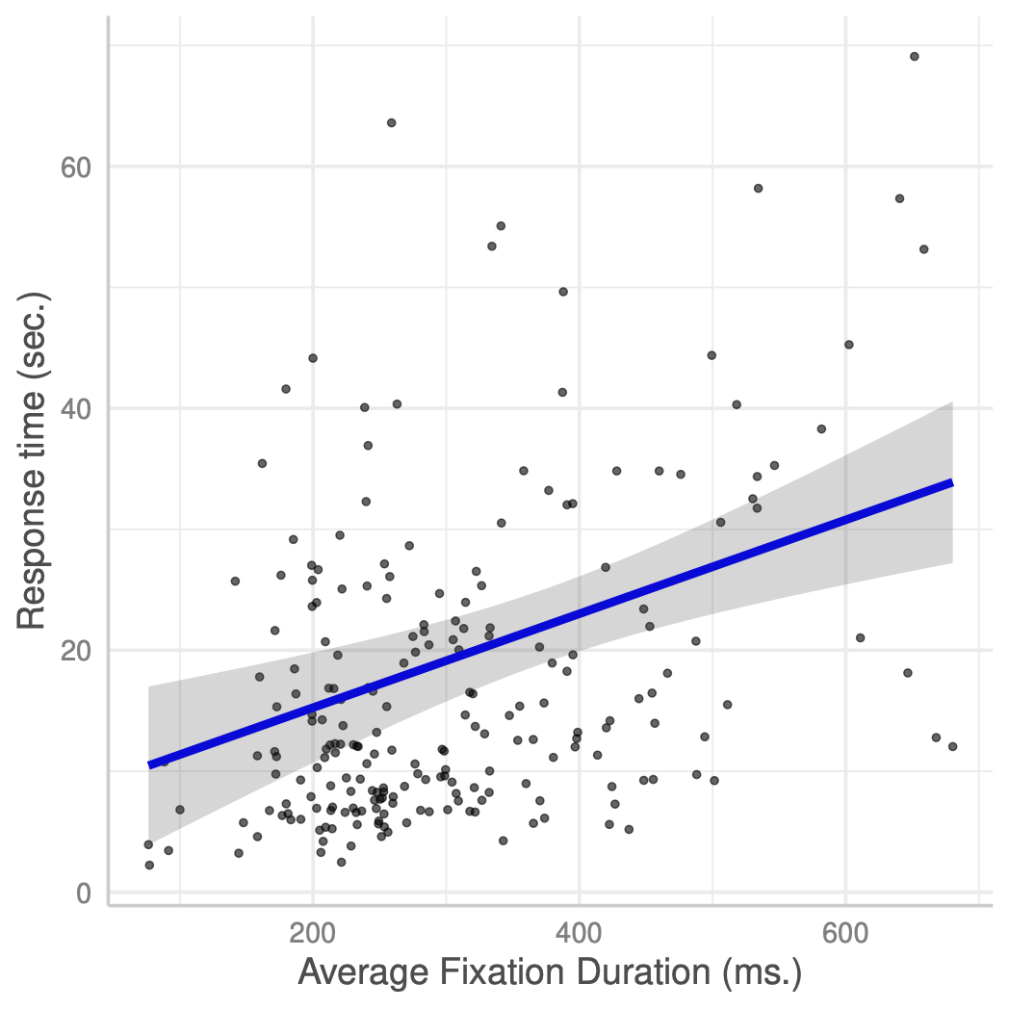
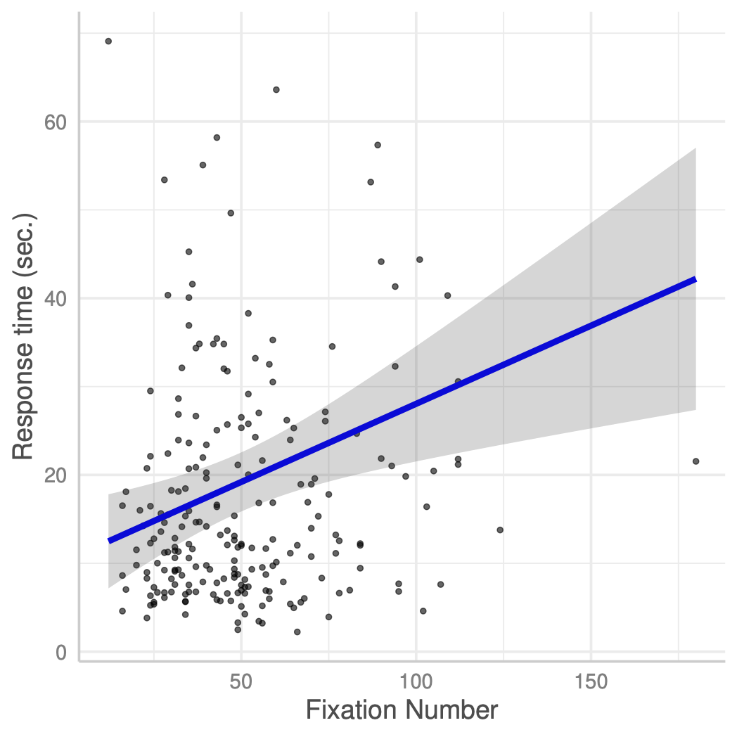
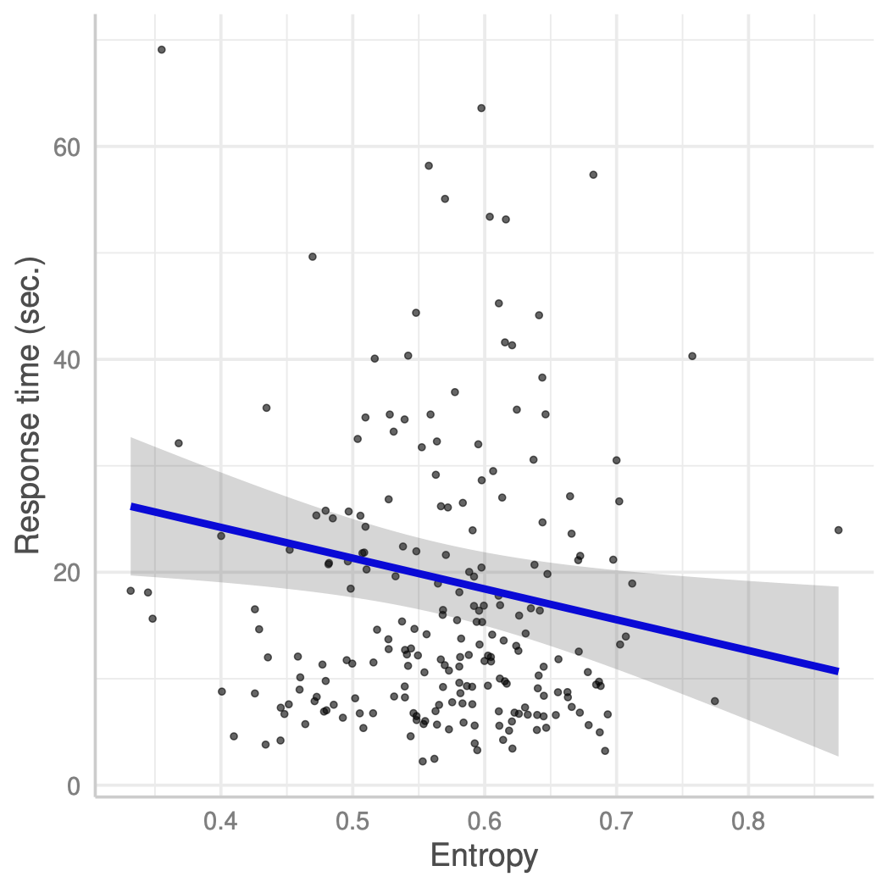
Results
Response accuracy & time (main effects)
Response accuracy:
significantly higher in text reading than in code reading
Response time:
significantly lower when the response was accurate than hen it was not.
Increase in average fixation duration and number of fixations predicts longer response time.
Entropy is inversely related to response time (greater entropy reduces response time).

Slide 14
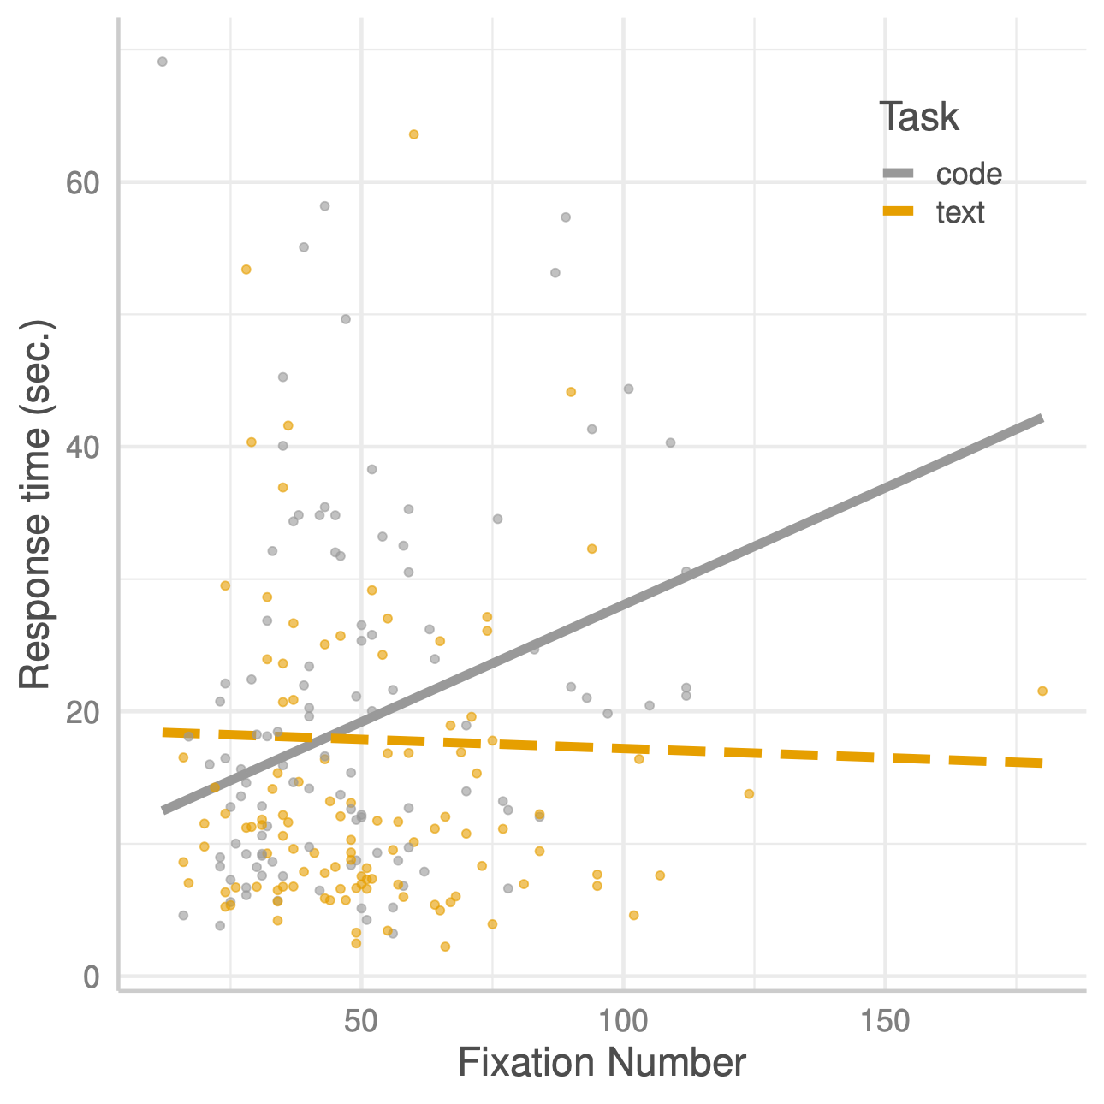
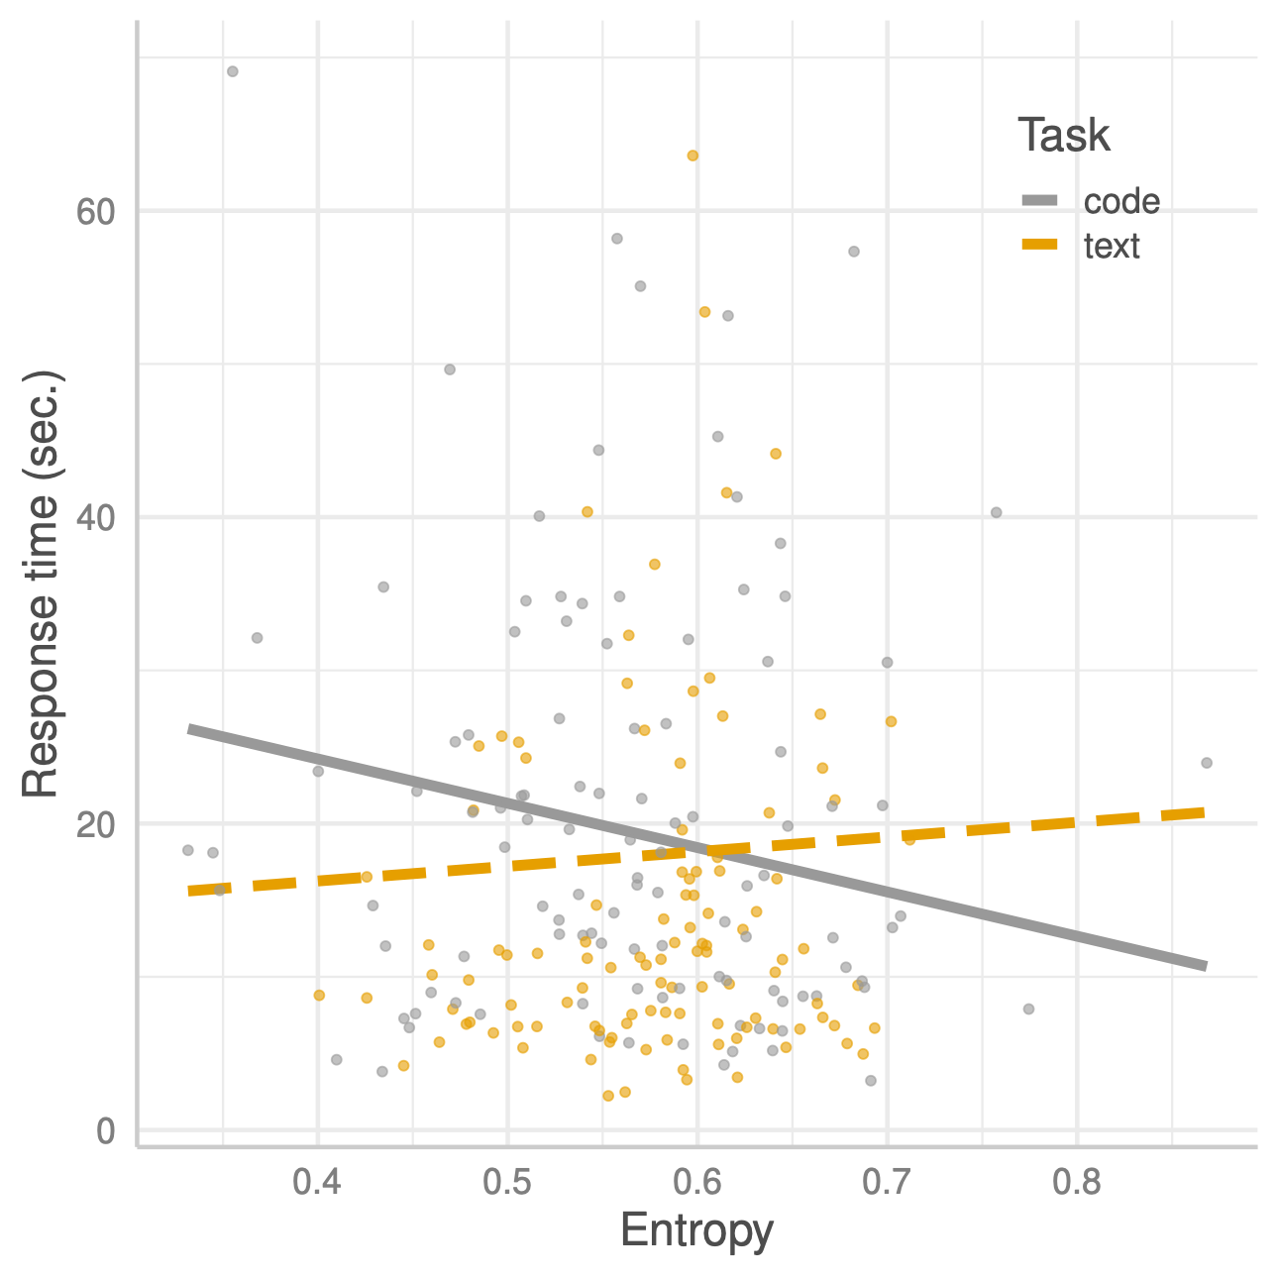
Results
Predicting response time in text and code reading tasks
Increase in fixations predicts longer code reading (but not text)
Decrease in entropy predicts shorter code reading
Increase entropy reduces response time but only for code reading

Slide 15
Discussion & Conclusions
Interaction between task, gaze, and entropy
increase in fixations predicts longer code reading (but not text)
decrease in entropy predicts shorter code reading (but not text)
greater entropy reduces response time but only for code reading, not text

Slide 16
Discussion & Conclusions
Implications of word span entropy for code reading
greater word span entropy can possibly lead to better comprehension of code
greater gaze switching strategy seems applicable to reading code, which differs from text
gaze switching over code could give reader better sense of structure (of the code)
Word span entropy
promising measure of the reading process
second-order metric that is easy to implement
future studies should consider differences between experts and novices

Slide 17
Entropy of Eye Movements While Reading Code or Text
Krzysztof Krejtz, Katarzyna Wisiecka, Izabela Krejtz
SWPS University of Social Sciences and Humanities
Warsaw, Poland
Andrew T. Duchowski
Clemson University
Clemson, SC, USA

